Slide 1
30th Annual Meeting AsCE (virtual conference) January 4-6, 2021
The Economic Impact of Trump’s Measures against Cuba
Dr. Paolo Spadoni
Augusta University
pspadoni@augusta.edu

Slide 2
Introduction
Trump in June 2017
Said Obama had negotiated “terrible and misguided deal” with Cuba
"Effective immediately, I am canceling the last administration’s completely one-sided deal with Cuba."
Promised to enforce tourism ban and embargo, help Cuban private sector, restrict dollars to Cuban military (first changes in Nov 2017)
Structure of the presentation
Brief review of Obama’s measures and their effects
Trump’s measures on Cuba since November 2017
Economic impact of Trump’s measures
Additional factors impacting Cuban economy
Concluding observations

Slide 3
Obama’s Measures on Cuba
Issued six sets of amendments to sanctions rules after 17D
Key changes
Independent travel to Cuba under general license (12 categories, no tourism)
Direct commercial flights, cruises, ferry services
No limits on remittances
US telecom firms can have JVs in Cuba
Trade with Cuban private sector (cuentapropistas and coops)
US financial institutions can open correspondent accounts at Cuban banks, process U-turn transactions linked to Cuba
Cash in advance (agricultural exports) from cash before shipment to cash before transfer of title
Modification of 180-day ship rule

Slide 4
Economic effects of Obama’s Measures
Travel and tourism industry
Significant, over 600,000 U.S. visitors (non-Cuban) to Cuba in 2017
Resumption of cruise trips in May 2016
Higher revenues for Cuban government and private entrepreneurs
Investment
Cuba more appealing investment market
Several U.S. business deals with Cuba (esp. travel/tourism, telecom)
Yet initial wave of enthusiasm gave way to more cautious approach
Other areas
Remittances up, especially to set up small private businesses
Cuba’s external debt eased, new credit lines, but still liquidity problems
Slow progress in trade

Slide 5
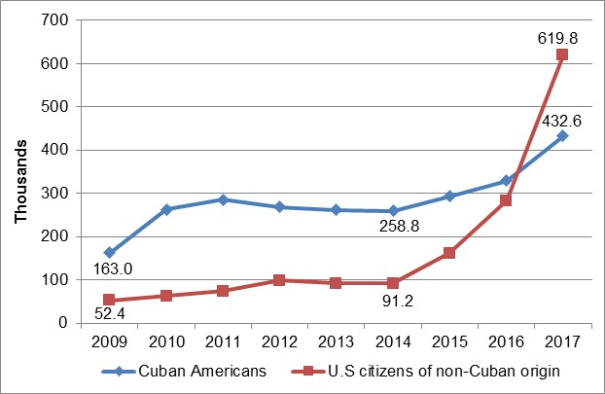
U.S. Visitors to Cuba, 2009-2017
Sources: Perelló Cabrera 2018; ONEI 2018.
Visits by U.S. citizens of non-Cuban origin grew almost seven-fold in 2014-2017
Cuban American visitors grew less because restrictions lifted in 2009
Over 1 million U.S. visitors to Cuba in 2017

Slide 6
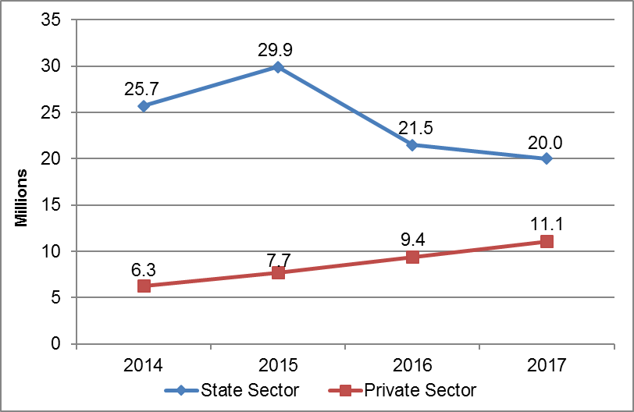
Visitor Days by Sector, 2014-2017
Source: MINTUR 2018.
Visitor days: combination of number of visitors and length of stay
Proportion state vs. private sector 4:1 in 2014, less than 2:1 in 2017
ONEI: revenues of private sector nearly doubled in 2014-2017

Slide 7
Trump’s Measures on Cuba
Issued eight sets of amendments to sanctions rules
Nov. 2017: people-to-people group travel, no business with GAESA firms
May 2019: activated Title III of Helms-Burton
June 2019: ended people-to-people travel, banned cruise ships to Cuba
Sept. 2019: limited family remittances ($1,000 per quarter), no U-turn trans.
Oct. 2019: revoked licenses for aircraft leases to Cuba, 10% de minimis for re-exports, suspended commercial flights to all Cuban cities except Havana
Jan 2020: suspended all U.S. to Cuba private charter flights except Havana
Aug 2020: suspended all U.S. to Cuba private charter flights
Sept 2020: banned U.S. citizens from staying at over 400 state-owned hotels in Cuba and from bringing back Cuban rum and cigars

Slide 8
Trump’s Measures on Cuba (cont.)
“List of Restricted [Cuban] Entities” (last update Jan 2021)
No “direct financial transactions” with hundreds of Cuban entities
Recent additions:
Fincimex + American International Services (remittances – Sept 2020)
Banco Financiero Internacional (BFI – Jan 2021)
Venezuela/Cuba
Sanctions on Venezuela’s petroleum industry and on tankers transporting Venezuelan oil to Cuba
Sanctions on foreign banks doing business with Cuba
Ordered Marriott to cease hotel activities in Cuba (June 2020)
Forced Western Union to end remittance services (Nov 2020)

Slide 9
Economic impact of Trump’s Measures
Travel and tourism industry
Major reduction of visitor flows to Cuba
Less revenues for Cuban government but especially for private sector
Investment (Helms-Burton law)
26 Title III lawsuits in first year – fewer than expected – with 76 companies named as defendants (50 U.S., 26 European firms)
H-B lawsuit against Carnival dismissed in July 2020
But some potential foreign investors in Cuba deterred (airport/railways upgrades, hotels construction, gold courses, others)
Other areas
Remittances probably down (esp. in 2020 also because of COVID-19)
Hindered Cuba’s ability to complete transactions with foreign banks ($12 billion total fines on numerous banks by March 2020), obtain external credit
Disrupted Venezuela’s oil supplies to Cuba (unreliable)

Slide 10
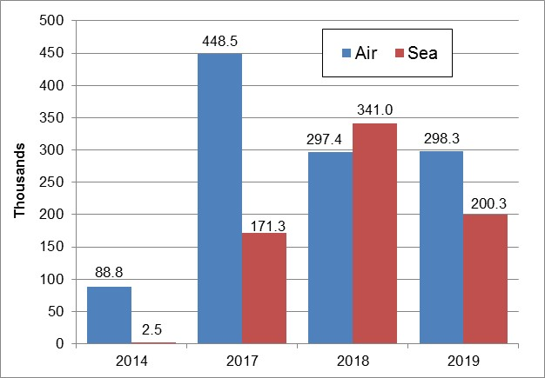
U.S. visitors by mode of transportation, 2014-2019 (excludes Cuban Americans)
Source: MINTUR 2020.
2017-2019: U.S. visitors -20% (air -33%) – full impact not seen at end of 2019
Cuban American visitors +28% during same period (about 553,000 in 2019)

Slide 11
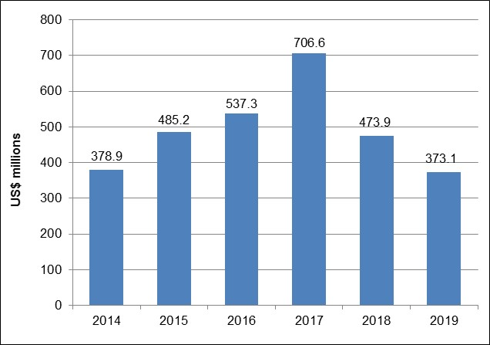
Tourism-Related Revenues of Cuba's Private Sector, 2014-2019
Source: ONEI 2020.
2017-2019: Cuba’s total tourism revenues –20%
Revenues of private sector –47% during same period

Slide 12
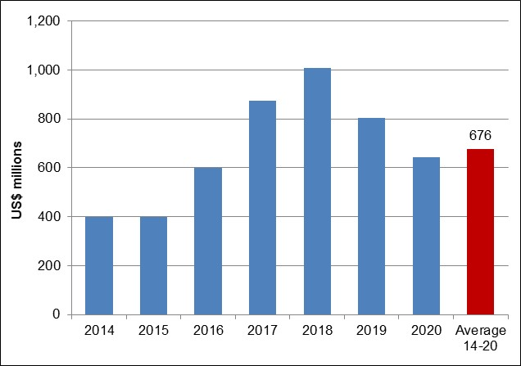
Foreign Direct Investment in Cuba, 2014-2020
Sources: EIU 2020, 2019.
Cuba govt: 180 projects worth $7.4 billion approved 2014-2020 (more in Mariel)
This refers to value of deals agreed (Cuba seeks $2-2.5 billion FDI per year)
EIU: average annual FDI was $676 million in 2014-2020 (below targets)

Slide 13
additional factors
Triple punch: Venezuelan crisis, Trump, coronavirus
Venezuela’s economic (and political) crisis
Reduced Venezuelan oil shipments to Cuba, exports of Cuban professional services to Venezuela, bilateral merchandise trade
Coronavirus pandemic
Halted tourism, disrupted informal remittance channels, increased shipping costs, exacerbated food shortages
Reduced hard currency revenues, financial flows (yet opportunities with medical missions abroad)

Slide 14
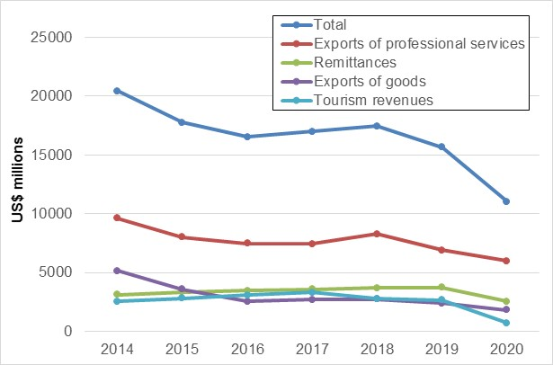
Cuba's Main Sources of Hard Currency, 2014-2020
Sources: ONEI 2020, 2019; MEP 2020; Morales 2020, 2019. *Estimates for 2020.
Cuba’s total hard currency revenues -30% in 2020 from 2019 (-50% from 2014)
Cuba’s GDP -11% in 2020 (-0.2% in 2019) – structural reforms needed

Slide 15
Conclusion
Trump kept his promise to reverse Obama’s Cuba policy
His measures had significant negative effects on Cuba (travel, investments, formal and informal remittances, oil supplies, banking operations)
Possible reinstatement of Cuba on U.S. list of state sponsors of terrorism
Cuba at the end of 2020
Very precarious economic situation
Venezuelan crisis, Trump’s measures, COVID-19, systemic problems
Prospects for 2021
Trump on his way out
Cuba announced critical economic reforms but unclear when and how they will be implemented
Also to be seen what new Biden administration will do with Cuba

