Slide 1
The Misery of Exports and the Sustainability of the Cuban balance of Payments
Ernesto Hernández-Catá

Slide 2
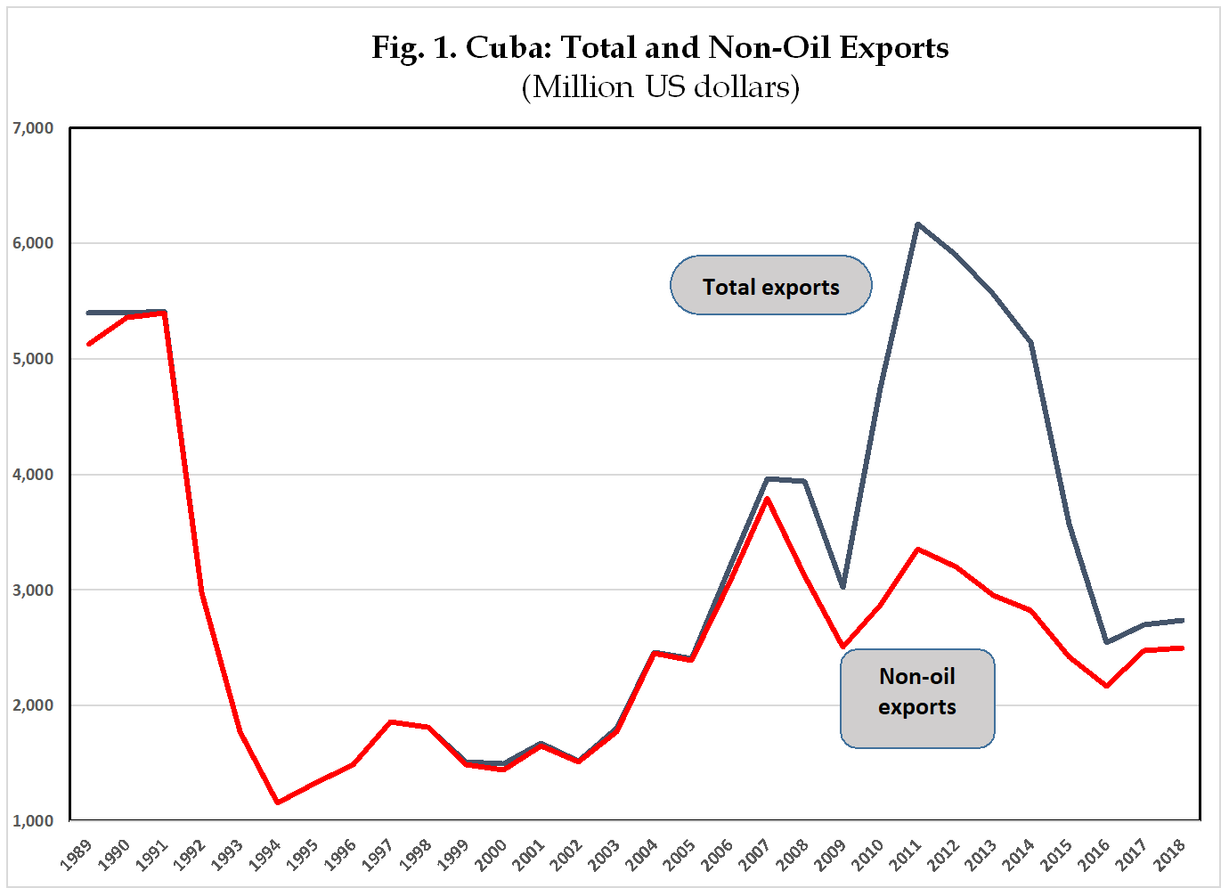

Slide 3
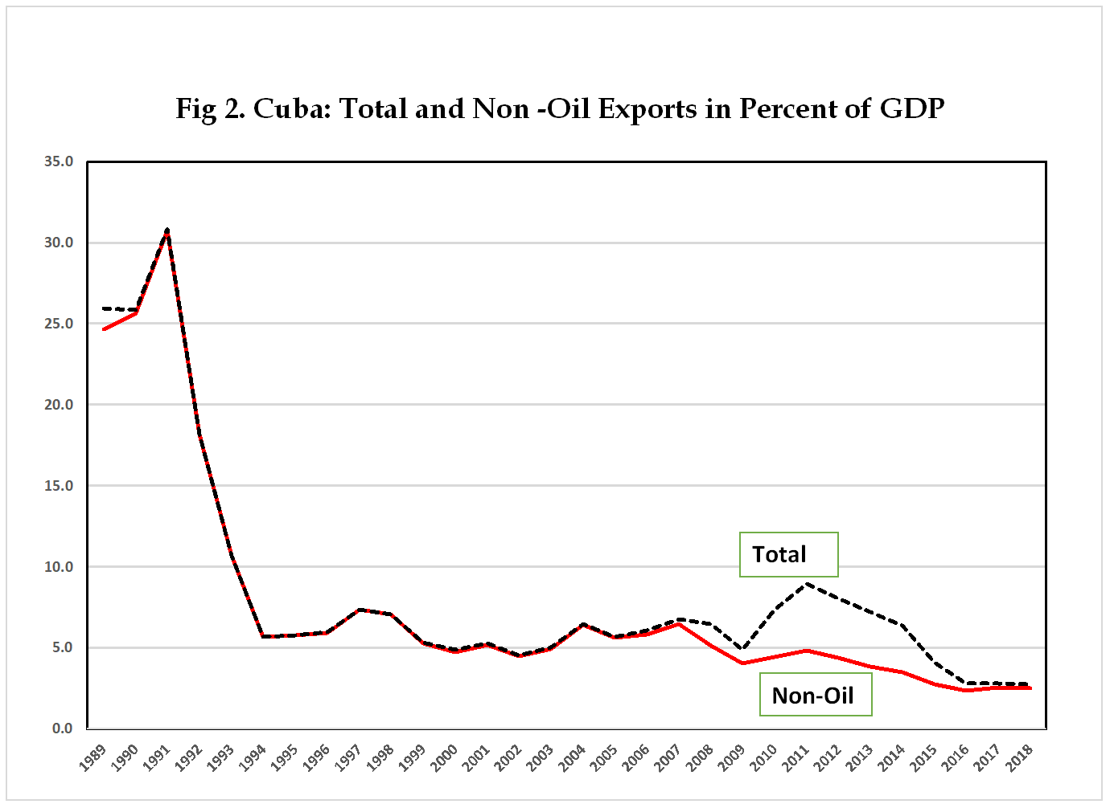

Slide 4
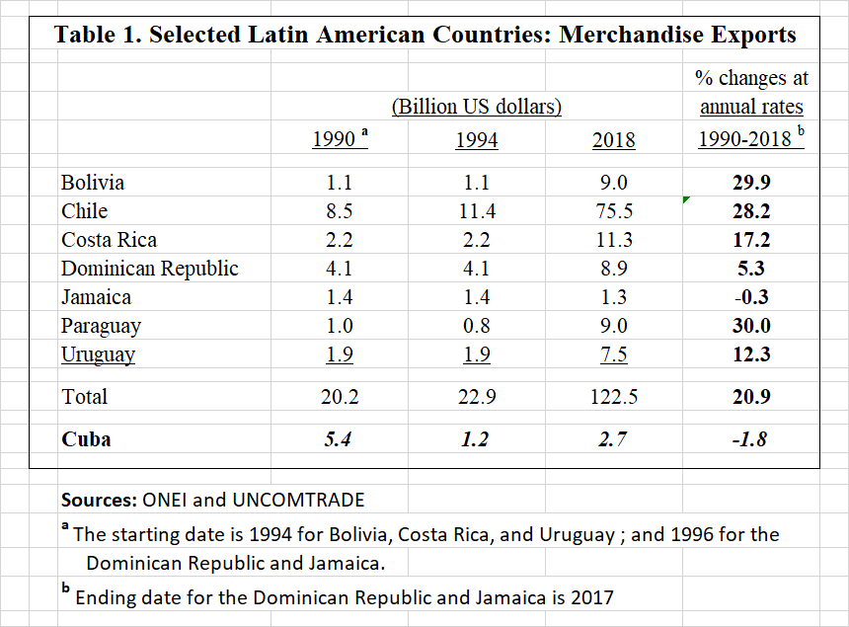

Slide 5
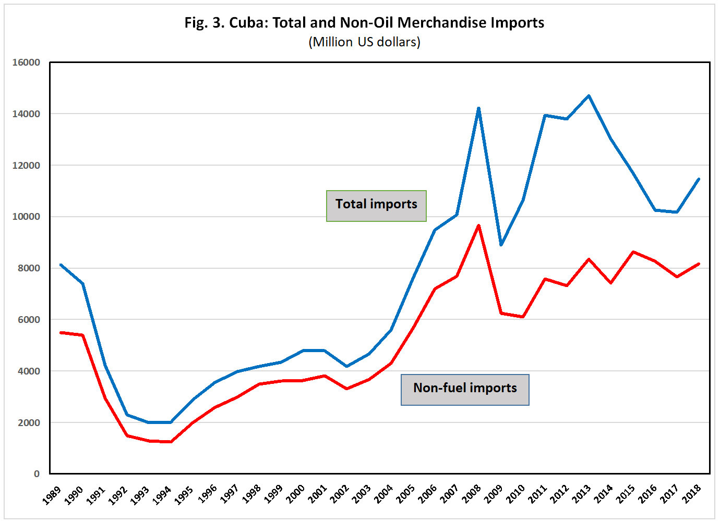

Slide 6
Weak exports and strong imports have led to a large deficit in merchandise trade.
But the current account has remained under control because of a surge in exports of services, associated primarily with Venezuelan payments for the work of Cuban professionals. These payments have been partly in the form of petroleum, partly in the form, of cash, investments and loans.
Over the last decade, strong revenue from private remittances and tourism have also helped to offset the impact of the trade deficit on the current account.

Slide 7
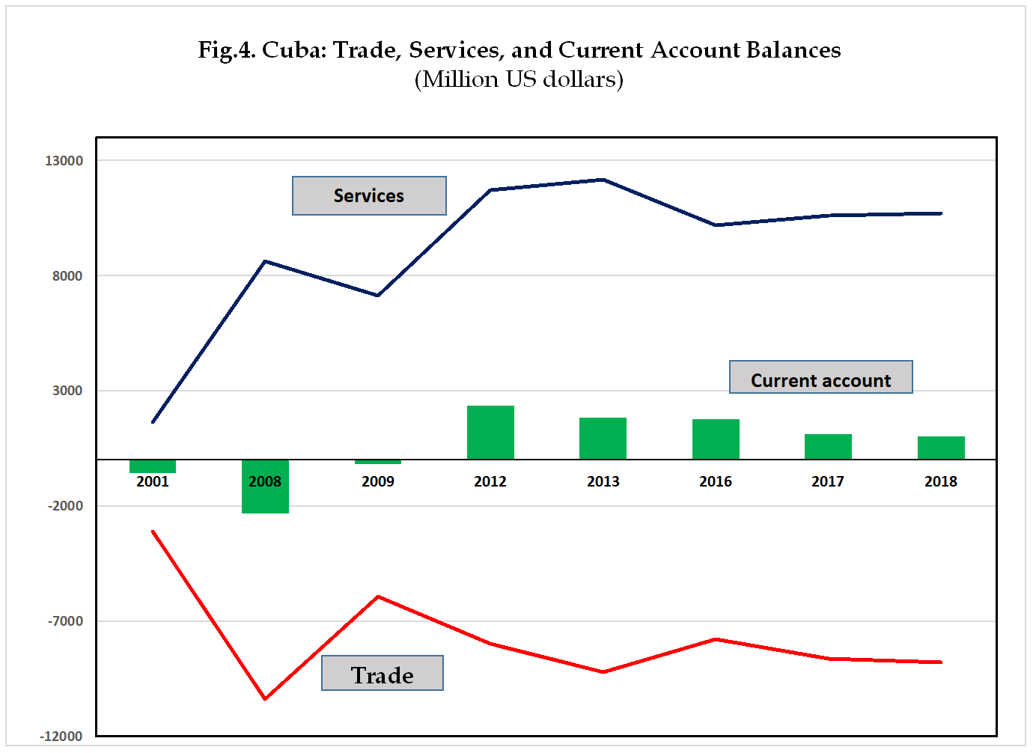

Slide 8
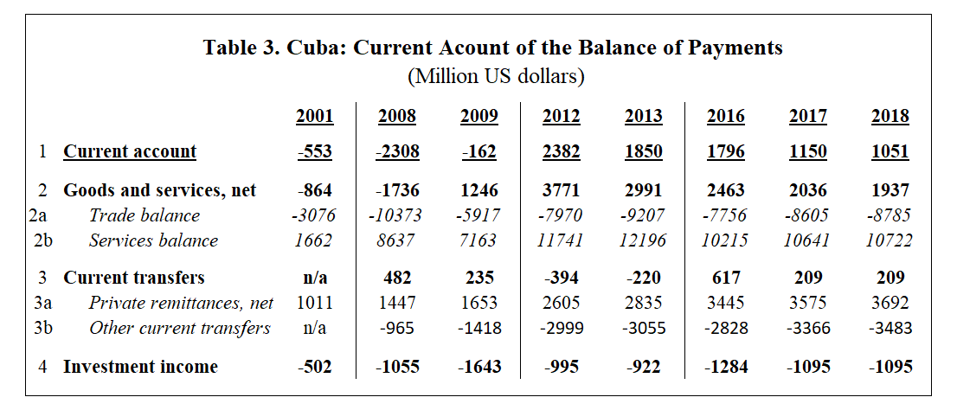

Slide 9
The reduction in revenue for the work of Cuban doctors in Venezuela and Brazil has been aggravated by the worldwide pandemic-induced recession, which has severely affected tourism, private remittances, and exports of goods.
All this has exacerbated the pressure on Cuba’s fragile current account and sharply curtailed the availability of foreign exchange. The government has reacted by imposing severe administrative restrictions on imports, with further adverse effects on distortions and on domestic absorption.
Cuba’s multiple exchange rate system (including the fixed $1 per peso rate for enterprises) has been a major cause of the unsustainable evolution of Cuba’s balance of payments. Its long-promised overhaul is now a fact. Cuba has devalued the now single currency (CUP) to 24 per $ and eliminated the ill-fated CUC. Now is the time to eliminate the subsidies that have hindered the Cuban economy for decades

