Slide 1
The Helms-Burton Act: Then and Now

Slide 2
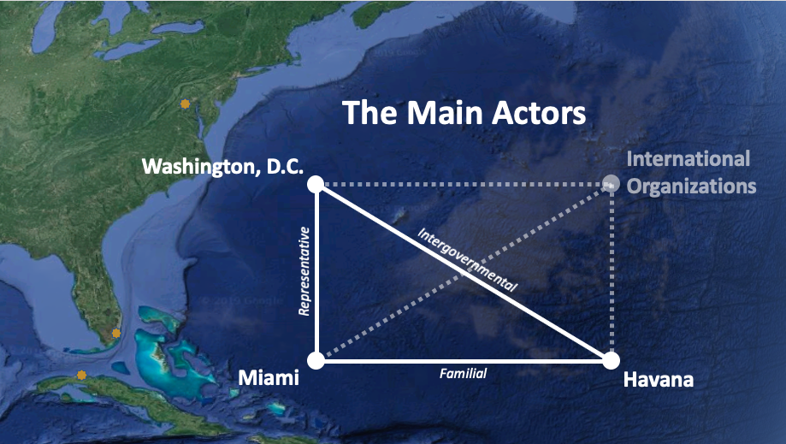

Slide 3
1.
BEFORE HELMS-BURTON
Pre-1996

Slide 4
Embargo Legislation
1917
1961
1963
Trading with the Enemy Act
TWEA
Foreign Assistance Act
FAA
Cuban Assets Control Regulations
CACR
1992
1996
2000
Cuba Democracy Act
CDA or Torricelli Act
The Cuban Liberty and Democratic Solidary Act
Libertad or Helms-Burton Act
Trade Sanctions Reform and Export Enhancement Act
TSRA or Title IX

Slide 5
CANF growth and success milestones
1981: CANF founded
1985: Radio Marti
1989: TV Marti, Ileana Ros-Lehtinen elected
1992: Cuba Democracy Act
1996: Helms-Burton Act

Slide 6
U.S.-Cuba Relations Before Helms-Burton
CANF founded
Radio Marti
Ros-Lehtinen,
TV Marti
CDA
Helms-Burton Act
TRSA
1980s
1990s
2000s
 | 1980 |  |  |  |  | 1985 |  |  |  |  | 1990 |  | 92 |  |  |  | 1995 |  |  |  |  | 2000
POTUS |  | REAGAN |  |  |  |  |  |  |  | GHW BUSH |  |  |  |  | CLINTON
Exile Waves | MARIEL |  |  |  |  |  |  |  |  |  |  |  |  |  |  | BALSEROS AND POST-SOVIET
Cuban Heads | FIDEL CASTRO
Benefactors | USSR |  |  |  |  |  |  |  |  |  |  |  | SPECIAL PERIOD |  |  |  |  |  |  |  |  | VZ

Slide 7
Helms-Burton Act Context
End of the Cold War
End of Soviet subsidies and trade partnerships
Special Period
Rafter Crisis
CANF and Congress
Electoral politics
U.S. allies
Brothers to the Rescue

Slide 8
Trade-offs
Benefits
Cuban-American votes
Political donations
Congressional support
International messaging
Support democratic transition
Support dissidents and exiles
Cut off cash supply to Cuban regime
Compensate property-owners
Retaliate for Brothers to the Rescue shootdown
Costs
Broadly unpopular
Undermine international alliances and U.S. reputation abroad
Other countries have greater influence in Cuba
Impair democratic transition
Contradict international laws and norms
Ostracize other dissidents and exiles
Overwhelm U.S. courts
Prevent U.S. business investments
Feed Cuba’s anti-U.S. propaganda

Slide 9
What changed?
Members of the Cuban military shot down and killed four Brothers to the Rescue pilots after spies tipped them off.

Slide 10
2.
THE HELMS-BURTON ACT
1996

Slide 11
The Helms-Burton Act
Title I
Concerns third countries and international institutions
Title II
Requirements for assisting Cuba and terminating the embargo
1
2
Right to sue entities that traffic confiscated Cuban property
Title III
Denies US entry to individuals who traffic confiscated Cuban property
Title IV
3
4

Slide 12
The message is clear: they are going to have to choose between collaborating with Castro or participating in the U.S. market.
- Lincoln Diaz-Balart

Slide 13
Why does it matter?
Codified embargo
Limited the president’s control over foreign policy
Contradicted international norms and (perhaps) laws

Slide 14
3.
REACTIONS & WAIVERS
1996-2019

Slide 15
International Reactions
Europe
"The EU considers the extra-territorial application of unilateral restrictive measures to be contrary to international law and will draw on all appropriate measures to address the effects of the Helms-Burton Act, including in relation to its WTO rights and through the use of the EU Blocking Statute.”
Canada
"Canada has had measures in place since 1996 under its Foreign Extraterritorial Measures Act (FEMA) to help protect Canadians and Canadian businesses and the workers they employ. Our FEMA legislation is strong and we are prepared to apply it.”
Mexico
"The Government of Mexico reiterates its rejection of application of Title III of the Helms-Burton Act and reaffirms its commitment to providing legal protection to any Mexican companies affected.”

Slide 16
Between Clinton and Trump
Waivers
International negotiations
Death of Jorge Mas Santos
Title IV sanctions
Elian
TSRA
CANF split and new exile organizations
Changing public opinion
Thawed U.S.-Cuba bilateral relations

Slide 17
U.S.-Cuba Relations After Helms-Burton
TRSA
U.S.-Cuba Democracy PAC
D17
Title III enacted
1990s
2000s
2010s
2020s
 |  | 98 |  | 00 |  | 02 |  | 04 |  | 06 |  | 08 |  | 10 |  | 12 |  | 14 |  | 16 |  | 18 |  | 20
POTUS | CLINTON |  |  |  | GW BUSH |  |  |  |  |  |  |  | OBAMA |  |  |  |  |  |  |  | TRUMP
Exile Waves | BALSEROS AND POST-SOVIET |  |  |  |  |  |  |  |  |  |  |  |  |  |  |  |  |  | AFTER THAW
Cuban Heads | FIDEL CASTRO |  |  |  |  |  |  |  |  | RAUL CASTRO |  |  |  |  |  |  |  |  |  |  |  | MDC
Benefactors | SPECIAL PERIOD |  |  | VENEZUELA |  |  |  |  |  |  |  |  |  |  |  |  |  |  | VENEZUELA+

Slide 18
Cuban-American Legislators
1981: CANF founded
1985: Radio Marti
CDA
Helms-Burton Act
TRSA
U.S.-Cuba Democracy PAC
D17
Title III enacted
1980s
1990s
2000s
2010s
2020s
 | 1989 | 1990 |  |  |  |  | 1995 |  |  |  |  | 2000 |  |  |  |  | 2005 |  |  |  |  | 2010 |  |  |  |  | 2015 |  |  |  |  | 2020
House | Ileana Ros-Lehtinen
 |  |  |  |  | Lincoln Diaz-Balart |  |  |  |  |  |  |  |  |  |  |  |  |  |  |  |  |  | Rivera |  | Garcia |  | Curbelo
 |  |  |  |  |  |  |  |  |  |  |  |  |  |  | Mario Diaz-Balart
 |  |  |  |  | Bob Menendez |  |  |  |  |  |  |  |  |  |  |  |  |  | Albio Sires
 |  |  |  |  |  |  |  |  |  |  |  |  |  |  |  |  |  |  |  |  |  |  |  |  |  |  | Alex Mooney
Senate |  |  |  |  |  |  |  |  |  |  |  |  |  |  |  |  | Mel Martinez |  |  |  |  |  | Marco Rubio
 |  |  |  |  |  |  |  |  |  |  |  |  |  |  |  |  |  | Bob Menendez
 |  |  |  |  |  |  |  |  |  |  |  |  |  |  |  |  |  |  |  |  |  |  |  |  | Ted Cruz

Slide 19
Cuban-American Legislators
House
Ileana Ros-Lehtinen
Lincoln Diaz-Balart
Bob Menendez
Mario Diaz-Balart
Albio Sires
David Rivera
Joe Garcia
Alex Mooney
Carlos Curbelo
Maria Elvira Salazar
Carlos Gimenez
Nicole Malliotakis
Senate
Mel Martinez
Bob Menendez
Marco Rubio
Ted Cruz

Slide 20
Title III Context
D17 thaw
Death of Fidel Castro
Trump’s electoral politics
Cuban-American legislators

Slide 21
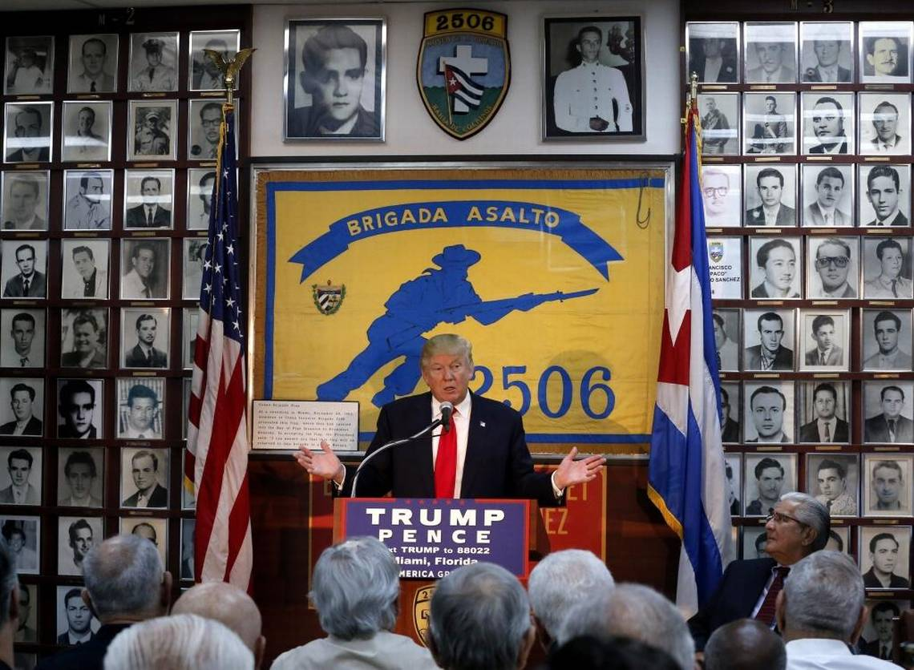
Donald Trump with the Bay of Pigs Veterans, Oct. 2016 (Source: Miami Herald)

Slide 22
4.
TITLE III ENACTED
2019-2020

Slide 23
TITLE III LAWSUITS
Canto v. Iberostar Hoteles y Apartamentos S.L. | Gonzalez v. Amazon.com, Inc.
Cueto v. Pernod Ricard | Havana Docks Corp. v. Carnival Corp.
Del Valle v. TRIVAGO GmbH | Havana Docks Corp. MSC Cruises SA Co.
Echevarria v. TRIVAGO GmbH | Havana Docks Corp. v. Norwegian Cruise Holdings, Ltd.
Exxon Mobil Corp. v. Corporacion CIMEX S.A. | Havana Docks Corp. v. Royal Caribbean Cruises, Ltd.
Garcia-Bengochea v. Royal Caribbean Cruises, Ltd. | John S. Shepard Family Trust v. NH Hotels, USA, Inc.
Garcia-Bengochea v. Carnival Corp. | Mata v. Grupo Hotelero Gran Caribe
Garcia-Bengochea v. Norwegian Cruise Line Holdings, Ltd. | Mata v. Melia Hotels International, S.A.
Glen v. American Airlines, Inc. | Mata v. TRIVAGO GmbH
Glen v. Expedia, Inc. | Regueiro v. American Airlines Inc.
Glen v. Travelscape LLC | Sucesores de Don Carlos Nunez y Dona Pura Galvez, Inc. v. Societe Generale, S.A.
Glen v. TripAdvisor LLC | Trinidad v. TRIVAGO GmbH
Glen v. Visa Inc.

Slide 24
Title III Results
Analysts overestimated the policy’s efficacy.
The impact has been primarily domestic.
It undermined foreign alliances and potential partnerships.

Slide 25
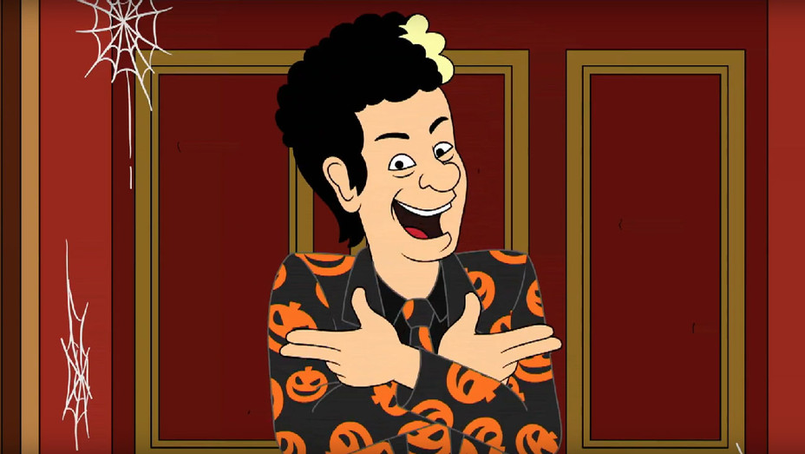
Thanks!
Any questions?
You can find me at:
cmccu011@fiu.edu

