Slide 1
CUBA AND VENEZUELA:
CONTEMPORARY CRISES.
Silvia Pedraza
University of Michigan
Departments of Sociology
and American Culture
Carlos A. Romero
Universidad Central de Venezuela

Slide 2
CUBA – DEEP CRISES:
Main Sources
1) A dismal economy
2) An old population
3) An old revolution – crisis of legitimacy
4) Continuing exodus, especially from the young
5) Growing inequality: class and race
6) Alliance with Venezuela
7) Relationship with the U.S.

Slide 3
1) A dismal economy
The “special period” from 1989 – 1999 due to the collapse of the Soviet Union and Eastern European communism. GDP contracted -35 % in a few years. Resulted in constant hunger (hambruna) and health problems.
Manifested itself in the crisis of the balseros -- massive departure of 36,000 in the summer of 1994.

Slide 4
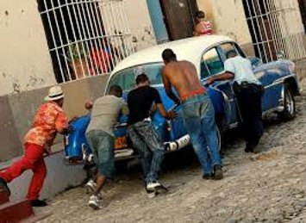
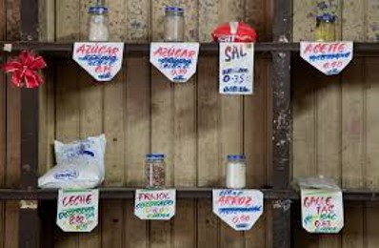
The “Special Period”

Slide 5
Prompted Raúl Castro’s (2006-2012) market-oriented reforms: increased tourism, self-employment (cuentapropismo), and joint ventures with foreigners.
However, still the inefficient model of centralized planning, state enterprises, and control of agriculture. Too many restrictions for the small private sector of the economy to be able to grow (taxes, disincentives)
Sugar industry output 82 % below 1989.

Slide 6
Recent economic trends:
In 2006 – Cuba’s GDP growth was 12.1 %
In 2009 – declined to 1.4 %
In 2017 – 1.8 %
In 2019 – 1 % and output of sugar 82 % below 1989
In 2020 -- -8 %

Slide 7
Total reliance on tourism
Latest reforms 2018 - 2020: the Ordenamiento.
Currency reform (disappearance of the CUC)
Decline of la libreta (rationing book)
Widespread use of the internet
Allowing the buying and selling of homes
Freer travel out of the country and return

Slide 8
2) An old population
As the result of a very low birth rate sustained for many years Cuba now has the oldest population in the Western Hemisphere.
Thus, the smaller working age population has to support both the young and the old. Pensions of the elderly are extremely low, forced to live with their family. population whose pensions are extremely low.

Slide 9
3) An old revolution
A crisis of legitimacy, especially as Fidel Castro grew older and in ill health (left power 2006, died 2016).
Increasing challenges to the state: growth of the dissident movement – e.g., Las Damas de Blanco; UNPACU – Unión Nacional Patriótica de Cuba. Increased repression.
Resulted in a new Constitution 2018 and the appointment of a new President, Miguel Díaz-Canel. Continuance with the past.

Slide 10
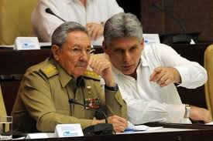
Raúl Castro and Miguel
Díaz-Canel

Slide 11
Increasing demands from the people to the government for real democratization.
Unprecedented social protests at end of November 2020. The San Isidro Movement together with the manifestation led by artists.

Slide 12
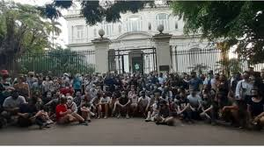
San Isidro Social Movement Protests

Slide 13
Cuban society is marked by very different political generations.
The generation born during “the special period” – the young -- is “the generation of disbelief.” To them, the glorious revolution is only a story they have been told (at home, in school, in television, in movies). They have only known poverty and want, as well as the wish to be free.

Slide 14
This is very different generation than “the generation of the glorious revolution” that are now old. Those who made the revolution still cling to its best: the spread of literacy and public health across the island, for everyone. They blame the U.S. embargo for everything that is wrong.

Slide 15
4) Continuing exodus
The exodus has continued, not only to the U.S. but to all of South and Central America, Spain, Canada, many European countries.
Overwhelmingly it is the exodus of the young, of the generation of disbelief. Problematic because everywhere it is young people who provide the leadership that calls for social change.
New exodus involves many who leave temporarily and others who return temporarily. Not a total break with the past.

Slide 16
5) Growing inequality
Rising inequality: social class and race.
Remittances from those in exile go to white Cubans, not to black Cubans. Hotels for tourism prefer to hire white Cubans. Students in the universities are now disproportionately white.
Decline in the quality in social services: in education and in public health.
Partly due to the export of doctors and health personnel.

Slide 17
6) Alliance with Venezuela
Alliance with Venezuela: formidable mutual support
doctors traded for oil – for Chávez’s Barrio Adentro. 50,000 Cuban health workers in Venezuela at its peak, 20,000 now.
Venezuela is now caught in the spiral of its own economic and political crisis and its assistance is declining, cannot be counted upon.

Slide 18
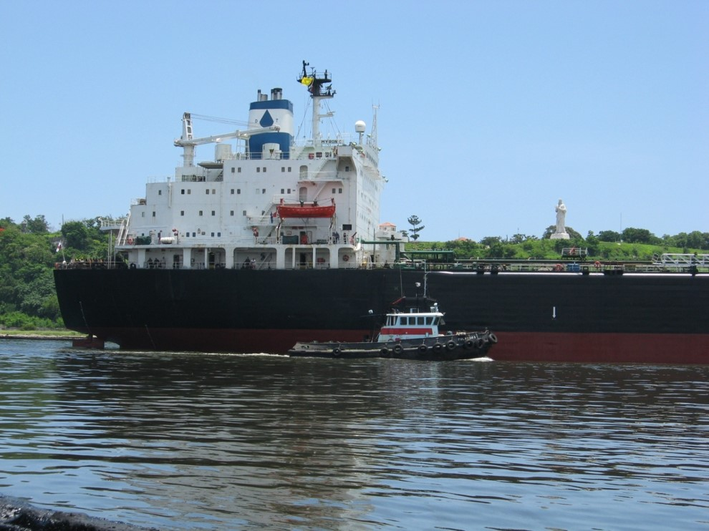
Venezuelan shipment of oil enters Havana

Slide 19
Venezuela’s oil shipments to Cuba declined:
2000-2012 about 100,000 barrels a day.
2013-2016 about 65,000 barrels a day.
2017-2020 about 43,000 barrels a day.
A permanent decline.

Slide 20
7) U.S. – Cuba Relations
New engagement: Restoration of diplomatic relations under Obama (“12/14” – July 2015).
Avalanche of tourism from U.S. to Cuba
(4-5 million tourists a year).
New hardline: Sanctions under Trump to undo Obama’s reforms and to isolate Cuba.
Prohibited U.S. companies from doing business with GAESA firms.

Slide 21
Ended cruises traveling to Cuba.
Ended “people to people” travel and visas
Ended most regular airline flights to Cuba
to cities other than Havana.
Together with Covid-19, resulted in
disappearance of tourism, impacting small businesses.
Ended Western Union remittances.

Slide 22
VENEZUELA – DEEP CRISES:
Main Sources
1) A dismal economy
2) A revolution not consolidated
3) A massive exodus – become a humanitarian crisis
4) Growing inequality: class
5) Relationship with the U.S.
6) Crisis of political legitimacy – dual political power

Slide 23
1) A dismal economy
Hyperinflation. In 2015 – 180 %; in 2016 – 800 %; in 2017 – 4,000 %; in 2018 – over 1 million %.
Lack of food and medicines – constant hunger.
Breakdown of public services – electricity, water, domestic gas.
Crumbling communication channels.
Lack of transportation.
Social unrest, street protests.

Slide 24
2) Massive exodus
Massive exodus estimated at 4-5 million people – has become a humanitarian crisis.
The United Nations Human Rights Council and the Organization of American States brought evidence of human rights violations. Venezuela has lost international support.

Slide 25
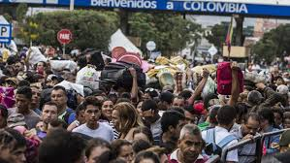
Venezuelan Exodus to Colombia

Slide 26
3) A revolution not consolidated
2013 -The Bolivarian revolution suffered 2 serious blows:
Hugo Chávez’s death, Nicolás Maduro governs. The accelerated decline of the economy. Death knell of the “socialism of the 21st century” – a socialism without poverty. Since 2016 Venezuela’s GDP change has also been negative.

Slide 27
Recent economic trends:
In 2016 – Venezuela’s GDP growth was -17.1 %
In 2017 – -15.7 %
In 2018 -- -19.6 %
In 2019 – -35 %
In 2020 -- -30 %

Slide 28
Under Maduro, political tendencies intensified:
extreme political polarization
increasing authoritarianism
Opposition has not responded well:
Parliamentary majority in the National Assembly elected in 2015 but it has not participated in a number of elections.
It is divided and fragmented.

Slide 29
4) Growing inequality
The different social classes are coping in various ways with the crisis:
Many have joined the exodus, left – working class.
Others with access to U.S. dollars cope best.
Others live from the informal economy – legal and illegal both.
Others live from government social programs or international charity and relief organizations.

Slide 30
5) Venezuela – U.S. Relations
Role of the U.S.: tempered no equivalent to Bay of Pigs.
Under President Trump, serious sanctions:
diplomatic relations broken.
reduced financial and credit capacity of PDVSA.
stopped oil shipments to U.S.
banned financial transactions, deterioration of trade.
supported Venezuela’s opposition -- “all options are still on the table.”

Slide 31
Trade relations deteriorated – from $ 55 billion in 2011 under Chávez to $ 0.57 in 2020 under Maduro.
Oil exports to the U.S. declined -- from $ 44 billion in 2011 to $ 0.28 billion in 2020, though oil production remained strong (530,000 barrels a day in August 2020).

Slide 32
6) A crisis of political legitimacy - dual power
Dual Power – 2 heads of state claim to be the legitimate one:
Maduro as elected President and Guaidó as the National Assembly President.
Each considers the other as illegitimate and as an “usurper.”

Slide 33
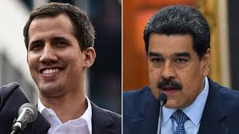
Guaidó and Maduro – dual power

Slide 34
International recognition:
Guaidó recognized by 60 governments;
Maduro recognized by 110: Cuba, Russia, China, Bolivia, Argentina, Turkey, Mexico, India, Malaysia, Singapore, some Caribbean countries, most of the Non-Aligned nations.
U.S. recognizes and supports Guaido’s government. CITGO, the U.S. oil company owned by PDVSA, passed into the hands of the opposition.

Slide 35
Cuba and Venezuela – At a Crossroad?
In moments of crisis, it is often said that “Such and such is at a crossroads.”
Are Cuba and Venezuela at a Crossroads? No.
They are standing at the edge of a precipice.
A question: How is it possible for their governments to continue to hold onto power in the face of these deep-seated crises?

