Slide 1
Bureaucratic structure and bureaucrats in Cuba. An obstacle for the economic growth and development?
Tamarys L. Bahamonde
ASCE- January 2021

Slide 2
Themes & Arguments
Bureaucracy responds to the social division of labor in two: intellectual work and manual work.
The bureaucracy constitutes a new social class in a socialist state like Cuba?
The extent of the bureaucratic apparatus is linked to the debate decentralization vs. centralization.
Domestic blockade vs. Administrative burden

Slide 3
Adverse effects of highly centralized and bureaucratized governments
1. Pervasive and intrusive role of bureaucratic institutions, like the Party, in the economic life of the state -including the Chinese corporative model, for example- (Kornai J., 1990).
2. The state “owns” the means of production on behalf of the people (Kornai J., 1990; Boisot & Child, 1998; Huchet & Richet, 2002), but the bureaucrats administrate and manage those means. It alienates the bureaucrats from the workers (Allahar & Valdés, 2013).
3. Party’s role of nigh-watchers asphyxiates creativity. (Luxemburg, 1971)
4. “The necessarily simple abstractions of large bureaucratic institutions, (…), can never adequately represent the actual complexity of natural or social processes. The categories that they employ are too coarse, too static, and too stylized to do justice to the world that they purport to describe.” (Scott, 1998, pág. 262). Ergo,
5. Bureaucracy is the principal reason for the ultimate demise of Soviet socialism. (Scott., 1998; Allahar & Valdés, 2013)

Slide 4
Domestic Blockade
The combined political will of multi-level bureaucrats which obstacle the proper design, development and/or implementation of policies perceived as threatening to the status quo and, therefore, to their power position and power dynamics.

Slide 5
Navia’s (2019) hierarchal order

Slide 6
Organization of the State and Government in Cuba

Slide 7
Cuban Bureaucracy
Top-level bureaucrats are professionals. Disproportional participation of non-college graduate and blue-collar workers at the country's highest level of leadership and administration.
The Politburo's age composition shows that half of them, in 2014, was over 70 years old.
Relatively low participation of women in the Council of Ministers and the Party's leadership.

Slide 8
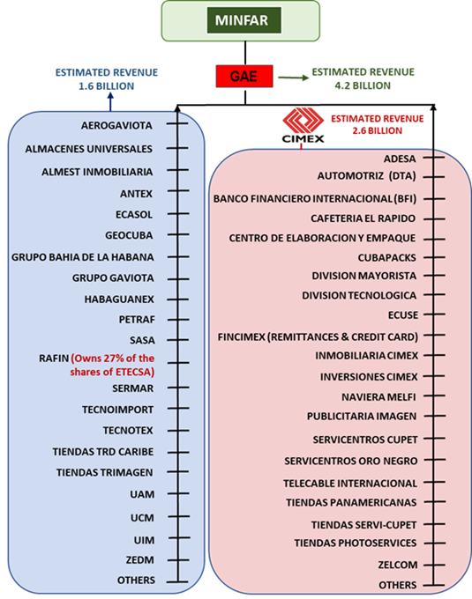
GAESA

Slide 9
Centralization vs. Decentralization. Centralization of Power
Source: Havana Consulting Group, 2018

Slide 10
Division of labor- Hierarchies- CIMEX (2008)
Presidency; 4 Vice-presidencies; 8 Directorates, work groups and specialized offices subordinated to the Presidency; 25 GD, directorates and divisions subordinated to Vice-presidencies.
2667 units for management and administration activities
1718 units of production of goods and services.
27,000 workers in total.

Slide 11
Domestic Blockade
1. Separating enterprises from the ministerial structures.
2. Eliminating any higher level of management that parasitizes their operation (OSDEs).
3. Instead of continuing using rigid mechanisms for resource allocation, start using financial planning methods. It will facilitate the enterprises’ development, generate an incentive system that would stimulate and expand the productions and exportations’ capacity.
(Fernández Estrada O. , Desatascar la Actualización , 2020)

Slide 12
Are the bureaucrats a new social class in Cuba?
Is the bureaucracy an obstacle to the crisis response and development?

