Slide 1
“Companies and the sequence of economic reform in Cuba”
Pedro Monreal
Session “Destrabando” the Cuban Economy: An Assessment of Reforms and the Road Ahead
August 14, 2020
10.30 am – 12:00 m

Slide 2
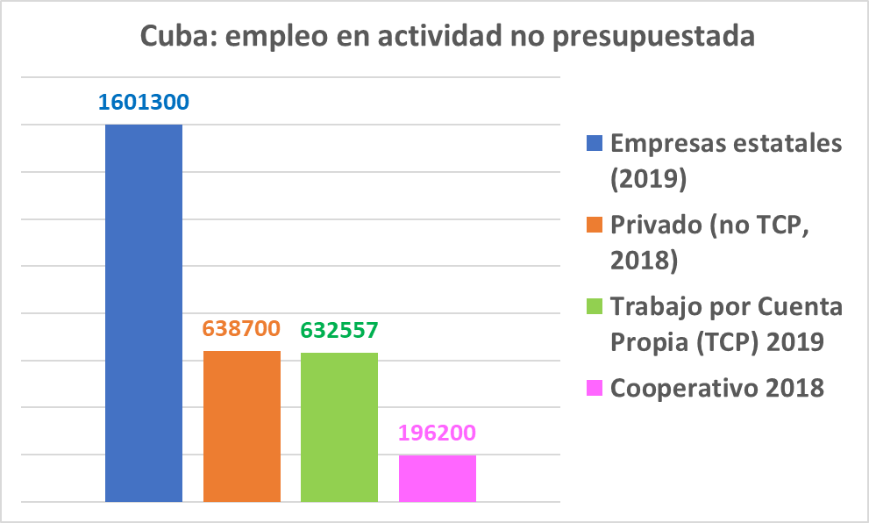
Reforming firms in Cuba: it is mainly a problem of employment and productivity…of course!

Slide 3
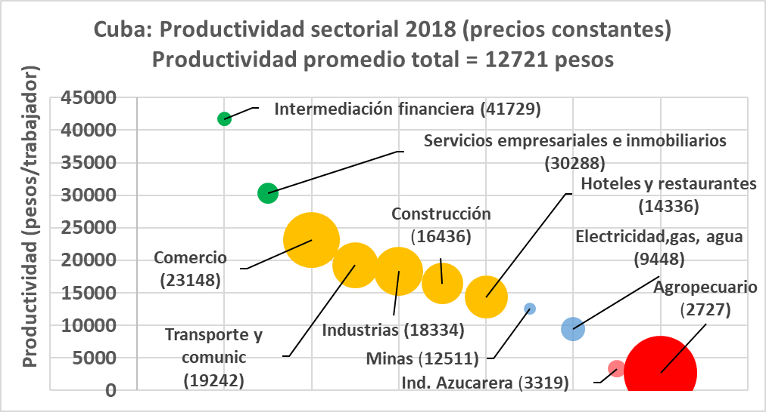
Productivity: What to do with the agro?

Slide 4
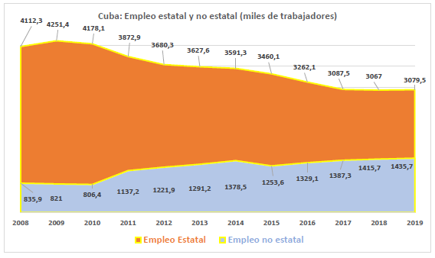
The increasing role of non-state activities in the creation of net employment

Slide 5
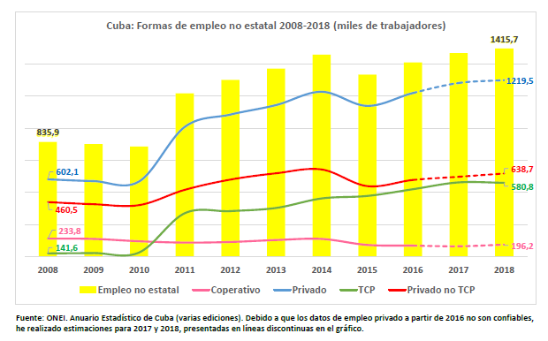
The decisive function of the private sector in the creation of net employment

Slide 6
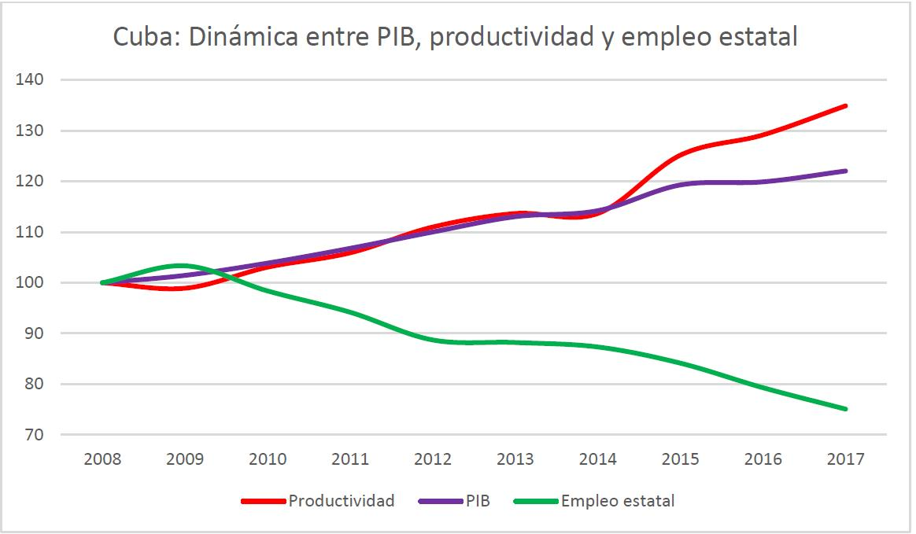
The shortcut to higher productivity: shrinking employment in the state sector

Slide 7
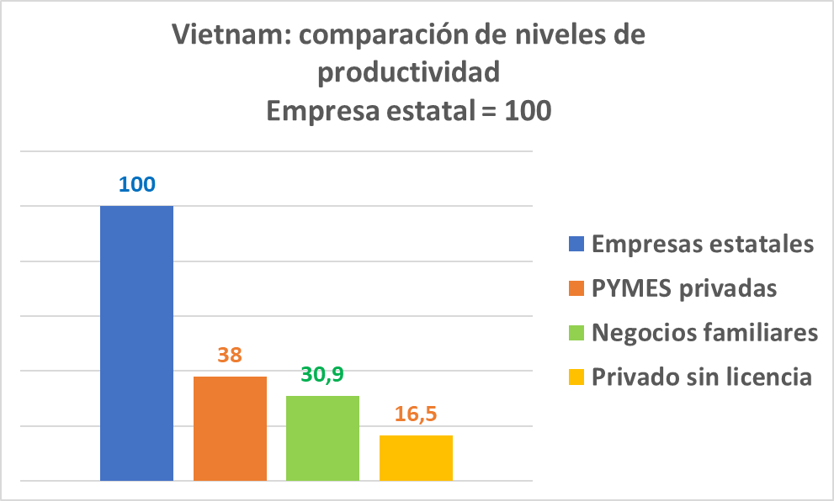
Do you need to transfer jobs from SOEs to the private sector? Well…the sign is on the wall!

Slide 8
A problem of sequence…

Slide 9
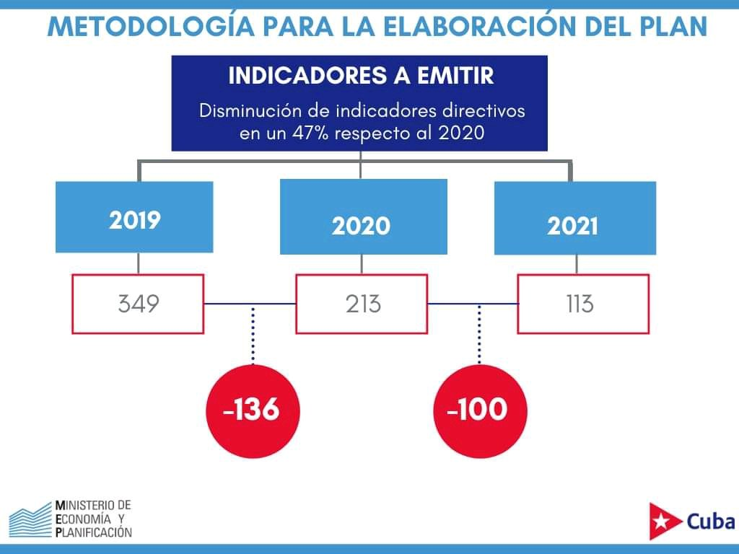
The “new” Centrally planned scheme is way too heavy!!!

Slide 10
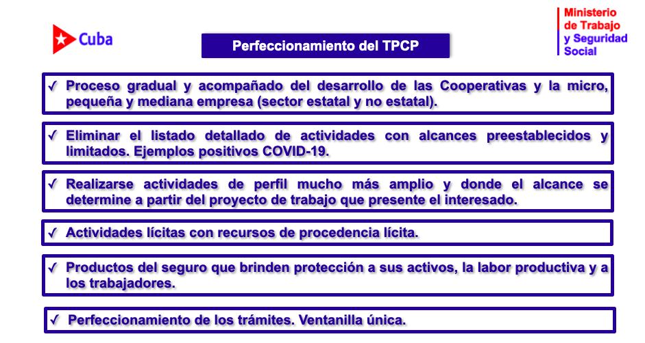
Something is better than nothing…

Slide 11
Restructuring firms: the plan and the evidence…thus far

Slide 12
Goodbye yellow brick road?

Slide 13


