Slide 1
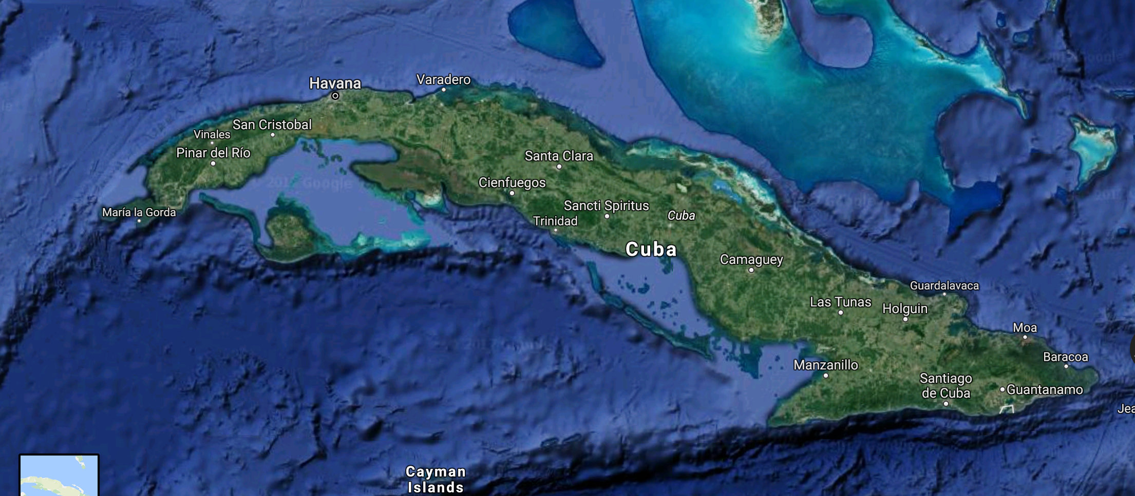
“Cuba’s Response to COVID-19 and the Consequences for Cuba of the Pandemic”
Larry Catá-Backer, Pennsylvania State University, and Yuri Gonzalez Hernandez (Havana)
Cuba From the Castros to COVID: An ASCE Virtual Conference
13 August 2020

Slide 2
Context
Most attention focused on great powers and great tragedies
Viewed in the popular press and by certain states as a test for the legitimacy and strength of a political system
The battles for policy supremacy between economics and health policy
Policy shaped by need to preserve health of entire population
Policy shaped by the need for a viable economic system to continue to function
Much less attention paid to the developing world
Exception—sensationalism in tragedy (Central and South America)
Exception—where a government that is unpopular in the United States does “badly” in its response (Brazil)

Slide 3
Cuba: A Unique Case Study
Has many of the characteristics of a developing states
But also shares some of the characteristics and sensibilities of a developed state
The conflict with the United States adds greater interest
The issue of medical internationalism exposes quite strong ideological rifts between Marxist Leninist and Western Liberal Democratic sensibilities
The tensions between seeking to help and protecting populations is substantially exposed
The interactions of economic and health policy and their tensions are highlighted
The specific effect of placement downstream in pathways of economic production produces dependencies that then affect health policy and capabilities

Slide 4
Overview—History of Pandemic
The infection vectors
Tourism—European visitors right before the European flareup
Diaspora—Cubans traveling back and forth from countries immediately before flare ups in host states
Internationalism--Cuban doctors and other medical staff abroad
Humanitarianism—the sage of the cruise ships allowed to dock in Cuba
Consequences
Closing borders
Developing treatments
Keeping the country running in the face of shortages
Reducing incidence of mortality and disease severity
Difficulties of maintaining disease reduction strategies

Slide 5
Focus on Key Issues: Tourism
Core challenge
Tourism is a critical element of economy
Economic development for 2030
Expansion of non-State sector
Tourism was the key vector for the introduction of disease
Pandemic dried up sources of tourist flows
Reduced investment by foreign companies
Response
Encouraging local tourism
Difficult to make up the difference
Diaspora Cubans effectively cut off
Collateral effects (restaurants, tour operators, difficult to manage)
From July 2020 effort to establish tourist safe zones, where tourists would be transported to 1 of 5 quarantined all inclusive resorts

Slide 6
Cuban Medical Internationalism
Has been controversial for years
Has proven effective during Pandemic
Cuban doctors sent worldwide
Special focus on Italy for example—well received
But the program has been controversial
Critics charge that it amounts to forced labor
Returning doctors have been a source of COVID-19 (e.g. recently from Venezuela)
Medical internationalism puts a potential strain on state’s ability to deal with local COVID infections

Slide 7
Medical Technologies
Advances in medical tech has also been a core area of development under 2030 Plan
COVID accelerated and redirected medical research
Deepened partnerships with China and European states
Recycling and repurposing drugs in development
Some success
Has been used strategically: in some cases less of an attempt to monetize drug treatment regimes than to use it for middle and long term political advantage.

Slide 8
Challenges
Sanitation
Hard to encourage hand washing where water scarcity is an issue
State incapable of meeting that challenge in the short term
Potential to increase susceptibility
Food
Condition of Cuban people waiting in long lines for food and other needs well publicized
Highlights inefficiency of internal state planned distribution networks
Highlights difficulties of Cuban access to goods where they are cash strapped
Potential to increase susceptibility
Economic Reform
The pressures of COVID response has induced state t return to some of the measures of the “Special Period”: Dollarization relaxation of central planning, expansion of areas let to private sector, etc.
Hard to plan—might be revoked as soon as crisis passes
Food security issues highlighted
Will the non-state sector expand with less oversight going forward? Non-state sector VERSUS informal sector poses its own problems

Slide 9
Conclusion
Cuba has been among the states better able to meet the challenges of the pandemic inters of infection and mortality rates
But being an island has not proven to be a positive means of avoiding pandemic in an age of globalization; not clear there is planning for managing future similar crsies.
Pandemic has substantially affected economic planning: internally opening the economy in ways rejected by the 7th PCC Congress in 2017; Externally mixed—bad for tourism, better for medical advances and medical internationalism
Has exposed the weaknesses of the state: sanitation, food security, and responsiveness.

Slide 10
Thanks!
Larry Catá-Backer, Pennsylvania State University, and Yuri Gonzalez Hernandez (Havana)
Cuba From the Castros to COVID: An ASCE Virtual Conference
13 August 2020

