Slide 1
Comparative Constitutionalism 比较立宪主义 East China University of Political Science and Law Shanghai, China November-December 2019
Lecture 8: Fourth Generation Constitutions and the Marxist-Leninist New Era
Larry Catá Backer
W. Richard and Mary Eshelman Faculty Scholar Professor of Law and International Affairs Pennsylvania State University | 239 Lewis Katz Building, University Park, PA 16802 1.814.863.3640 (direct) || lcb11@psu.edu

Slide 2
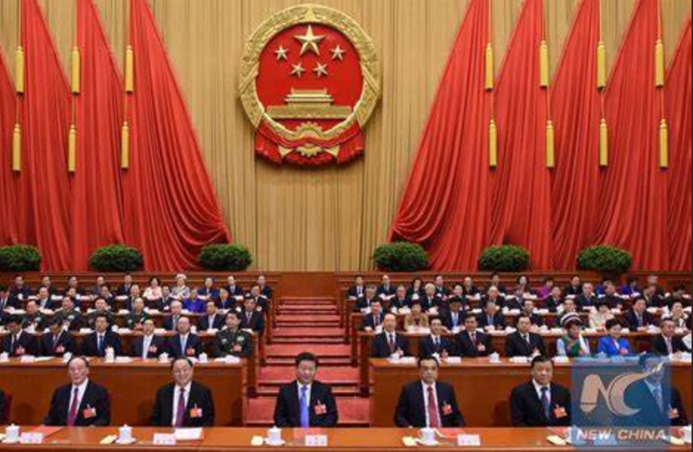
Class 8
12月6日（周五）
December 6, Friday
第1—4节8:30-11:45
Fifth Generation Constitutions
CCP Congress

Slide 3
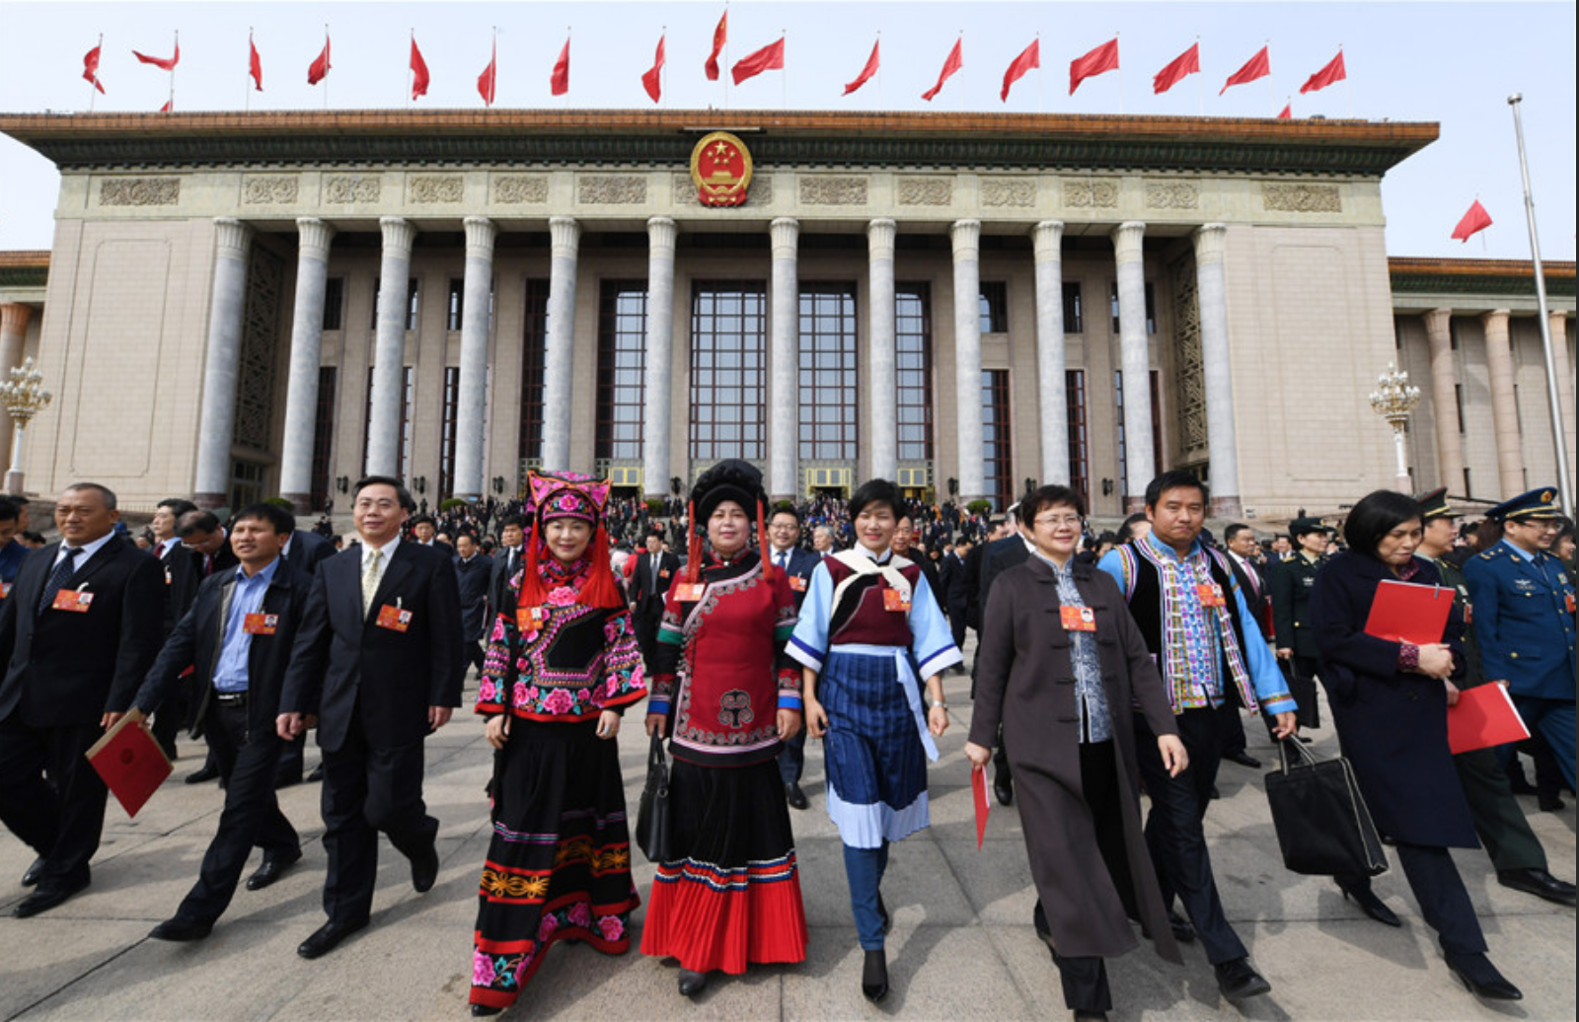
What We Discuss Today/我们今天讨论的内容
Fifth generation constitutions –rethinking separation of powers, the role of vanguard parties；Review and drawing general conclusions from the study of constitutions and constitutionalism
第五代宪法：新时代可能的方向；回顾并得出宪法和宪政研究的一般结论。

Slide 4
From Theocratic to Marxist-Leninist Constitutionalism
Reaction
Like 4th Generation Constitutions, 5th Generation constitutions reflect a reaction against the premise that liberal democratic principles must serve as the baseline for building legitimate constitutional orders
Like 4th Generation constitutions, 5th Generation constitution accept the framework of ordering legitimate constitutional orders: (1) rule of law; (2) process rights; (3) core substantive basis for establishing and managing the core political order.
But where the basis of the substantive order is religion in 4th Generation constitutional orders; in 5th Generation orders the fundamental ordering basis are the principles of Marxist-Leninist governance.
Innovation
This represents both an innovation in approaching the character of Marxist Leninist systems and an effort to align such political orders within the constitutionalist framework that emerged after 1945.

Slide 5
Difference Between Chinese and Soviet Approaches
Soviet
political-economic model tended to stagnate
Heavy focus on cult of personality
Conflation of state and Party apparatus
Willing to consider political reform that aligned with principles of liberal democracy
Rejected any role for markets and centered direct central planning
Class struggle as the only andcentral contradiction
China
Different path since the leadership of Deng Xiaoping
Reform and Opening Up Initiative inaugurated the earlier New Era
Emancipating the mind and development f Marxist Leninist theory with Chinese characteristics
Focus from class struggle to development of productive forces; Xi Jinping New Era refocus from development of productive forces to the contradiction of the fdtribution of the gains of Reform and Opening Up
Greater separating between the administrative apparatus of state and the political apparatus of the CCP
Commitment to aligning theory with current historical conditions

Slide 6
Constitutional Analysis 憲法分析
CCP does not enjoy an extra-constitutional role in Chinese political organization, but it does exist autonomously from the state. State organs, under the constitution that established them and defined their powers, are understood to be required to accept the leadership role of the CCP.
Under the Chinese constitutional order, the CCP is the repository of political power, and the state organs fulfill the administrative function.
Chinese Constitution could be understood as establishing an administrative apparatus under the leadership of the CCP and its multi-party coalition.
雖然CCP並非在憲法之外，但是在中國的政治秩序中，CCP 不從屬於國家機器。根據《憲法》，中國國家機構必須認同CCP的領導。
中國《憲法》的功能可以理解為在共產黨為領導的多黨合作框架之下建立的行政管理體制。
在中國的憲政秩序下，中共是政治權利的提供者，政府則是行政管理的機關。

Slide 7
Separation of Powers

Slide 8
Where is the Chinese Constitution
CCP Constitution
Expresses the rules for the internal organization of the leading social and political forces of the nation organized as a Leninist Party
States the core principles and premises of the political-economic model from which the CCP derives and shapes its leadership authority
The Current expression of those are principles is expressed in the CCP Basic Line and its elaboration in the CCP’s work
Key Process principles
Mass Line
Democratic Centralism
Key Substantive principle
Establishment of a communist society in and for China
State Constitution
Expresses the application of the CCP Line to the organization of the apparatus of State
It is binding on everyone in the sense that
it operates as law between the state organs and the nation;
it operates as the binding political expression of the CCP’s application of core principles in a contemporary context suitable for the current historical stage of development of the nation
It embodies the substantive responsibilities of the State organs to the people in line with the substantive principles of CCP leadership
The State Constitution binds the people and its own organs as an expression of higher order socialist rule of law
The State Constitution binds the CCP as an expression of the political will of the CCP and remains subject to reform as the application of the CCP Basic Line changes

Slide 9
What is the Relationship Between the State and the CCP Constitutions?
CCP Constitution political principles and the organizational premises on which the state and political realms are organized
State Constitution provides the expression of implementation of the political constitution f the CCP within the organs of state.
CCP Constitution is the expression of the highest political authority and is bound by its core principles from which there can be no deviation (Marxist-Leninism, Mao Zedong Thought, Deng Xiaoping Theory, Three Represents, Harmonious Society and New Era Thought).
State Constitution represents the application of the political will in the organization of government on the basis of law.

Slide 10
Fundamentals of Chinese Constitutionalism
Rejects liberal democracy as the sole or highest expression of constitutionalist baselines
Embraces a separation fo powers theory in which political authority is exercised by the vanguard Party and administrative authority is delegated to the state organs
Practices democracy through the mass line, the principles of Socialist Consultative Democracy, and within the CCP itself on the basis of democratic Centralism
Adopted a endogenous principle of democratic participation (not centered on elections but on formal engagement by the represenatives of social groups.

Slide 11
Summary Baseline
CCP Constitution speaks the language of politics but bound within a cage of Substantive principles
State constitution speaks the language of law but bound within Socialist rule of law principles and is subject to the leadership of the CCP
Core bridging principle—People’s Democratic Dictatorship
Like the United States acknowledges th eobjectives of human rights but trates constitutional internationalism as external to its own political order
Like the United States treates the anti-Aggression principles as matters of international law obligations of state but not necessarily of the constitutional order itself.
A very different form of constitutionalism

Slide 12
Thanks!

