Slide 1
Comparative Constitutionalism 比较立宪主义 East China University of Political Science and Law Shanghai, China November-December 2019
Lecture 7: Fourth Generation Constitutions and therise of Theocratic constitutionalism
Larry Catá Backer
W. Richard and Mary Eshelman Faculty Scholar Professor of Law and International Affairs Pennsylvania State University | 239 Lewis Katz Building, University Park, PA 16802 1.814.863.3640 (direct) || lcb11@psu.edu

Slide 2
Class 7
12月4日（周三）
December 4, Wednesday
第5—8节13:30-16:40
Fourth Generation Constitutions

Slide 3
What We Discuss Today/我们今天讨论的内容
Fourth generation constitutions—the rise of theocratic constitutions (Iran, Iraq, Pakistan); and the different paths to managing the religious element of constitutions.
第四代宪法：神权宪法的兴起（伊朗，伊拉克，巴基斯坦）；以及处理宪法中宗教因素的不同途径。

Slide 4
The “Empire” Strikes Back
The narrative of 3rd generation constitutions substantially displaced the conversation about the possibility of variation in the fundamental ordering principles of constitutional states
From 1945, the solution for the German and Japanese “problem” was universalized and institutionalized within the UN system’s constitutional internationalism and human rights regimes.
Apex of legitimacy was principles of liberal democratic order
Within the liberal democratic order debate was possible
About scope of protections of substantive “liberties”
Respecting the nature of aggression and militarism
Outside of the principles of liberal democracy no debate possible
Only regime change discussion was possible
Swept up theocratic and Marxist Leninist regimes along with authoritarian states whether they ostensibly followed Marxist or non-Marxist political principles

Slide 5
Pushback
Arguments began to surface challenging the primacy of libera democracy as the sole constituting element of constitutional orders
Soviet Bloc
African states—de-colonialization indigeneity
Asian principles (Confucianism, etc.)
Effort to return to the baseline of 1st Generation constitutions with flexibility of ordering principles
But now also incorporate the elements of necessary legitimacy
Conformity to the objectives of human rights (protection of indivuduals and their “liberties”
Issue –right in individuals or obligations of states
Could be understood as a revival of Imperial models of Germany and Japan
Japanese principles of constitutionally derived rights now reconstituted to suit the times.
German principles of collective authority with a strong administrative center also reconstituted
Issue—the search for an outside source for nornative constraints beyond the UN system of rghts and expectation.

Slide 6
Leading Forces
Soviet Union
Was never able to fully engage in the debate about the essential role of liberal democratic principles in the fundamental ordering of legitimate constitutional orders
No real development of discourse of constitutionalism
Essentially reactive and inward looking
Suffered as well from a large gap between Soviet theory and Soviet practice
Legitimacy of its alternative collapses in the wake of Soviet militarism: Hungary (1956); Czechoslovakia (1968).
China
Great Proletarian Cultural Revolution; essentially out of the loop of international discussion
Muslim States: 2 Development paths
Embedding of Islamic principles in ordering state
Iran 1979: Establishment of a wholly theocratic constitutional order
Saudi Arabia?: pre-constitutional order then catching up a sui geris case? Theocratic constitution WITHOUT theocratic constitutionalism

Slide 7
In Search of a Constitutional Template for Theocratic Political Orders
Theocracy points to the source of substantive principles and rules.
But a divine source of rules does not necessarily suggest the form of its implementation among the community of believers and those under their control.
For that purpose, there must be a connection between divine will and divine command in a form reducible to law.
There must also be an institutional mechanism for implementing that divine will in legal form.
But they suggest no connection to constitutionalism.
A government of priests is not understood as a government of laws whose powers are restricted and defined, and whose construction respects rule of law norms.
The conventional understanding of theocracy, then, is a gateway to the more difficult question of implementation.
Questions of theocracy, for example, produce discussion of theonomy or divine nomocracy-"government administered in accordance with a divine system of law.”’
Theocracy, on the other hand, may suggest a direct rule of the Divine through unalterable and inflexible commands.
Theocracy, narrowly understood, points to a subset of the inquiry demanded within a constitutionalism framework. Implementation of a certain form does not necessarily follow from the acceptance of the supremacy of a divinely-mandated system of behavioral norms.

Slide 8
Elements of Constitutionalization
First,
The forms of "rule of law" constitutionalism are observed. The government constituted is in some great sense democratic.
There is a significant element of separation of powers in the construction of the state apparatus.
Second
The substantive elements of modern constitutionalism are also observed.
Human rights are enshrined in the constitution and protected. The power to petition the government is preserved.
Third
The power of the state and its governance organs are strictly limited....
The difference-and a critical one to be sure-is the source of the norms constituting those boundaries of governance and the mechanisms for engaging with those norms.

Slide 9
The Basis for Constitutional Ordering
Theocratic constitutionalism is grounded in notions similar to those that underlie 3rd generation transnational secular constitutionalism
Principally: That there is a set of universal values under the authority of which government is both constructed and limited.
The form of that government must respect the dignity of individuals and avoid the elevation of any particular individual to a position in which he can use the authority of the state for personal ends.
Government is meant to give effect to the rule of law.
But the universal values which provide the framework within which governmental power may be asserted, and the framework for evaluating the relation of individual to state is provided by religion.
As in transnational secular constitutionalism, the key lies in an embrace of the ideas that certain substantive principles of state construction-certain values-are both universal and mandatory, and that such values can only be supplied by an understanding of the Divine Word.

Slide 10
The Template for Theocratic Constitutionalism: Iran

Slide 11
Governmental Order
The government constituted pursuant to the Iranian Constitution is in some great sense democratic.
There is a significant element of separation of powers in the construction of the state apparatus.
But ultimate authority is exercised by the Guardian Council that acts like a core of political leadership
Intermediary between state apparatus and Religious authority
Second, the substantive elements of modern constitutionalism are also observed.
Human rights are enshrined and protected in the constitution.
The power to petition the government is pre-served.
The legislative power is vested in representatives of the people whose actions are constrained within a system of institutionalized and nominally democratic legislation adopted in accordance with constitutional requirements.
Like modern constitutions it also imposes limits on power that can be exercised by the state.
But constitutionally granted authority may only be exercised within the limits of the legal framework of Islam.
Islam is not only normatively foundational but also constituted as a foundational system of legal organization.
It is not a supplement but a substitute for the constitutionalist values represented by the international system and the values generated by the community of states.
Expression of popular sovereignty
There is no popular right to interrogate and alter the formulation of the basicsubstantive norms on which political governance is founded-unless one is part ofthe instructional structure of the religion.

Slide 12
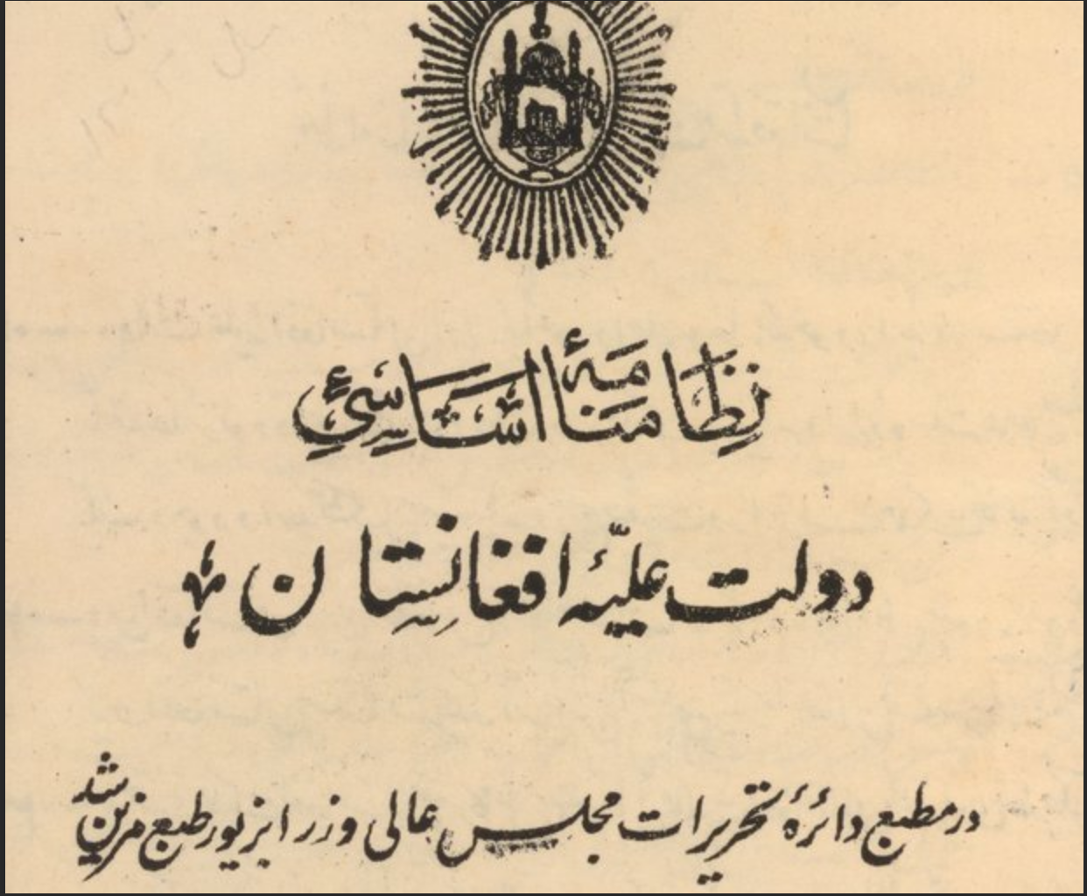
Hybrid Theocratic Constitutional Orders
Afghanistan

Slide 13
Afghanistan Constitutional Structure
Context
Like that of Germany and Japan after 1945, this constitutional order was guided by the U.S. and its allies after the overthrow of the Taliban government
Taliban brand of theocracy was viewed as constitutionally illegitimate and could produce outside intervention after provocation (Sept 11 2001 NYC attack.

Slide 14
Foundation
The Afghani Constitution also provides an example of a constitutional settlement that looks to principles of theocratic constitutionalism for its legitimacy.
Its preamble suggests a certain internationalism in the values underlying the constitutional project.
Observing the United Nations Charter and respecting the Universal Declaration of Human Rights, For consolidating national unity, safeguarding independence, national sovereignty, and territorial integrity of the country, For establishing a government based on people's will and democracy, For creation of a civil society free of oppression, atrocity, discrimination, and violence and based on the rule of law, social justice, protection of human rights, and dignity, and ensuring the fundamental rights and freedoms of the people, For strengthening of political, social, economic, and defensive institutions of the country, For ensuring a prosperous life, and sound environment for all those residing in this land.
Yet, the lens through which such substantive protections are grounded in religious universalism
The constitution is instituted "In the name of God, the Merciful, the Compassionate." Id.("We the people of Afghanistan: With firm faith in God Almighty and relying on His lawful mercy, and Believing in the Sacred religion of Islam,.").

Slide 15
Constructing the Polity and Political Rights
T he Afghani Constitution builds strong protections against derogation from its core substantive provisions.
"The provisions of adherence to the fundamentals of the sacred religion of Islam andthe regime of the Islamic Republic cannot be amended.”’
Islam does not so much reject a fundamental rights value system as incorporate it within the normative framework of Islam.
Despite suggestions to the contrary, it inverts the hierarchy of values-religion is not interpreted as an object of fundamental rights; instead, fundamental rights are interpreted as an object of Islam.
"In Afghanistan no law can be contrary to the beliefs and provisions of the sacred religion of Islam.”
For those from different religious traditions, there is conformity to an Islamic worldview within which a certain measure of toleration is possible.
This, of course, parallels the limits to toleration within conventional transnational constitutional systems of beliefs and practices, which might be deemed threatening to the politico-legal order.
"Followers of other religions are free to exercise their faith and perform their religious rites within the limits of the provisions of law.”’
But threats to the religious basis of the legal order-including efforts to pry Muslims from their faith, are less tolerated.
Legitimacy through Islam also shapes the extent to which internal political action is treated as legiti-mate. Thus, for example, the right to form political parties is guaranteed, as long as the "program and charter of the party are not contrary to the principles of sacred religion of Islam ...

Slide 16
Constitutional Review Through the Lens of Religion
The Afghani Constitution also incorporates theocratic elements within its constitutionalist structure of the judiciary.
The criteria for the selection of judges are meant to emphasize the Islamic character of the legal basis of the state.
ch. 7, art. 3 (specifying the qualifications of Afghani Supreme Court justices as requiring "a higher education in law or in Islamic jurisprudence"). Such judges "swear in the name of God Almighty to support justice and righteousness in accord with the provisions of the sacred religion of Islam and the provisions of this Constitution and other laws of Afghanistan." Id. ch. 7, art. 4.
The Constitution enforces a rule of law regime on the judiciary, requiring judicial re-view to be in "compliance with the Constitution of laws, legislative decrees, international treaties, and international conventions, and interpret them, in accordance with the law,"' but in critical respects that review function is grounded in principles of Islamic law, which must be applied directly under certain circumstances, even the context of constitutional review.
"When there is no provision in the Constitution or other laws regarding ruling on an issue, the courts' decisions shall be within the limits of this Constitution in accord with the Hanafi juris-prudence..." Id. ch. 7, art. 15.
Special provision is made for the application of Shi'a law under certain circumstances. Id. ch. 7, art. 16.
"Ultimately, whenever the norms of international law are taken to contradict Islamic principles, the Supreme Court may consider them unconstitutional. Such an approach reflects the view of Muslim scholars that there is no other source of law, whether domestic or international, than the divine will of God."
Islam thus serves as the meta-constitutional principles through which the constitution is interpreted and applied.

Slide 17
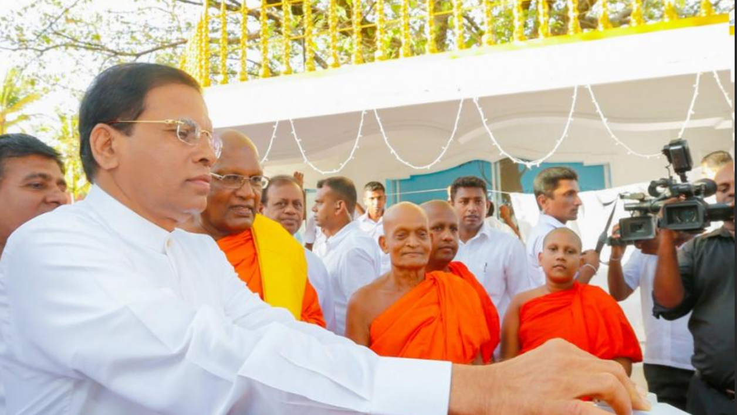
Soft Buddhist Theocratic Hybrid: Sri Lanka

Slide 18
The Provisions on Buddhism
Chapter II - Buddhism Buddhism
9. The Republic of Sri Lanka shall give to Buddhism the foremost place and accordingly it shall be the duty of the State to protect and foster the Buddha Sasana, while assuring to all religions the rights granted by Articles 10 and 14(1)(e).
Freedom of thought, conscience and religion
10. Every person is entitled to freedom of thought, conscience and religion, including the freedom to have or to adopt a religion or belief of his choice.
14. (1) Every citizen is entitled to
e) the freedom, either by himself or in association with others, and either in public or in private, to manifest his religion or belief in worship, observance, practice or teaching;

Slide 19
Summing Up
Theocratic constitutionalism covers a growing number of constitutional orders that seek to combine the mechanics and sensibilities of constitutionalism with the substantive framework of religious principle
It seeks to adhere to the basic principles of constitutionalism EXC EPT that for a liberal democratic order (and all it entails), it would substitute the rules and principles of a single religious system
The result is a quite different mix of rights, duties and approaches ot the relationship between people and the state
And it posits a large role for religious intermediaries—a priesthood of some sort
But at the same time it offers the protections of rule of law and an accountable basis for judging the discretionary decision making of government, as well as the validity of legislative initiatives
The result is unacceptable under the ordering principles of 3rd generation constitutionalism
But it presents the possibility of legitimacy around a different set of communal principles.

Slide 20
Thanks!

