Slide 1
Comparative Constitutionalism 比较立宪主义 East China University of Political Science and Law Shanghai, China November-December 2019
Lecture 5: Second Generation Constitutions
Larry Catá Backer
W. Richard and Mary Eshelman Faculty Scholar Professor of Law and International Affairs Pennsylvania State University | 239 Lewis Katz Building, University Park, PA 16802 1.814.863.3640 (direct) || lcb11@psu.edu

Slide 2
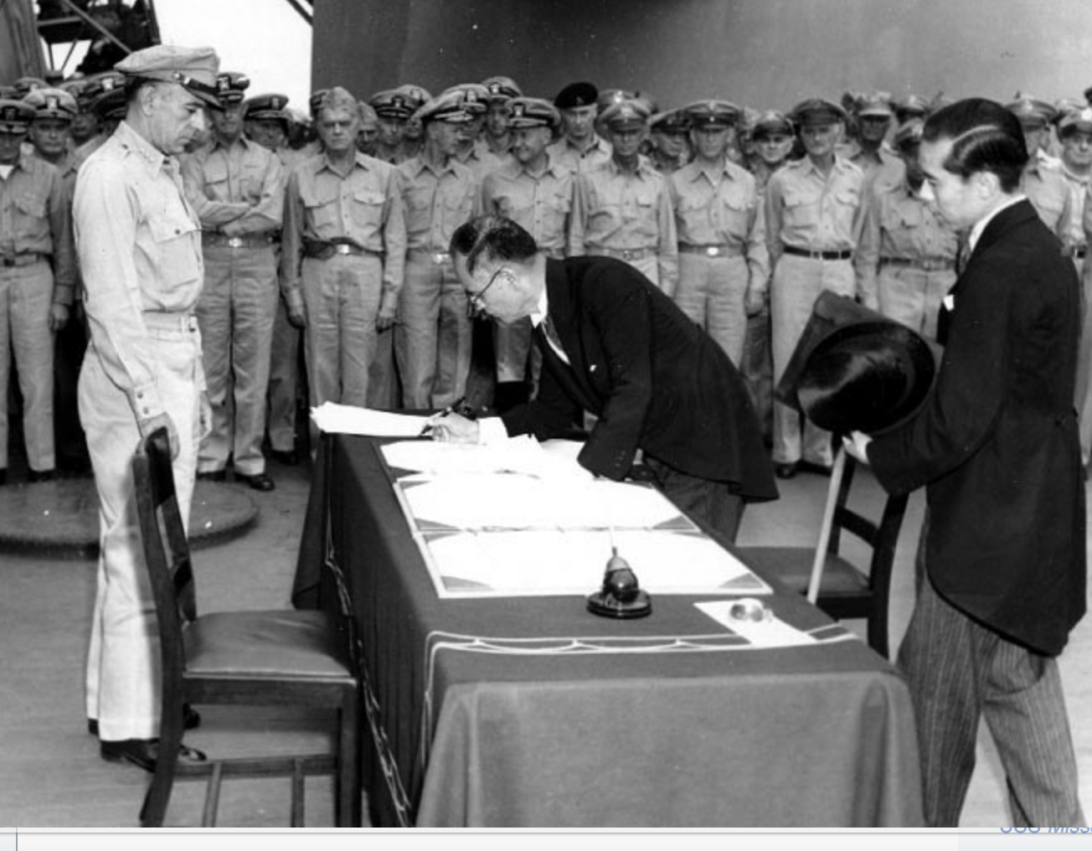
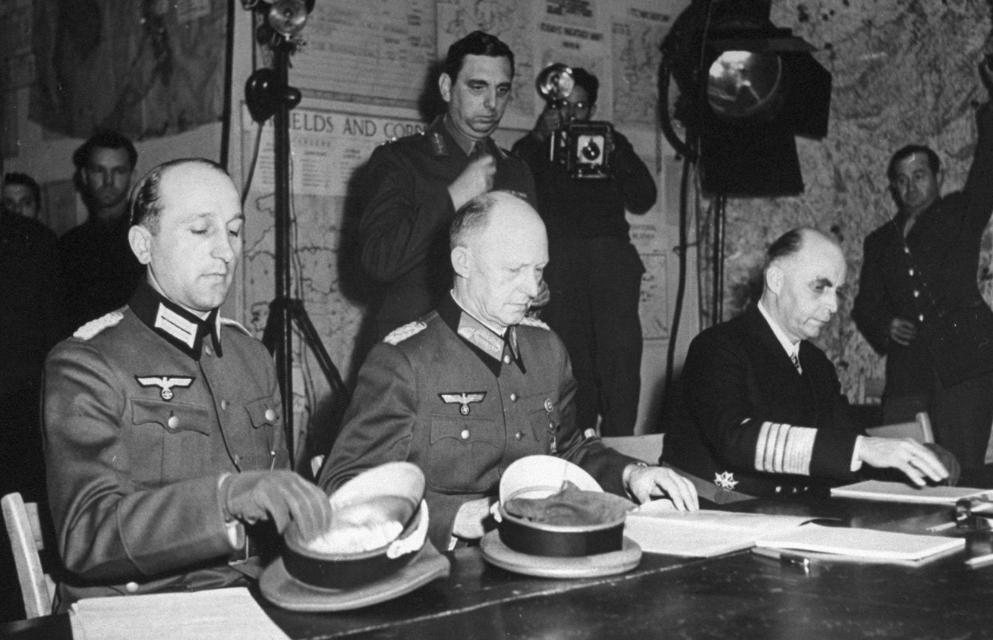
Class 5
12月2日（周一）
December 2, Monday
第1—4节8:30-11:45
2nd Generation Constitutions

Slide 3
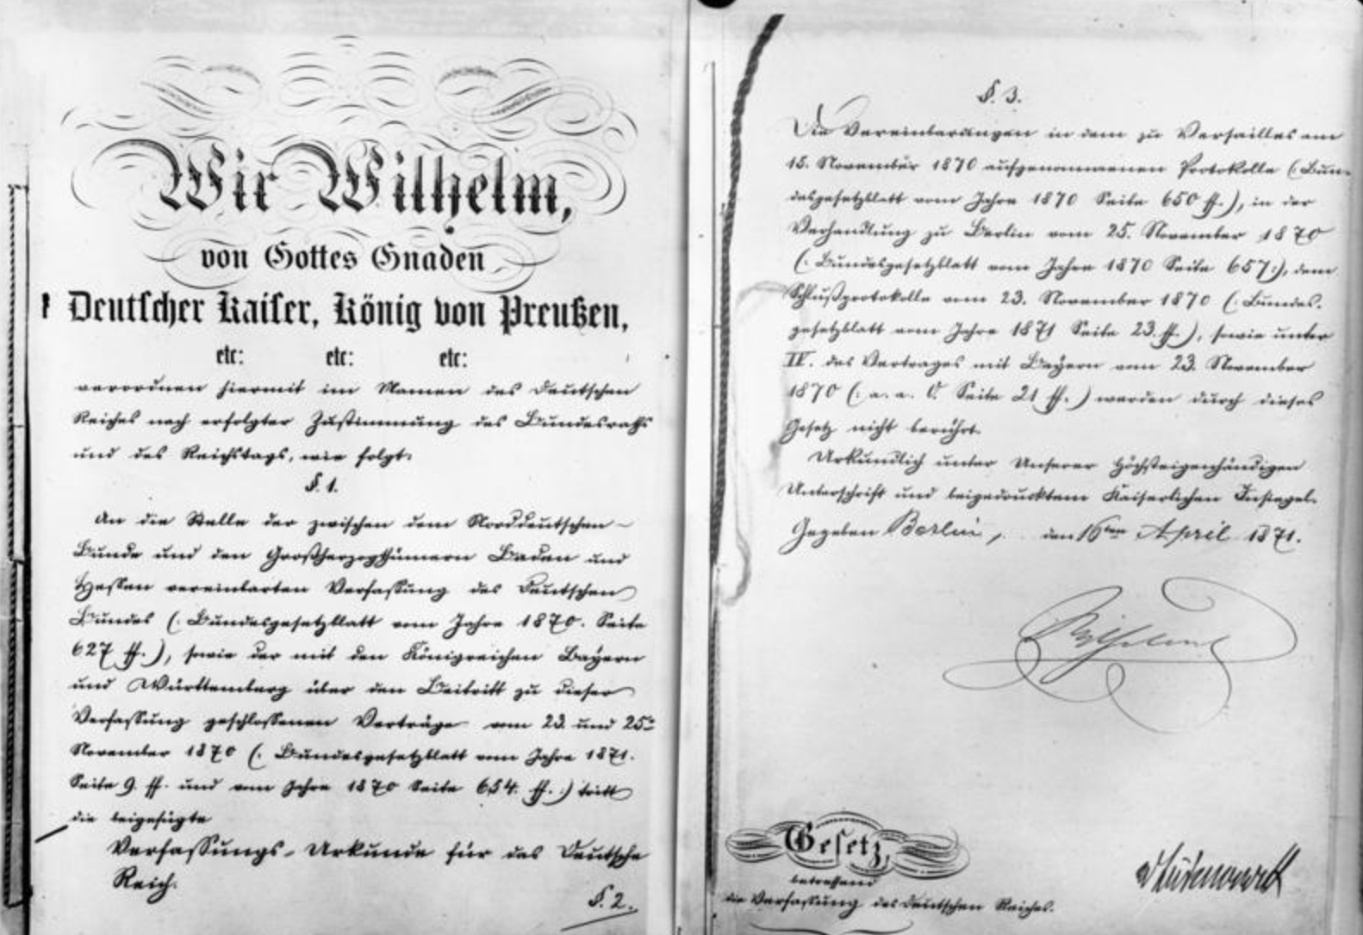
What We Discuss Today/我们今天讨论的内容
Second generation constitutions—
the rise of substantive constitutional ideology and constitutional internationalism
Germany; Japan.
第二代宪法：
实质性宪法意识形态和宪法国际主义的兴起
（德国；日本）。

Slide 4
Baselines
In the last lecture we considered the original forms of modern constitutions
Distinguished them from ancient and medieval
Represent a break from prior approaches to the organization of political power
They did not take the forms of functions of government as either given (and unalterable) or organic and therefore embedded in cultural practices
The development of architectures of political authority through a collective, popular act of will.
1st Generation constitutions evidence the revolutionary power of leading social forces in moving form an old to a new era.
Short written compacts now tied to the language and ideology of law
Moving from a social to a contractual model
From politics to law as framing element
Rules rather than discretion
Institutions rather than personalities
Dispute resolution through tribunals based on document (text/objectives)
Provided the cultural basis for all that followed
Consent
Certainty
Self-Referencing nature of document (do not look outside the document for terms)

Slide 5
Baselines
Each reflected their different Origins
With Different Consequences:
U.S.
External Revolution: Producing 13 new sovereign states seeking some sort of union distinct from origin state
Preserving objective: to protect ancient liberties from modernization
Create something new: Constitution a means to produce a union of independent states with common origins and common objectives
France
Internal revolution: to overthrow an ancient system of government and substitute another
Advancing objective: Substitute a modern for an ancient regime
Create something new: New set of social relations as a basis for constituting political authority of the state

Slide 6
Another Stream of Constitutional Development in 19th Century
Imperial Constitutions
Development of a model of constitutionalism that rejected the liberal democratic model of the U.S. and France
But did not reject the principles of federalism in the U.S., or the principle of strong central authority in France.
German Imperial Constitution (1871) and Federalism
How to construct a single empire from out of many sovereign states, with one predominant?
Italy used the same model to forge the Kingdom of Italy in the late 1800s
Japanese Imperial Constitution (1889) and Strong Central Authority
How do you develop a relation where rights are the expression of the obligation of the central government toward its subjects
Not a rights based state, but one based on the duty of the ruling collective toward the masses.

Slide 7
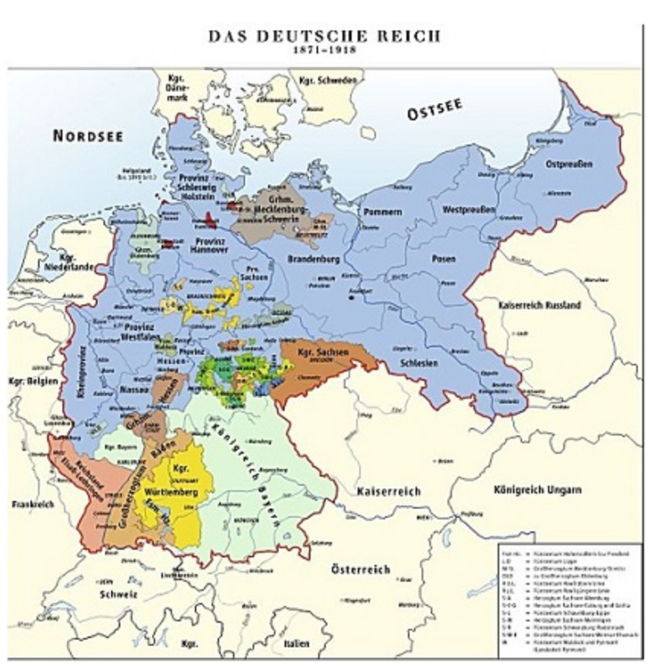
German Imperial Constitution—2nd Reich
Political foundations for the creation of the Reich: Compromise
Between the king of Prussia and the rulers of the other German states
Who agreed to accept him as the Kaiser (emperor) of a united Germany, provided they could continue to rule their states largely as they had in the past.
Between segments of German society
Accept a unified Germany based on a constitution that combined a powerful authoritarian monarchy with a weak representative body, the Reichstag
Elected by universal male suffrage and secret ballot.
Kaiser controlled the Imperial executive.

Slide 8
Germany An Imperial Form of Federation With a Strong Executive
Kaiser
Ministerial government: full control of foreign policy and military
Kaiser selected the Chancellor as head of government, serving at the Kaiser’s pleasure
Government’s actions not subject to the Reichstag approval.
Parliament
The Bundesrat (Federal Council) represented Germany’s princes.
One-third of its seats were held by Prussians.
Upper house; could only on legislation drawn up by the government before it became law.
The Reichstag
No power to draft legislation
Law Making
Required approval of Reichstag and Bundesrat
Government proposals
Political power split between Reich and States
Reich legislation superior (Art. 2)
Protection of rights and privileges of citizenship throughout the Empire (Art. 3)
Delegation of specific legislative powers (Art,. 4).
Art4(13) “whole domain of civil law, criminal law; likewise legal procedure.”

Slide 9
German Federalism (Art. 4)
The following matters shall be under the supervision of the Empire and its Legislature:-
Regulations with respect to the freedom of migration; matters of domicile and settlement; citizenship; passports; surveillance of foreigners; trade and industry, including insurance; so far as these matters are not already provided for by article 3 of this Constitution, in Bavaria, however, matters relating to domicile and settlement are herefrom excluded; and likewise matters relating to colonization and emigration to foreign countries;
Legislation concerning customs, duties, and commerce, and such imports as are to be applied to the uses of the Empire.
Regulation of weights and measures, and of the coinage, together with the emission of funded and unfunded paper money.
Banking regulations in general.
Patents for inventions.
The protection of literary property.
The organisation of a general system of protection for German trade in foreign countries; of German navigation, and of the German flag on the high seas; likewise the organisation of a general consular representation of the Empire.
Railway matters (subject in Bavaria to the provisions of Article 46) and the construction of means of communication by land and water for the purposes of home defense, and of general commerce.
Rafting and navigation upon those waters which are common to several States, and the condition of such waters, as likewise river and other water dues.
Postal and telegraph affairs; but in Bavaria and Württemberg these shall be subject to the provisions of Article 52.
Regulations concerning the execution of judicial sentences in civil matters, in the fulfillment of requisition of general.
The authentication of public documents.
General legislation with respect to the whole domain of civil law, criminal law; likewise legal procedure.
The Imperial Army and Navy.
The surveillance of the medical and veterinary professions.
The Press, trades' unions, etc.

Slide 10
From Empire to Republic to National Socialism 1918-1945
Collapse
The collapse of the Imperial government in 1918 did not signal the end of the Reich system of constitutionalism
Weimer Constitution modified the Imperial constitution but did not reject many of its core principles
Changes
Liberal democratic model; but liberal democracy is not made the unalterable foundation of political culture
Stronger Parliament
Office of Chancellor still critical
Underlying norms and legal systems substantially unchanged
Innovations
Right of constitutional change remains unlimited but now vested in the state poltical organs
Listing of “liberties” protected now in the body of the constitution
Normative “modernization along then contemporary US lines

Slide 11
Rights From Empire to Weimar to Nazi System
Nazi Constitutionalism
The Weimar constitution officially remained in effect throughout the Nazi era from 1933 to 1945.
The Nazi regime was established in a technically established in accordance with law (broadly but plausibly interpreted)
That evidenced both the flexibility of the 1st generation model and its dangers.
What changed was the normative political order that was operated through the Rechtstaat principles of the Constitution
E.g., race laws technically produced a change in the meaning of terms (excluding “Jews” from its definitions and protections for example( without changing the words themselves.
Suggests the elasticity of hermeneutics in a principles based constitutional document with respect to which there are no outside political, cultural, r societal restraints
And indeed, at its limit constitutional sensibilities were designed to give full effect to the will of the people (expressed through a majority of sovereign holders) wherever that will took the political culture.
In the case of the Nazi leadership period, it moved the state towards military aggression and a race based framework for social ordering
The Individual
Equality before the law
Gender equality
Protection of home
Rights inviolable except as provided by law
Community Life
Peaceful assembly
Private associations
Everyone eligible for public office
Language rights of minorities guaranteed
Religious Practice
Free practice of religion
These survived into Post 1945 Constitution
Education
Joint control; free through 18 years of age
Public Welfare
Economic justice provisions
Labor rights protected
Intellectual property

Slide 12
Japanese Imperial Constitution
Example of Emancipating the Mind and Reform and Opening Up in 19th Century
Itō Hirobumi chaired a government bureau to research various forms of constitutional government
1882, overseas mission to study “civilized state” constitutions.
US model rejected as too liberal
Latin models (Spain, France) rejected as unstable and promoting tendency toward despotism.
German Imperial model with string Imperial machinery of most interest; liked Reichstag structure and the organization of the Prussina monarchy.
UK Westminster system rejected as unwieldy (too socially embedded in Common law culture) and rejected Parliamentary supremacy principle.
For sozialstaat notions substituted kokutai or “national polity” principle for those of Christianity and European ethics. Also basis of Imperial authority as sourced in the notion of divine descent and the unbroken line of emperors, and the unique relationship between subject and sovereign.
Article 4. The Emperor is the head of the Empire, combining in Himself the rights of sovereignty, and exercises them, according to the provisions of the present Constitution.

Slide 13
Japan rights and duties of Subjects (Chp. II)
Article 18. The conditions necessary for being a Japanese subject shall be determined by law.
Article 19. Japanese subjects may, according to qualifications determined in laws or ordinances, be appointed to civil or military offices equally, and many fill any other public offices.
Article 20. Japanese subjects are amenable to service in the Army or Navy, according to the provisions of law.
Article 21. Japanese subjects are amenable to the duty of paying taxes, according to the provisions of law.
Article 22. Japanese subjects shall have the liberty of abode and of changing the same within the limits of the law.
Article 23. No Japanese subject shall be arrested, detained, tried or punished, unless according to law.
Article 24. No Japanese subject shall be deprived of his right of being tried by the judges determined by law.
Article 25. Except in the cases provided for in the law, the house of no Japanese subject shall be entered or searched without his consent.
Article 26. Except in the cases mentioned in the law, the secrecy of the letters of every Japanese subject shall remain inviolate.
Article 27. The right of property of every Japanese subject shall remain inviolate. (2) Measures necessary to be taken for the public benefit shall be any provided for by law.
Article 28. Japanese subjects shall, within limits not prejudicial to peace and order, and not antagonistic to their duties as subjects, enjoy freedom of religious belief.
Article 29. Japanese subjects shall, within the limits of law, enjoy the liberty of speech, writing, publication, public meetings and associations.
Article 30. Japanese subjects may present petitions, by observing the proper forms of respect, and by complying with the rules specially provided for the same.
Article 31. The provisions contained in the present Chapter shall not affect the exercise of the powers appertaining to the Emperor, in times of war or in cases of a national emergency.

Slide 14
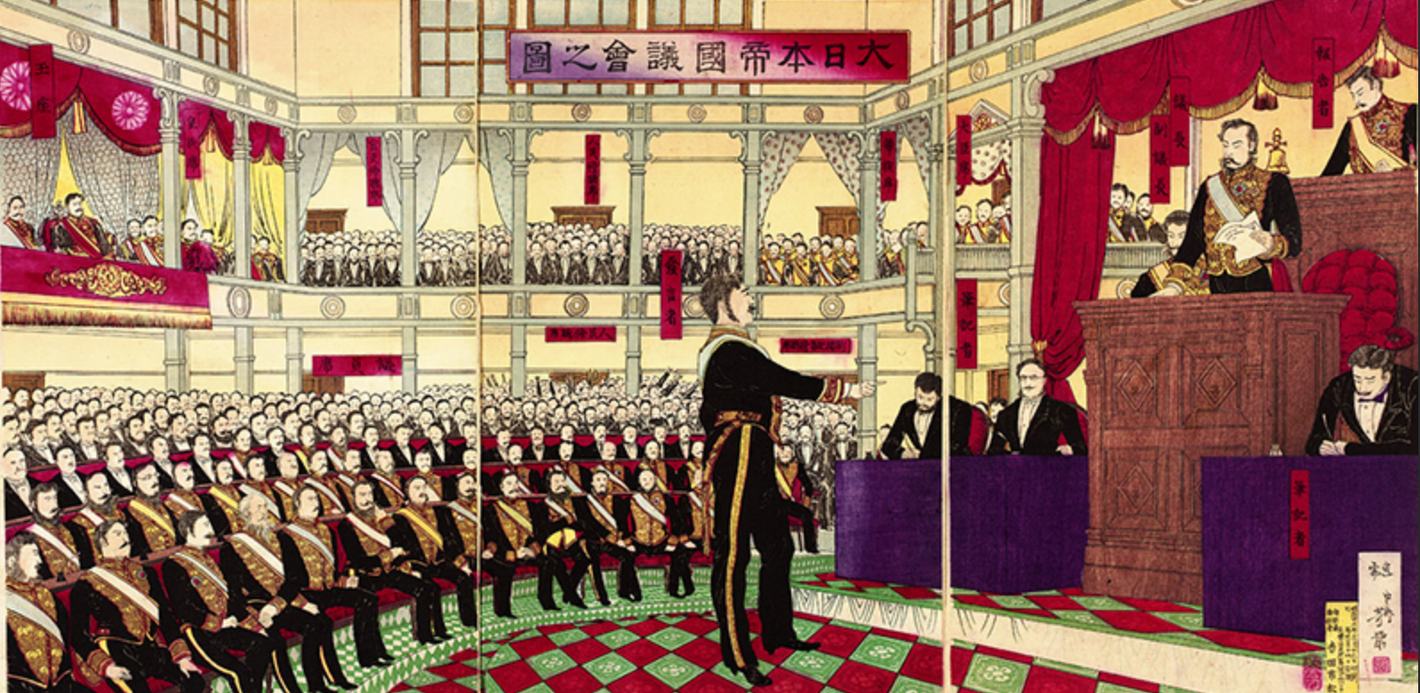
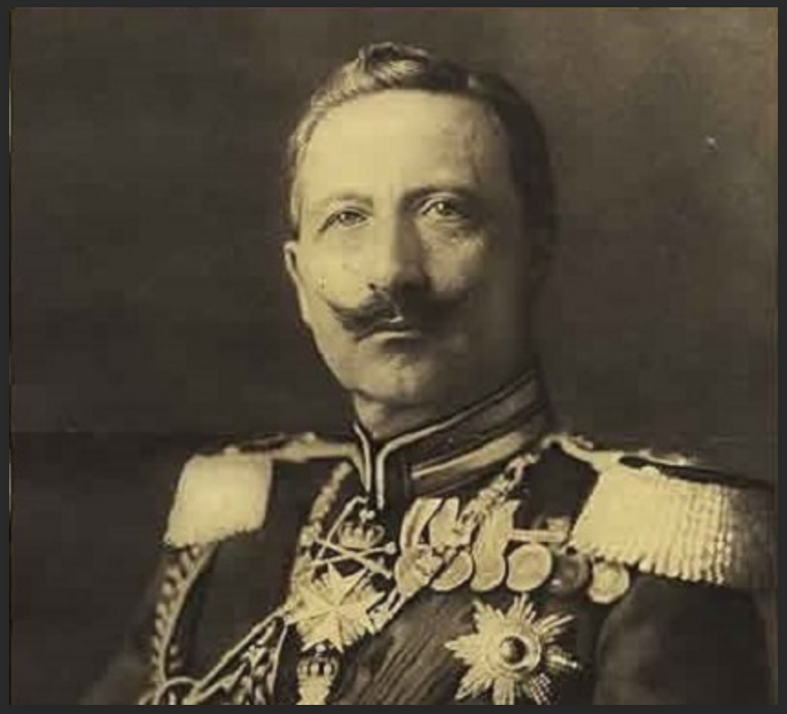
Imperial Constitutions: Points of Convergence/Divergence
Convergence
Strong executive
Limited power of legislature
Sovereignty flowed from the Emperor (Japan) and the federated rulers (Germany)
Constitutions created merely to organize the implementation of political authority rather than to re-examine it.
Rejected liberal democratic values; offer an alternative basis for development of governance order.
Strong fear of populism and popular control of machinery of state
Divergence
Centralized (Japan) vs. decentralized (Germany)
Specification of rights and obligations
Source of rights (from the sovereign authority of the person of the Imperial Family (note not the monarch) or from the states that make up the Empire under the leadership of the principal state (Prussia).

Slide 15
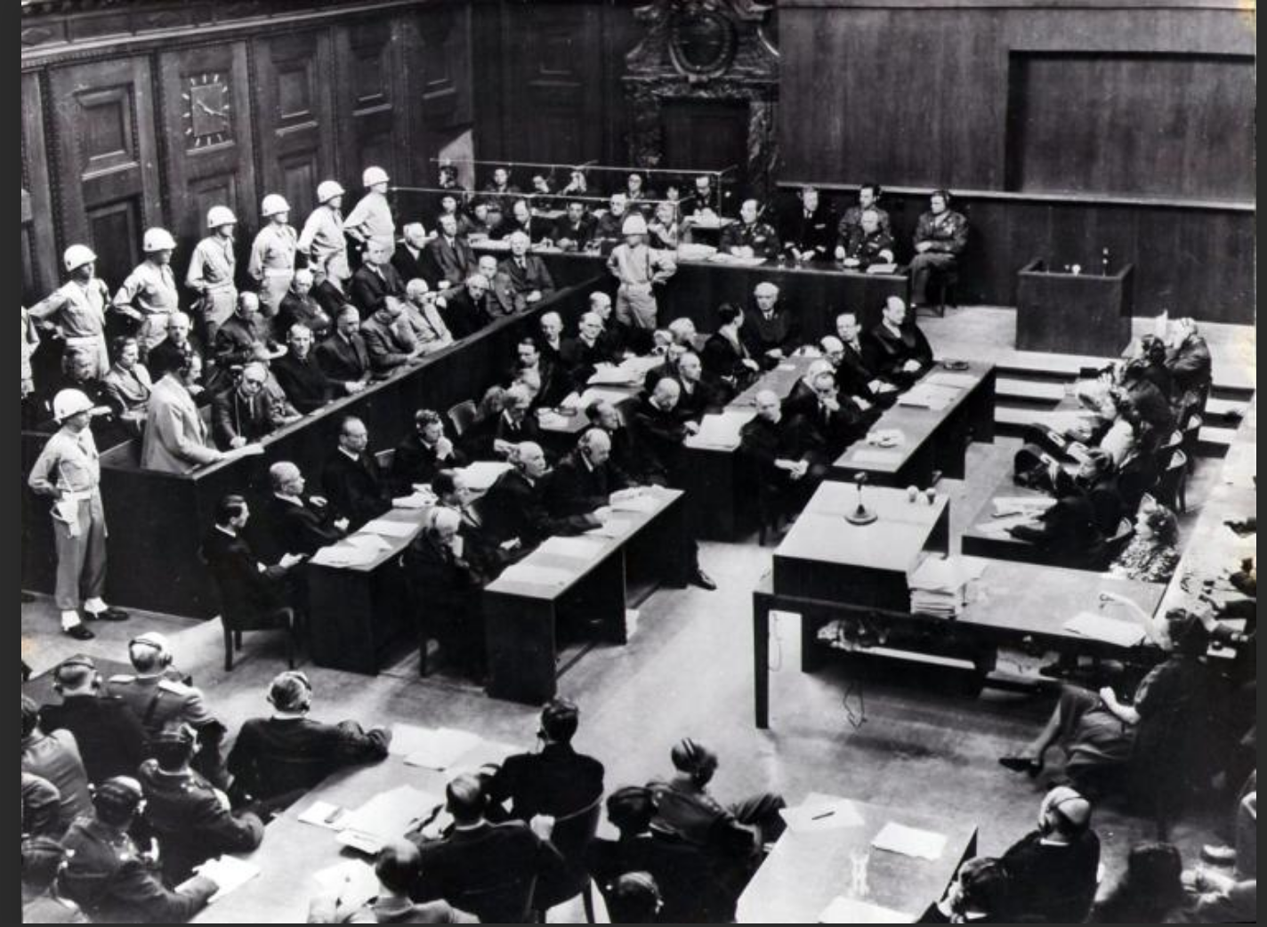
From Imperial to Post-1945 Constitutions

Slide 16
From Imperial Constitution to a Crisis of Constitution
The imperial of Japan survived through 1946
Defeat in WWII and the forced transformation of its political order by outside forces
The imperial constitution of Germany survived through 1918; and in modified frm through 1945
Defeat in WWI band forced transformation of political order through internal revolution.
Weimar Constitution served as a transition another forced transformation this time by outside forces in wake of defeat of Germany in WWII.
Both applied core principles of 1st Generation constitutions producing effects which after 1945 were deemed to be unacceptable within the community of nations
Principle that national constitutions were substantially self-referencing without substantial connection outside.
Principle that there were no limits on the normative principles a people could impose on themselves through a constitution .
The effort to impose an international (and external) framework for constraining national constitutional power marked the transition from 1st to 2nd generation constitution
German mass eugenics based on racial/religious criteria
Japanese militarism and no respect for sovereign dignity of other states
All government action under law (rechtstaat)

Slide 17
Rationale (JAPAN)
Problem: How to deal with Japanese militarism and German ethno-religious savagery
Conscious project of Allied Powers (E.g. Potsdam Declaration--Japan):
the elimination "for all time of the authority and influence of those who have deceived and misled the people of Japan into embarking on world conquest";
"The Japanese Government shall remove all obstacles to the revival and strengthening of democratic tendencies among the Japanese people. Freedom of speech, of religion, and of thought, as well as respect for the fundamental human rights shall be established."
"Japan shall be permitted to maintain such industries as will sustain her economy and permit the exaction of just reparations in kind, but not those which would enable her to rearm for war. . . . Eventual Japanese participation in world trade relations shall be permitted."
"The occupying forces of the Allies shall be withdrawn from Japan as soon as these objectives have been accomplished and there has been established, in accordance with the freely expressed will of the Japanese people, a peacefully inclined and responsible government.”
Disarming of Japanese military

Slide 18
Rationale (Germany)
Yalta Joint Statement (Roosevelt, Churchill, Stalin—Feb. 1945):
It is our inflexible purpose to destroy German militarism and Nazism and to ensure that Germany will never again be able to disturb the peace of the world. We are determined to disarm and disband all German armed forces; break up for all time the German General Staff that has repeatedly contrived the resurgence of German militarism; remove or destroy all German military equipment; eliminate or control all German industry that could be used for military production; bring all war criminals to just and swift punishment and exact reparation in kind for the destruction wrought by the Germans; wipe out the Nazi Party, Nazi laws, organizations and institutions, remove all Nazi and militarist influences from public office and from the cultural and economic life of the German people; and take in harmony such other measures in Germany as may be necessary to the future peace and safety of the world. It is not our purpose to destroy the people of Germany, but only when Nazism and militarism have been extirpated will there be hope for a decent life for Germans, and a place for them in the comity of Nations.

Slide 19
From Rationale to Constitutionalism
Issue
How to create structural impediments to the causes of war
Suspicion was that the source was in the political cultures of those states
Must reform culture
Solution
Develop legal structures and internationalism for a new era of political governance of states
Develop overall direction of political culture under guidance of leading global forces (the Allies).
Law
Use rule of law and law sensibilities Rechtstaat (its process aspects—fairness, predictability, transparency)
to create a binding system of Sozialstaat (substantive norms) constrants
Internationalism
Built around the new UN system; RECIPROCAL RELATIONSHIP
Solves problem of the source of sozialstaat norms as constraints
The Community of states would be the conscience of the world and the source of its core values
Especially where exercise of national choice affects the world around them

Slide 20
Result: Constitutionalism or Constitutional Internationalism
Constitutionalism
In the sense that it creates baseline expectations for constitutional orders
And then rates them based on conformity to that baseline
Basis for measuring legitimacy
Legitimacy as a trigger for intervention
Constitutional Internationalism
Focus of the “New Era” post 1945 international order--to supply a normative basis for constraining constitutional practice
Source is consensus among community of nations
Limit through international law the exercise of national preferences
De-Center other sources of constitutional compulsion (Natural law, religion, etc.)
Initial Core: (1) Militarism and aggression; (2) human rights as a response to and rejection of Nazi (race-religion-governance) policies

Slide 21
The Theory of 2nd Generation Constitutions Applied—German Basic Law and Japanese 1946 Constitution

Slide 22
German Basic Law

Slide 23
German Basic Law (1949)— De-Nazification; De-Prussianification
Preamble:
“Conscious of their responsibility before God and man, inspired by the determination to promote world peace as an equal partner in a United Europe, the German people, in the exercise of their constituent power, have adopted this Basic Law.
The Basic Law is constructed as the constitutional expression of a new legal order grounded in international constraints and anchored in a baseline of human rights principles against which the state and its government is both organized and operates.
Developed in parallel to the construction of the first great human rights projects of the new UN System (the Universal Declaration of Human Rights).
Germany and Japan, in a sense, the first test cases for this New Era ordering of state construction.
We consider the key provisions that characterize this New Era model fo constitutions:

Slide 24
Human Rights at the Center
Article 1[Human dignity – Human rights – Legally binding force of basic rights]
(1) Human dignity shall be inviolable. To respect and protect it shall be the duty of all state authority.
(2) The German people therefore acknowledge inviolable and inalienable human rights as the basis of every community, of peace and of justice in the world.
(3) The following basic rights shall bind the legislature, the executive and the judiciary as directly applicable law.
Additional Rights specified Articles 2-19.
Article 18 [Forfeiture of basic rights]
Whoever abuses the freedom of expression, in particular the freedom of the press (paragraph (1) of Article 5), the freedom of teaching (paragraph (3) of Article 5), the freedom of assembly (Article 8), the freedom of association (Article 9), the privacy of correspondence, posts and telecommunications (Article 10), the rights of property (Article 14) or the right of asylum (Article 16a) in order to combat the free democratic basic order shall forfeit these basic rights. This forfeiture and its extent shall be declared by the Federal Constitutional Court.

Slide 25
The Right of Resistance and Super-Constitutonal Provisions
Article 20 [Constitutional principles – Right of resistance]
(1) The Federal Republic of Germany is a democratic and social federal state.
(2) All state authority is derived from the people. It shall be exercised by the people through elections and other votes and through specific legislative, executive and judicial bodies.
(3) The legislature shall be bound by the constitutional order, the executive and the judiciary by law and justice.
(4) All Germans shall have the right to resist any person seeking to abolish this constitutional order if no other remedy is available.
* * *
Article 79 [Amendment of the Basic Law]
(1) This Basic Law may be amended only by a law expressly amending or supplementing its text. In the case of an international treaty regarding a peace settlement, the preparation of a peace settlement or the phasing out of an occupation regime or designed to promote the defence of the Federal Republic, it shall be sufficient, for the purpose of making clear that the provisions of this Basic Law do not preclude the conclusion and entry into force of the treaty, to add language to the Basic Law that merely makes this clarification.
(2) Any such law shall be carried by two thirds of the Members of the Bundestag and two thirds of the votes of the Bundesrat.
(3) Amendments to this Basic Law affecting the division of the Federation into Länder, their participation in principle in the legislative process, or the principles laid down in Articles 1 and 20 shall be inadmissible.

Slide 26
Internatonalism
Article 24 [Transfer of sovereign powers – System of collective security]
(1) The Federation may, by a law, transfer sovereign powers to international organisations.
Article 25 [Primacy of international law]
The general rules of international law shall be an integral part of federal law. They shall take precedence over the laws and directly create rights and duties for the inhabitants of the federal territory.

Slide 27
Protection of the Federal Constitutional Court and the Democratic Order
Article 21 [Political parties]
(1) Political parties shall participate in the formation of the political will of the people. They may be freely established. Their internal organisation must conform to democratic principles. They must publicly account for their assets and for the sources and use of their funds.
(2) Parties that, by reason of their aims or the behaviour of their adherents, seek to undermine or abolish the free democratic basic order or to endanger the existence of the Federal Republic of Germany shall be unconstitutional.
(3) Parties that, by reason of their aims or the behaviour of their adherents, are oriented towards an undermining or abolition of the free democratic basic order or an endangerment of the existence of the Federal Republic of Germany shall be excluded from state financing. If such exclusion is determined, any favourable fiscal treatment of these parties and of payments made to those parties shall cease.
(4) The Federal Constitutional Court shall rule on the question of unconstitutionality within the meaning of paragraph (2) of this Article and on exclusion from state financing within the meaning of paragraph (3).
* * *
Article 115g [Federal Constitutional Court]
Neither the constitutional status nor the performance of the constitutional functions of the Federal Constitutional Court or its judges may be impaired. The law governing the Federal Constitutional Court may be amended by a law enacted by the Joint Committee only insofar as the Federal Constitutional Court agrees is necessary to ensure that it can continue to perform its functions. Pending the enactment of such a law, the Federal Constitutional Court may take such measures as are necessary to this end. Determinations by the Federal Constitutional Court pursuant to the second and third sentences of this Article shall be made by a majority of the judges present.
Fundamental authority Article 93.

Slide 28
Japan Constitution of 1946

Slide 29
Japan Constitution—De-Militarization and Re-Entry into Family of Civilized States
Preamble
We, the Japanese people, acting through our duly elected representatives in the National Diet, determined that we shall secure for ourselves and our posterity the fruits of peaceful cooperation with all nations and the blessings of liberty throughout this land, and resolved that never again shall we be visited with the horrors of war through the action of government, do proclaim that sovereign power resides with the people and do firmly establish this Constitution. Government is a sacred trust of the people, the authority for which is derived from the people, the powers of which are exercised by the representatives of the people, and the benefits of which are enjoyed by the people. This is a universal principle of mankind upon which this Constitution is founded. We reject and revoke all constitutions, laws, ordinances, and rescripts in conflict herewith.
We, the Japanese people, desire peace for all time and are deeply conscious of the high ideals controlling human relationship, and we have determined to preserve our security and existence, trusting in the justice and faith of the peace- loving peoples of the world. We desire to occupy an honored place in an international society striving for the preservation of peace, and the banishment of tyranny and slavery, oppression and intolerance for all time from the earth. We recognize that all peoples of the world have the right to live in peace, free from fear and want.
We believe that no nation is responsible to itself alone, but that laws of political morality are universal; and that obedience to such laws is incumbent upon all nations who would sustain their own sovereignty and justify their sovereign relationship with other nations.
We, the Japanese people, pledge our national honor to accomplish these high ideals and purposes with all our resources.

Slide 30
And the Rest
Critical transformations
Chapter 1: The Emperor
Chapter 2: Renunciation of War
Continuity
Chapter 3 Rights and Duties of People
Modification to liberal democratic model
The structuring of government and popular political rights

Slide 31
The Emperor
Article 1
The Emperor shall be the symbol of the State and of the unity of the People, deriving his position from the will of the people with whom resides sovereign power.
Article 2
The Imperial Throne shall be dynastic and succeeded to in accordance with the Imperial House Law passed by the Diet.
Article 3
The advice and approval of the Cabinet shall be required for all acts of the Emperor in matters of state, and the Cabinet shall be responsible therefor.
Article 4
The Emperor shall perform only such acts in matters of state as are provided for in this Constitution and he shall not have powers related to government.
The Emperor may delegate the performance of his acts in matters of state as may be provided by law.

Slide 32
Renunciation of War
Article 9
Aspiring sincerely to an international peace based on justice and order, the Japanese people forever renounce war as a sovereign right of the nation and the threat or use of force as means of settling international disputes.
In order to accomplish the aim of the preceding paragraph, land, sea, and air forces, as well as other war potential, will never be maintained. The right of belligerency of the state will not be recognized.

Slide 33
Rights & Duties of the People
Article 10
The conditions necessary for being a Japanese national shall be determined by law.
Article 11
The people shall not be prevented from enjoying any of the fundamental human rights. These fundamental human rights guaranteed to the people by this Constitution shall be conferred upon the people of this and future generations as eternal and inviolate rights.
Article 12
The freedoms and rights guaranteed to the people by this Constitution shall be maintained by the constant endeavor of the people, who shall refrain from any abuse of these freedoms and rights and shall always be responsible for utilizing them for the public welfare.
And the rest:
Right to life, equality under the law, universal suffrage and political rights, right to petition government, slavery prohibited, freedom of opinion, religious liberty, separation of church and state, press freedom, academic freedom, right to assembly, matrimonial equality, right to health and to standard of living, right to health care, compulsory education, obligation to work, labor rights, property rights, obligation to pay taxes, dur process rights, process rights, access to courts, protection against unreasonable searches and seizures, fair trial, prohibition of cruel or unusual treatment, right to counsel, protection against self-incrimination, protection against false imprisonment, and against double jeopardy .
COMPARATIVE NOTE:
Human dignity central to German Basic Law; forms only a part of Japan Art. 24 relating to marriage .

Slide 34
Judicial Review and Authority in Constitutional Interpretation; Supremacy of Constitution; Internationalism
Article 81
The Supreme Court is the court of last resort with power to determine the constitutionality of any law, order, regulation or official act.
Article 97
The fundamental human rights by this Constitution guaranteed to the people of Japan are fruits of the age-old struggle of man to be free; they have survived the many exacting tests for durability and are conferred upon this and future generations in trust, to be held for all time inviolate.
Article 98
This Constitution shall be the supreme law of the nation and no law, ordinance, imperial rescript or other act of government, or part thereof, contrary to the provisions hereof, shall have legal force or validity.
The treaties concluded by Japan and established laws of nations shall be faithfully observed.
Article 99
The Emperor or the Regent as well as Ministers of State, members of the Diet, judges, and all other public officials have the obligation to respect and uphold this Constitution.

Slide 35
Summary
Movement from Imperial Constitutions to contemporary constitutions of Germany and Japan suggest a movement of constitutional design from the 18th to the 20th century
Issue of legitimacy becomes important
Supremacy of the political model of victorious Allies: liberal democracy and free markets in property protective legal environments
Parallel development of internationalism, anti-aggression principles, and human rights with rise of structures to constrain the freedom of states to design their constitutional orders they they like.
To speak to constitutions after 1945 is to acknowledge the role of the international system and the centrality of human rights (including political and economic rights) in constitutional discourse.
These are features missing from 18th century constitutions
We have seen how France has adopted some of these features
The United States has modified its constitutional order but gone its own way—promoting internationalism abroad but rejecting its direct application internally
The authoritarianism of the Imperial constitutions were rejected as illegitimate
Sets the stage for the clash between these internationalist constitutional orders and those of theocratic and Marxist Leninist States in the later part of the 20th century.
The central issue there returns us to the issue resolved in 1945: can one build a legitimate constitutional order that does not adhere to liberal democratic ordering principles for the allocation of political authority?

Slide 36
From Crisis of Constitution to the Emergence of Constitutionalism and the Supremacy of Liberal Democracy as Baseline ordering Principle
Finding a principled solution to the problem of 1st Generation constitution where imperial governments cause harm
A move asway from diversity of political models to one necessarily founded on principles of liberal democracy
Idea was that US-France model worked, and German-Japanese model did not
Effort to identify conceptual (and universal) basis for difference
A move asway from the idea of national popular sovereignty without limit
Idea was that the people themselves could violate fundamental principles of government by pursuing their own desires
Need to protect sovereign people form themselves
Effort to identify principled basis for such constraints
Post-War constitutions of Germany and Japan represent the first product of this new ideology of constitution
Principles of liberal democracy fundamental for legitimate public order
Multilateralism provides the “higher law” of constitutional principle which must be respected by all states in their constitutional orders
Center international law and norms as the barriers beyond which LEGITIMATE national constitutions could not go
Incorporate the notion of illegitimate constitution and an international law that permitted interference to remedy illegitimacy in constitutional ordering

Slide 37
Thanks!

