Slide 1
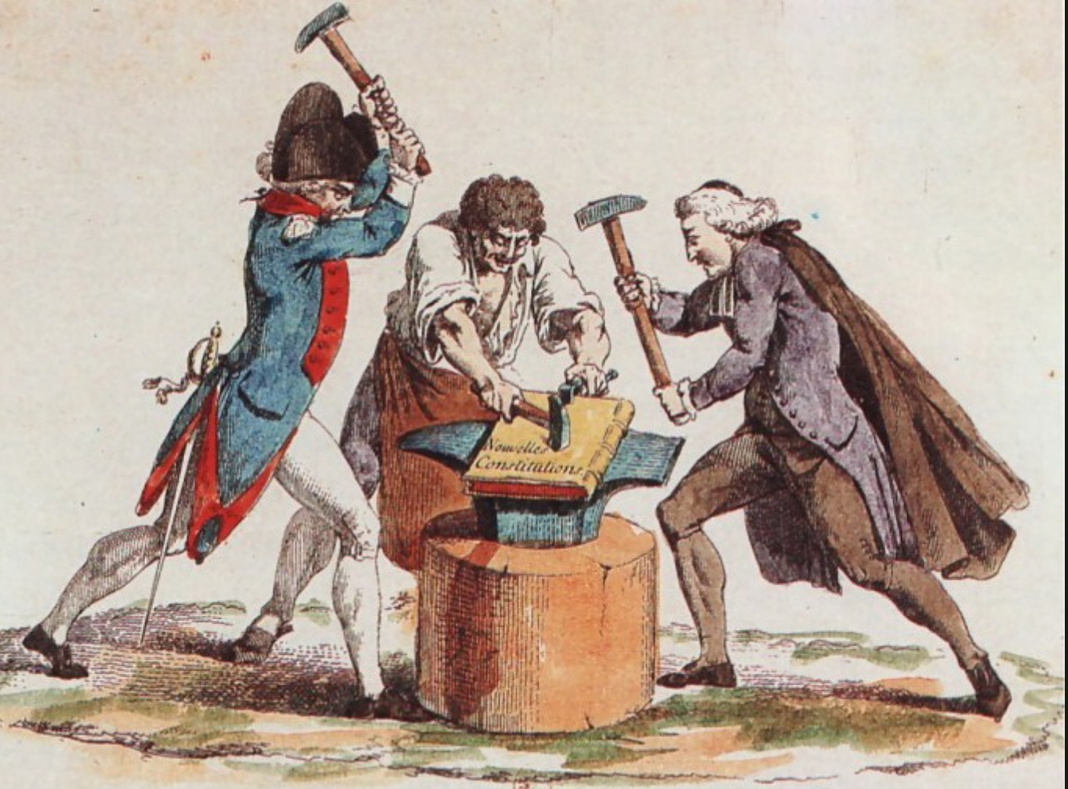


Comparative Constitutionalism
比较立宪主义
East China University of Political Science and Law
Shanghai, China November-December 2019
Lecture 4: First Generation Constitutions:
U.S. and France
Larry Catá Backer
W. Richard and Mary Eshelman Faculty Scholar Professor of Law and International Affairs
Pennsylvania State University | 239 Lewis Katz Building, University Park, PA 16802 1.814.863.3640 (direct) || lcb11@psu.edu

Slide 2
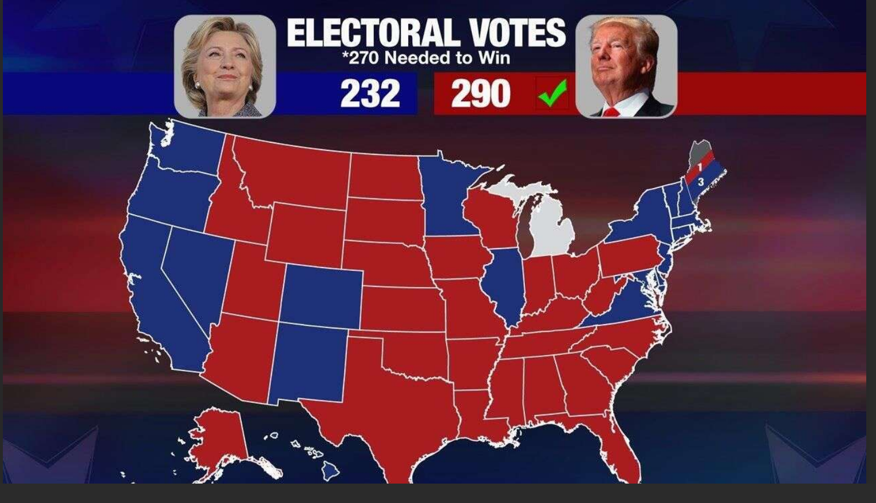


Class 4
11月15日（周五）
November 15, Friday
第1—4节 8:30-11:45
First Generation Constitutions

Slide 3
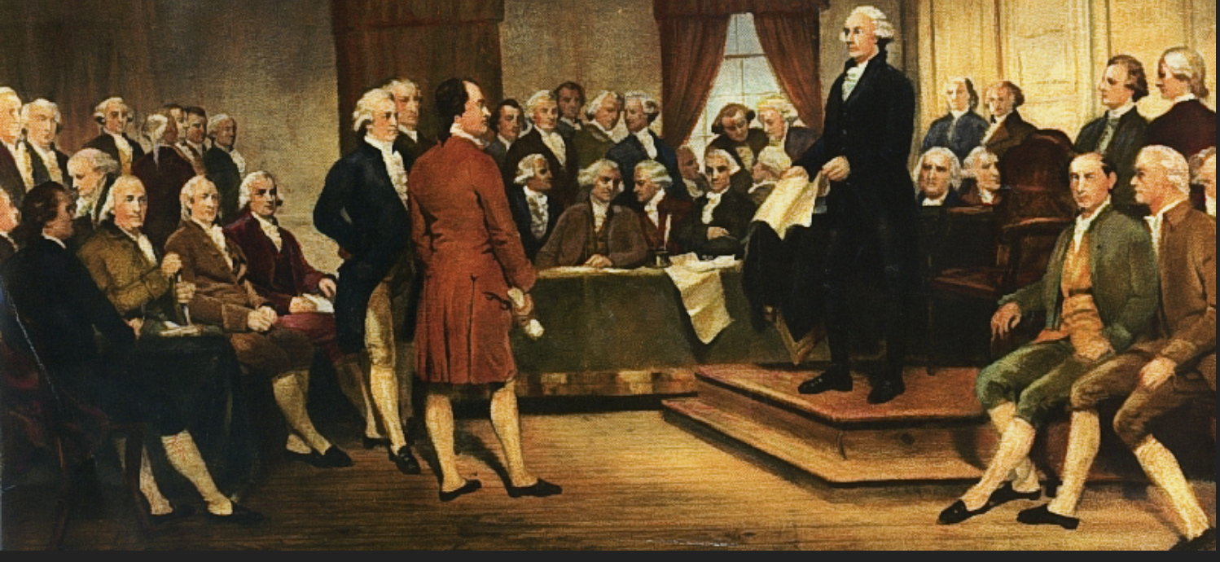
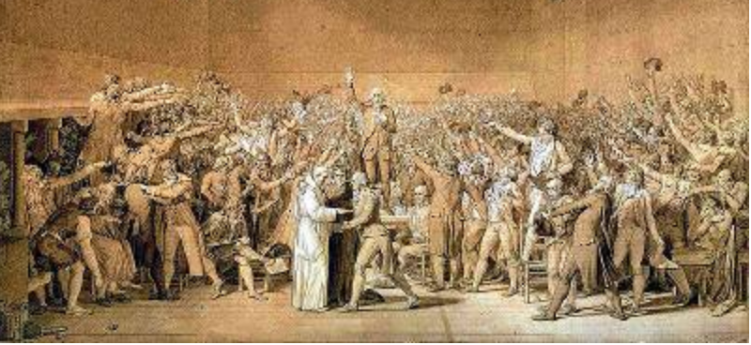
What We Discuss Today/我们今天讨论的内容
First generation constitutions—the rise of the form and the centrality of national characteristics in constitution making
  U.S.
  France.
第一代宪法：宪法制定中民族国家特征的形式与中心地位
  美国；
  法国。

Slide 4
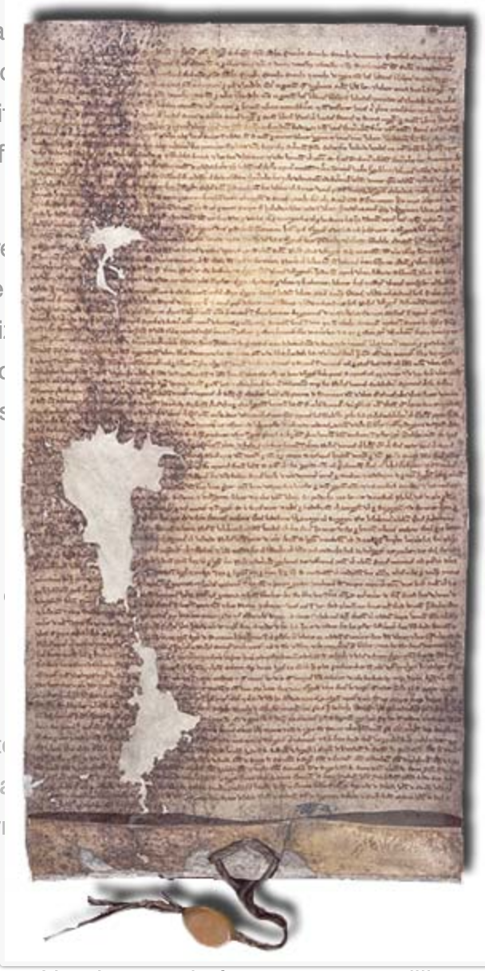
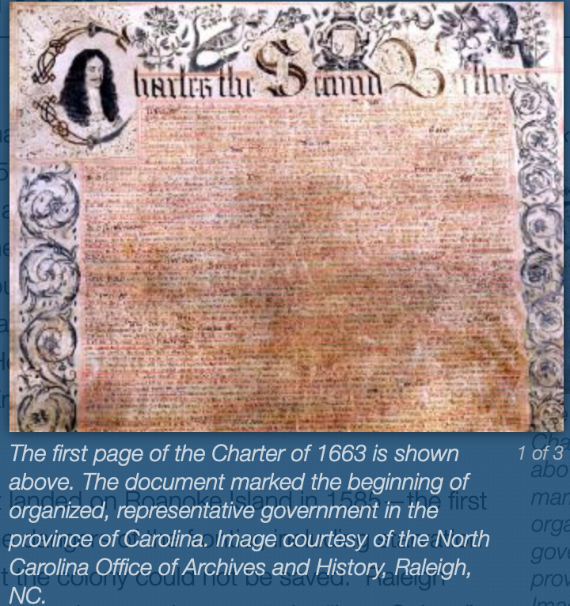
Baseline—Ancient and Medieval Constitutions
Magna Carta
Nature of the term “constitution” has changed in the West
Western Foundations: Greek-Roman
  Custom and tradition; not law but connected to legal expression
  Uncodified set of guidelines or principles applied through precedent in courts and legislature
  Core principles developed: veto, term limits, checks and balances + separation of powers, impeachment, etc.
Medieval
  Prerogatives of great customary stakeholders against absolute power of the center
  From prerogative (the granting of liberties) to rights
  Fundamental binary: Absolute authority in the center constrained by limits on exercise of that power (from prerogative to the language of rights after 18th century
Carolina Charter Pix Credit

Slide 5
What Changes After 18th Century?
From charter to contract
Political document
In the sense that what is bargained in the construction and distribution and institutionalization of power relations
Expressed in the language of law of contract
“Social” contract
Document granting or recognizing specific rights (land, privileges, community, etc)
Title-like deeds of liberties or rights to property; PLUS obligations. Rights/prerogatives as property
Self-constitution of political community that can be distinguished from others
But what created?: Confederation; Federation; Union; or other.
Downward grant--Usually issued by monarch (who embodies the will of the people)
Constitutions are not merely the sum of ancient liberties and arrangements with the central authority, but now also constitute the government itself
Power constrained through a “higher” form of law; a law of politics

Slide 6
What Changes?
Relation to law
Invokes the language and forms of law (written by lawyers steeped in English Common Law and 18th readings of Roman Republic)
But what kind of contracts are these?
Establish a government
Bind non-parties
Objectify and distribute power to maker decisions and command resources
Rule of Law—Rule of Contract
Exercise of state power based on rules
Rechtstaat (process rule of law)
Substantive values against which exercise of discretion is judged and constrained
Sozialstaat (substantive rule of law)
Framework for the legalization of politics and power
Adopts the cultural mechanism of law;
Produce the culture of governance
Meant to the solve the fundamental problem of the medieval constitution-its lack of a mechanism for the protection against arbitrary exercise of power or abuse of Charter protections
Protect customary “liberties” against usurpation by the government as successor to the monarch

Slide 7
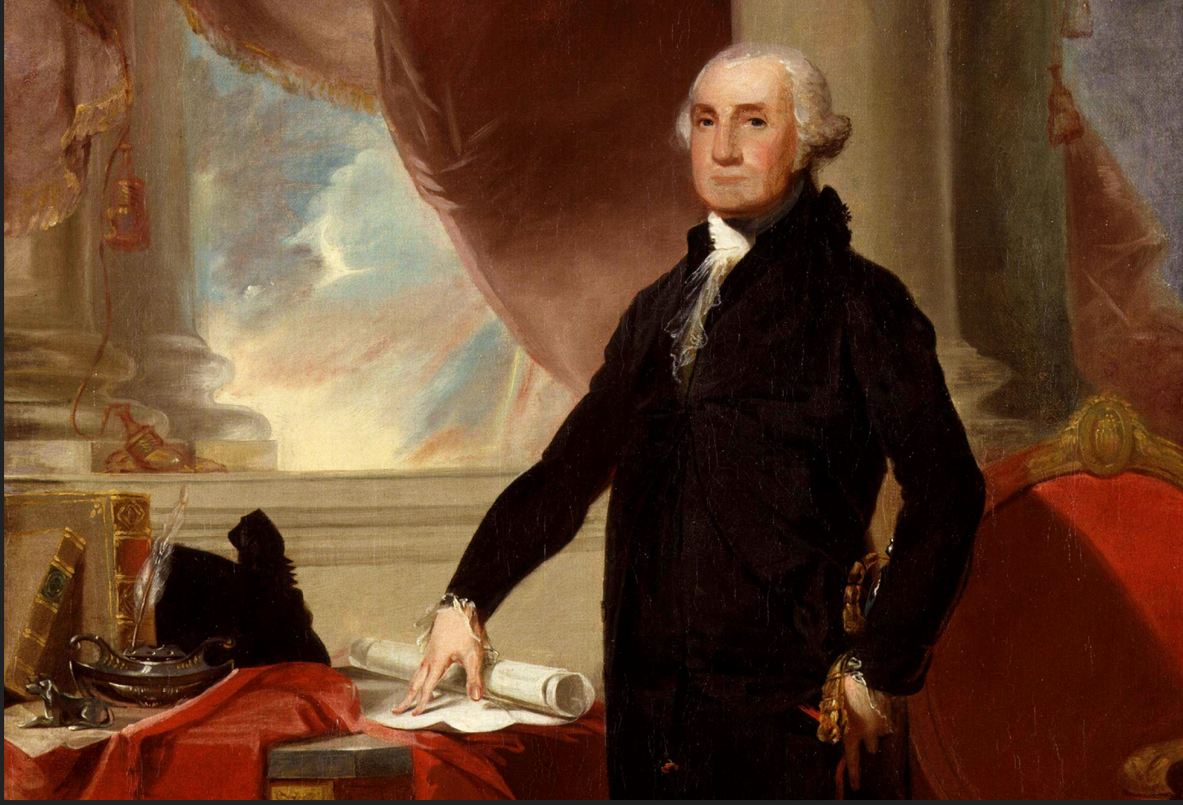
United States

Slide 8
From Colonies to Union to Nation Through Constitution
1st Effort at union: Articles of Confederation
Preserve the sovereign authority of states
Weak Central government—intergovernmentalism versus state creation
More like an international organization
2nd Effort: Federal Constitution
Consider the origins; Constitutional convention was something like a public-private partnership
Appointed selected by states not people (leading social forces of the time (a vanguard revolutionary movement?)
States protect their prerogatives; but united in the face of outward threats
No sense of forging a nation—just a union of states to the extent their common interests warranted common positions
Early Republic a model (template) for European Union
Constitutional Transformations from 1789-2019
Civil War aftermath: from union to nation; process of weakening of state power commences
1870s-1918; from state based to federal based nation building
Causes: development of national markets; consolidation of territorial expansion
Structural changes; Direct election of Senators and approval of federal income taxation
1930s: The growth of national supremacy and judicial power over administrative state

Slide 9
The Structure of Government
Separation of Powers (HORIZONTAL)
Legislative Authority (Article 1)
Senate
Executive Authority (Article 2)
President; Federal Departments
Judicial Authority (Article 3)
Supreme Court
Inferior federal courts
Administrative Authority?
Not contemplated in original constitution
Product of judicial interpretation
House of Representatives
Checks and balances:
Senate approval of ministers, judicial officers and treaties
Money bills originate in the House of Representatives
Presidential veto of Congressional bills; Veto override provisions
Impeachment and removal of executive officers including President
Courts may declare a law unconstitutional; Congress controls budget
Judicial decisions must be enforced by the executive
President commander in chief but Congress controls military spending

Slide 10
The Distribution of Political Power (Vertical)
Federal (Union) Government
Power limited to that granted in the Federal (Union) constitution
Issue of interpretation
A broad or narrow reading: Political question
But one consigned since the early 1800s to the federal courts.
Issue of interpretive authority becomes a sensitive political matter with real consequences
State Governments
10th Amendment
What is left after Union government exercises power delegated to them
People
9th Amendment
What is left after Union and state governments interpret and exercise authority reserved to them
Referendum authority in some states
Is Marbury v. Madison constitutional law or a political determination?

Slide 11
The Normative Constitution:
Bill of Rights and Organic Rights
The role of custom and tradition
Rights of Englishmen at 1791
Rights as against the state and its assertion of power
The role of revolutionary grievances
The Declaration of Independence as evidence of grievances that trigger revolution
The rejection (as radical innovation) of Parliamentary supremacy and notions of Crown in Parliament
The role of religion
Should there be an alignment between government and religion or a separation?
Should there be a distinction between religious ethics/morals and religious institutions and theology
The role of politics
Should normative structures fall within or outside law OR politics
Who can identify these and apply them,?

Slide 12
Innovation and Controversy
1790s: Fight Over inclusion of Bill of Rights—what is the effect of putting some fundamental rights in text?
Contra--it would limit the protection of the rights the protection of which caused the Revolution
Pro: Protect states and the people against the encroachment of power by Federal government
Issue remains unresolved
1865-1880s: Reconstitution of the Republic and notions of due process and equal protection applied to state power
From union of states to nation; fundamental reordering of power and protection of rights of individuals (due process, equal protection): eventual application to states
Early 1900s: the last bit of erosion of state power:
direct election of Senators and
income tax provisions
1930s: Expansion of interpretation of national power (reviving initial efforts in early 1800s)
Judicialization of contests between political branches in federal government
and between states and federal government
1960s: The judicialization of the Constitution respecting social issues
Constitutionalization of politics in the context of race and gender and societal warfare
After 11 September 2001: Individual liberties in the context of war on terror
governmentalization of private sector, and
Judicialization of social warfare for over control of national cultural narrative: Privacy; rights of sexual minorities, migration, continuation of race/gender/ethnic/religious controversies

Slide 13
Are Normative Rights Inside or Outside the Constitution?
Textualist Position
All normative rights constitutionally protected against encroachment by the federal (or state) governments must be written Inside the text of the constitution
If it is not written inside then there is no constitutional protection (within the Constitution EVERYTHING; outside the Constitution NOTHING)
Left to democratic politics
Return to issue is where is the constitutional right—
WITHIN THE WORDS OF THE TEXT;
WITHIN THE INTENTION OR OBJECTUIVES EXPRTESSED BY THE TEXT
Natural Rights Position
Constitution written in shadow of broad natural rights
Built into and expression of customs and traditions of people
Moral and ethical domaine
While Constitution might protect some rights against government, that should not be read as limiting the pre-existing power of the natural rights (the customary liberties) of the people
Ultimate issues:
Where is the “higher” substantive law (liberties) whose protection is the fundamental burden of state?
Natural Law theory in tension with the ultimate political principle of the relationship of sovereign power to moral values

Slide 14
France

Slide 15
From Monarchy to Empire to Monarchy to Republic to Empire to Republics
The problem of the monarchy
Estates General; Society divided by class;
Monarch—nobility (itself divided)—Clergy—Commons (itself divided with bourgeois representing everyone else)
The Constitutional Monarchy of 1791
From constitution to the 1st Republic (1792) and the Terror (1793)
Directorate to Empire (1799-1814)
Restoration in 1814
The Orleanais coup (1830)
2nd Republic (1848)
The return of the Bonapartist empire
3rd Republic (1871-1940)
Instability under the shadow of threat
Vichy and the end of the sclerotic Republic
4th Republic (1946)
Parliamentary republic with a semi-presidential (or dual-executive) system
Power split between a prime minister as head of government and a president as head of state.[
Crisis of Empire and the rise of DeGaulle
The 5th Republic and contemporary France
The crisis of Algeria and the 1958 Constitution
Strong head of state, which embodying l'esprit de la nation ("the spirit of the nation")

Slide 16
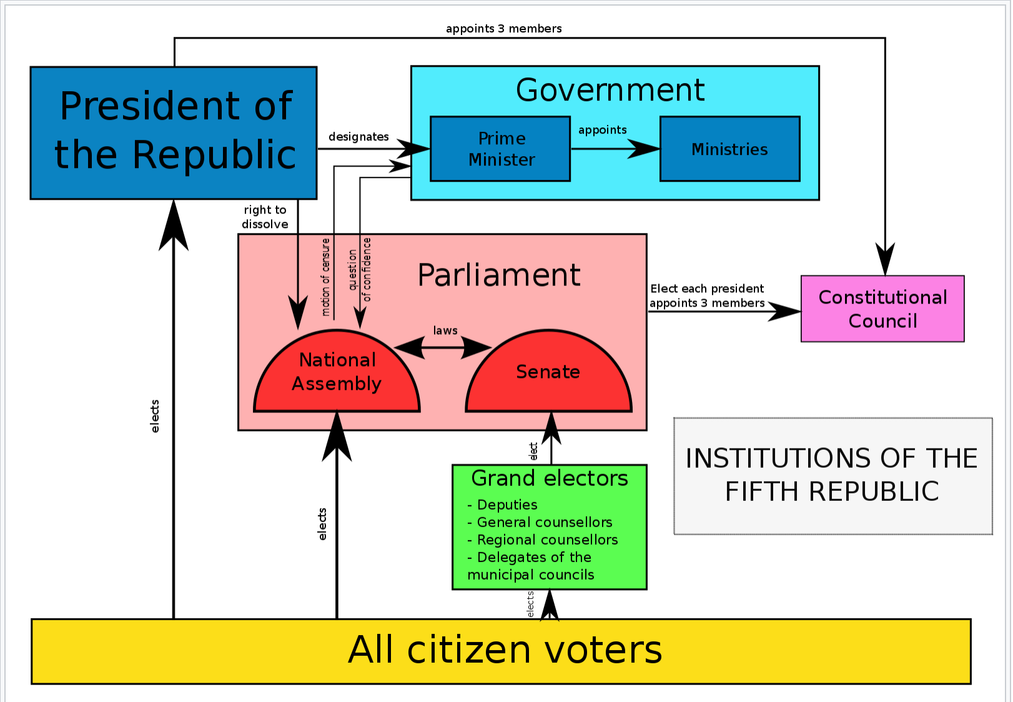
Operation of the 5th Republic Gvernment

Slide 17
Fundamental Issues
Control the power of the King
Unchanged since the Constitutional Monarchy of 1791
Protect against the excesses of the people (the TERROR)
Preserve the rights of French people against encroachment by the government
Protect the power of the legislature and executive in preserving France
Law Versus Administrative Regulation
Former centers power in legislature
Later centers authority in the executive
The issue of laïcité
What does it mean to have a secular society?
What positive duty does the concept impose on the state?
Is everything measured against the rules and practices of the Ancien Regime?
E.g., the natural rights of Frenchmen are those of the “liberties” of nobles?
Are the powers retained by the state a continuation of the great debates between the 3 estates and the king?
Contemporary substitute President for King

Slide 18
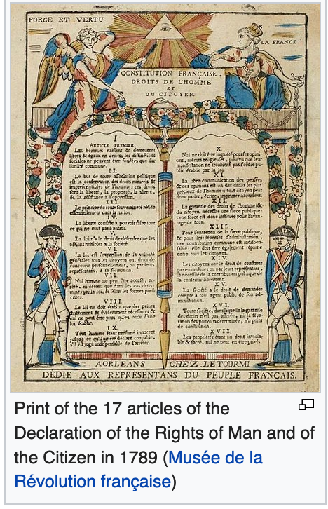
Normative Rights
Incorporated through the Preamble
  Declaration of the Rights of Man and the Citizen (1789)
    Lafayette; Jefferson, Mirabeau
  Constitution of 1946 Preamble.
  Not read intro the Constitution until 1971
Other sources?
  International Law
    Article 54. If the Constitutional Council, consulted by the President of the Republic, the Prime Minister or the President of either assembly, has declared that an international obligation includes a clause contrary to the Constitution, authorization to ratify or approve it may be accorded only after revision of the Constitution.
  European Human Rights Convention
  European Union Treaties
The role of custom and tradition?
Are there any limits to the power of the people to speak normatively through the constitution?
  May the provisions be radically changed TO SUIT THE TIMES?

Slide 19

The Defender of Rights (Défenseur des droits)
Article 71-1
Ombudsman; appointed by President for 6 year term
“Ensure the due respect of rights and freedoms by state administrators” and others.
Referrals made pursuit to Institutional Act
  Referrals can be made “by every person who considers his rights have been infringed.”
  Competence in 4 different areas: the Rights of the users of public services, (as the national Ombud) the Defense of Children’s Rights, the non-discrimination and promotion of Equality, and the issue of ethics in security services (police and other private security services complaints’ Commission).
  Limited powers of inquiry and powers of intervention.

Slide 20
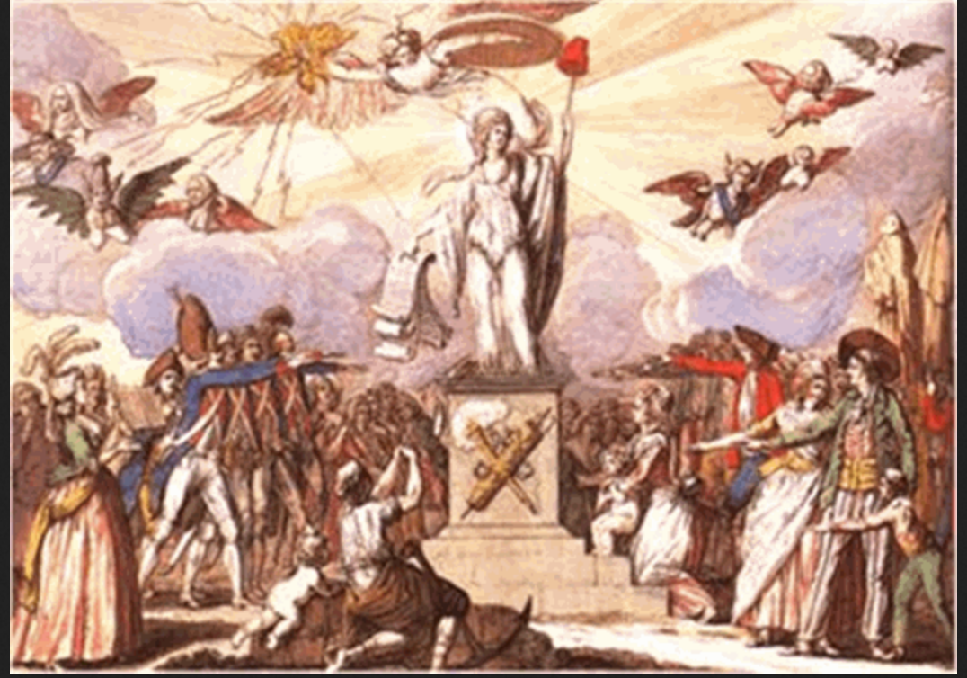
The United States and France as Representative 1st Generation Constitutions: Points of Comparison

Slide 21
The United States and France as Representative 1st Generation Constitutions: Points of Comparison
(1) By whom is the constitution made
(2) to whom is the constitution directed
(3) to what extent is the constitution directly effective and for whom;
(4) who may interpret and apply the constitution and with reference to what;
(5) mechanisms for resolving constitutional disputes?
(6) the allocation of power (vertical and horizontal allocations of political authority);
(7) organization of representation in the executive, administrative and legislative organs;
(8) how are representatives selected;
(9) how is the representation of the people reflected in the organization of the legislature (and other organs)–e.g., by residence in a specific territory (state, province, etc.), by membership in a specific ethnic, religious or other group, etc.; and
(10) the elaboration of the rights and responsibilities of government (the architecture of basic protections for the people).
(locus of sovereignty and direct connection between constitution and constituting body; e.g., the people, the monarch, the vanguard, etc.);
(e.g., to the people, to the holders of political authority, to vanguard groups, etc.);

Slide 22
The Points of Comparison: By Whom is the Constitution Made
US
France
Theory: by the people
Application: Representatives
  Appointed by State legislatures
  Recall that this was to be a federal union of sovereign states
  State interests were to be represented
Which people, then, were represented? Nation (did not exist yet; or states
Can thr Constitution limit the power of the people to amend it?
  Forbidden amendment? No
  People are outside the constitution though bound by it
  Never been tested
  EXCEPTION: Secession
Theory: By the people
Application: Representatives
  Elected from the “most notable” of each of the estates.
Complex politics
  Parish priests against princes of the Church (bishops etc.)
  Nobles viewed as protectors of the constitutional liberties of the French against the absolutism of the monarch through the parlements.
  Third estates lawyers, magistrates merchants and rich landowners.
May the constitution limit power of people of state to amend?
  State yes; it is WITHIN the constitution
  People, NO—they are outside the constitution.

Slide 23
Points of Comparison: To Whom is the Constitution Directed?
US
France
Theory:
  the People;
  the States
Application:
  Who are the people; to be determined by the federal or state constitutions?
  Criteria: property ownership, sex, race, religion
  Movement toward eventual universal citizenship but only in the 20th century
  Ought the constitution to be understood as directed to the states?
  States were the political communities that had ceded authority to the union, not the people of the resulting union
  This was a highly contested issue through the close of the Civil War
  Echoes remain in discussions of federalism
Theory:
  The people;
  the Ancien Regime
Application:
  Who are the people?
  Initial distinction between active citizen (with political rights) and passive citizen (without such rights)
  Movement toward universal male suffrage than universal suffrage

Slide 24
Points of Comparison: to what extent is the constitution directly effective and for whom
US
France
Theory:
  Directly effectives a basis for the avoidance of liability or assertion of right
  Directly effective by courts that could void government action
Application:
  Directly effective through courts
  Applied in private conflicts
  Applied to test validity of a provision
  Applied to test the boundaries of constitutional provision
Theory:
  Directly effective as a basis of avoidance of liability
  Limited use to declare parliamentary act void
Application:
  Until 1970s effective supremacy of political branches
  Solution—revolution or agitation

Slide 25
Points of Comparison: Interpretation and Application
US
France
Theory:
  Everyone
Application:
  Political branches interpret as they engage in legislative and executive actions
  People as they order their lives and seek to resolve disputes against other private parties or the state
  Replicated at the state level with state constitutions
Issues
  Hierarchy of authority relating to application
Theory:
  The political apparatus
  And then the people
Application:
  Highly centralized state
  But now deeply embedded in international instruments: EU/Human Rights Charter
Issues
  Hierarchy of authority (inside and outside France)
  And authority to act (eg the constitutional court)

Slide 26
Points of Comparison: Representation and Selection
US
France
Universal suffrage (a 200 year project)
  But distinguish between citizen and others
Exogenous democracy
  Principal expression through voting for representatives in state apparatus
  Essence of liberal democracy
Direct and indirect voting Mechanisms
  Direct voting for House of Representatives (and now Senate)
  Originally people's representatives in State legislature appointed Senators
  Electoral College Presidential elections
Universal suffrage (a 200 year project)
  But distinguish between citizen and others
Exogenous democracy
  Principal expression through voting for representatives in state apparatus
  Essence of liberal democracy
Direct and indirect voting
  Direct voting for National Assembly; President
  Indirect voting for Senate (grand electors elected local officials)

Slide 27
Points of Comparison: Participation
US
France
No structural space for participation
  Voting ends structural protection of liberal democracy
  Indirect participation—resort to judicial organs to invoke constitutional interpretation
Discretionary Participation
  Testimony and access
  Lobbying (directly or through paid agents)
  Rulemaking in Administrative agencies
Criticism
  Tends to favor: well connected, those with technical capacity, repeat players, those who know the rules, those with the funds to engage in participation.
No structural space for participation
  Voting is only connection between citizen and the work of representative organs
  No real mechanism for indirect structural participation
Discretionary Participation
  Many of the same venues as U.S.
Criticism
  Endogenous democracy not available to all

Slide 28
Constitution as Instrument
US
FRANCE
Short document
  Principles
  Structures
  Preamble of little practical effect
Not Written like a detailed Code
  Open textured; much space to read specifics into the document
  But creates a legal structure within which to manage politics
Meant to serve as a covenant to survive the ages
  The same constitution continues to frame the same republic established in 1789
  This despite the substantial transformative changes between 1789 and 2019.
Short document
  Structures
  Power
  Principles in the Preamble
Not written like a detailed code
  Leaves much to politics
  Provides a cage of rules within which politics may be exercised
  Large space for exercise of political judgment and administrative discretion
Not meant to survive the ages
  As constitution radically transformed (by revolutionary agitation, a new constitution, and a new republic is born

Slide 29

Summary Characteristics: 1st Generation Constitutions

Slide 30
Common Characteristics 1st Generation Constitutions
Core elements of liberal democratic political order
Sovereignty directly realized by the people
Right to revolutionary change in the face of core violations of fundamental liberties
Government is a tool
For the preservation of liberties,
For the protection of customs and traditions
To preserve property
Object of constitution
Delegate political power to government
Organize government for the exercise of authority
Provide very basic constraints for the exercise of authority
Constitution versus law code
Construction of Exogenous democratic mechanics
Voting serves as the relationship between population and government
Internal workings severed from direct popular control
Normative limits
Scope of developing normative order (principles) unrestricted
People free to impose as they like
But is there a “higher law” limit?

Slide 31
Thanks!

