Slide 1
Socialist Democracy in China: The Constitution of the Political-Consultative Conference
Flora Sapio
Marxism Leninism 2.0: Theories and Practices of Socialist Democracy in China and Cuba
February 12, 2019 - Pennsylvania State University

Slide 2
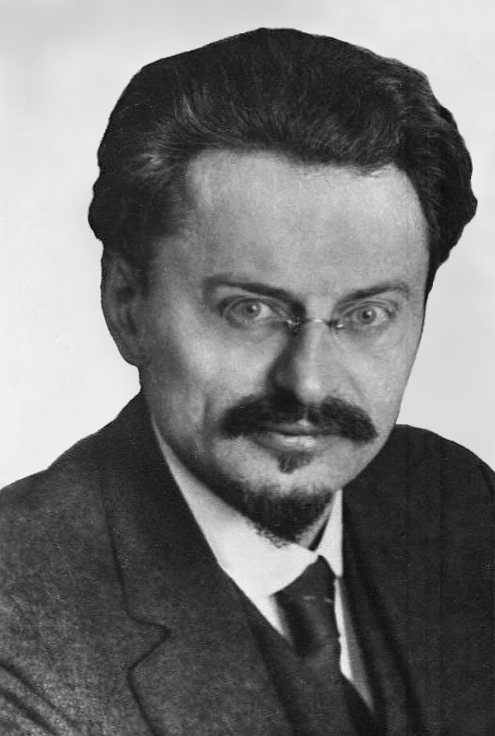
The United Front Genesis of the Concept
The United Front is «an initiative whereby the Communists propose to join with all workers belonging to other parties and groups and all unaligned workers in a common struggle to defend the immediate, basic interests of the working class against the bourgeoisie»
Leon Trotsky, «Theses on Comintern Tacticts», 1922

Slide 3
The United Front Adaptation to the Chinese Context and Evolution
Three Stages
1923 – 1927: First United Front Constituted Between the Communist Party of China and the Nationalist Party
1937 – 1941: the concept of United Front is autonomously interpreted and used by Mao Zedong
1949 – 2018: the concept of United Front becomes one of the fundamental principles of the version of Marxism-Leninism created in China

Slide 4
The United FronT A Concept EmbodieD
Party Apparatus
State Apparatus
1938
United Front Departments of Party Committees created
Absent
1940
Central United Front Department
Absent
1944
Central United Front Department downgraded
to a section of the Central Department for Urban Work
Absent

Slide 5
The United FronT A Concept EmbodieD
Party Apparatus
State Apparatus
1948
Mao Zedong conceives the creation of a
coalition government, asking for the support of the Revolutionary Committee of the Chinese Kuomintang, and the Central Committee of the China Association for Promoting Democracy
-
-
1949
Creation and convening of the Chinese People’s Political Consultative Conference

Slide 6
Birth and Development of a tripartite constitutional structure 1948 - 2018
Political arm: Communist Party of China
Channel of domestic and global political participation: CPPCC
Administrative arm: State Apparatus

Slide 7
The Constitution of the Chinese People’s Political Consultative Conference
1954 Common Program of the Chinese People’s Political Consultative Conference
Document distinct from the Constitution of the Communist Party of China, and the Constitution of the People’s Republic of China
Amended at every major juncture of China’s political and institutional development

Slide 8
The 2018 Constitution of the CPPCC
Sets forth the developmental goals and normative principles guiding the action of the Political-Consultative Conference, and shared with the Chinese Communist Party and the State apparatus.
Defines and regulates the relations between the Political-Consultative Conference, the Constitution of the Communist Party of China, and the State Apparatus
Specifies how the Political-Consultative Conference will contribute to achieving the developmental goals set by General Secretary Xi Jinping
Defines multi-party cooperation and political consultation as the “basic political system” of China
Defines the sometimes controversial concept of «Consultative Democracy»
Regulates the relations between the Political-Consultative Conference, the 8 democratic political parties, and persons not affiliated to any political party

Slide 9
The Chinese People’s Political Consultative Conference
Institutional embodiment of the United Front principle
Organization subordinated to the leadership of the Communist Party of China, and to the Constitution of the State, yet autonomous from the Party and the State apparata
The sole forum for multi-party cooperation and political consultation;
An important component of China’s domestic and transnational governance

Slide 10
The Issue of REplicability
Variables leading to the birth of the Political-Consultative Conference as one of the possible institutional expressions of the «United Front» principle
Interpretive autonomy: space allowing for heterodox, autonomous, multiple interpretations of a concept in Trotskyism
Operational autonomy: concrete possibility to work towards the realization of goals defined by the concept of «United Front», as understood by its individual recipients, and adapted to circumstances, institutions, and practices existing in their social and political systems

