Slide 1
Rhetorical Dynamics of Strategic Framing in Shaping Social Movement Personae
Analyzing Metaphors of “Revolution” and “Movement” in 2014 Hong Kong Protests
Keren Wang – Penn State University, kuw148@psu.edu
Dominic Manthey – Penn State University, djm513@psu.edu

Slide 2
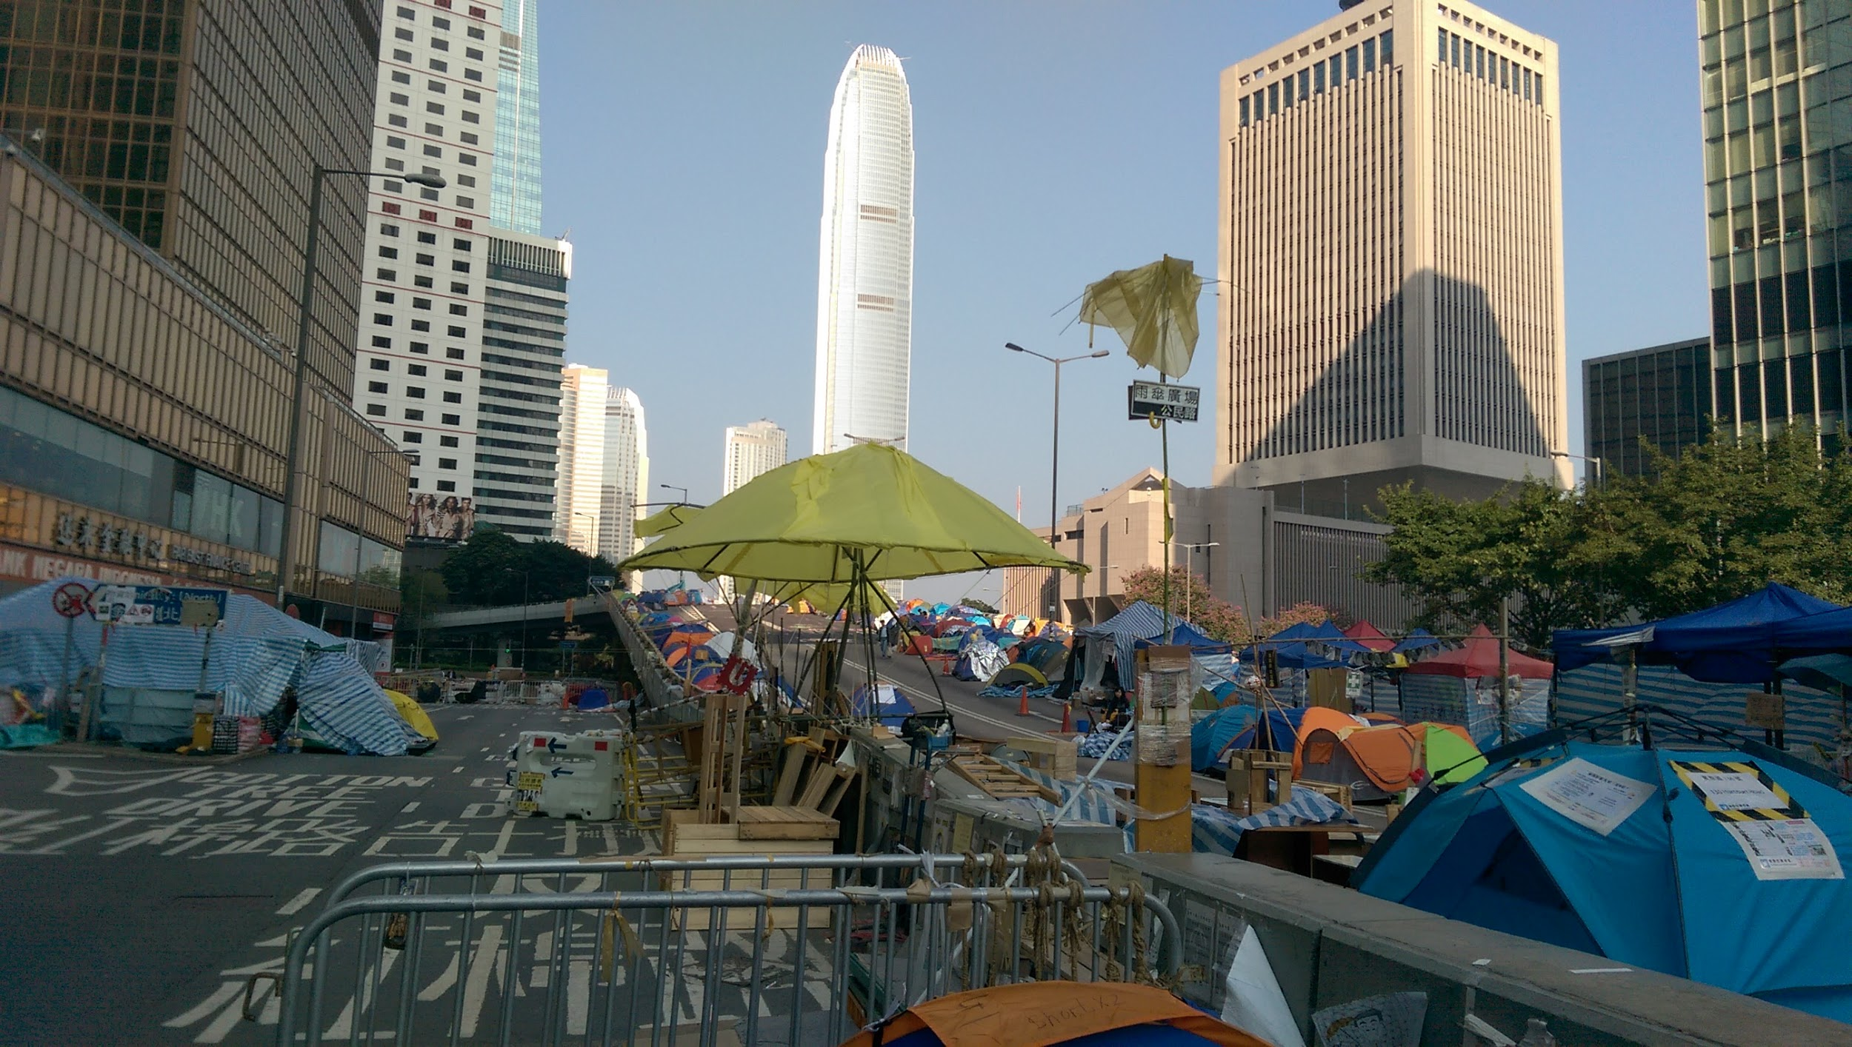
Wang, Keren. "Admiralty protest site" Admiralty, Hong Kong Nov 16, 2014. Digital photography.

Slide 3
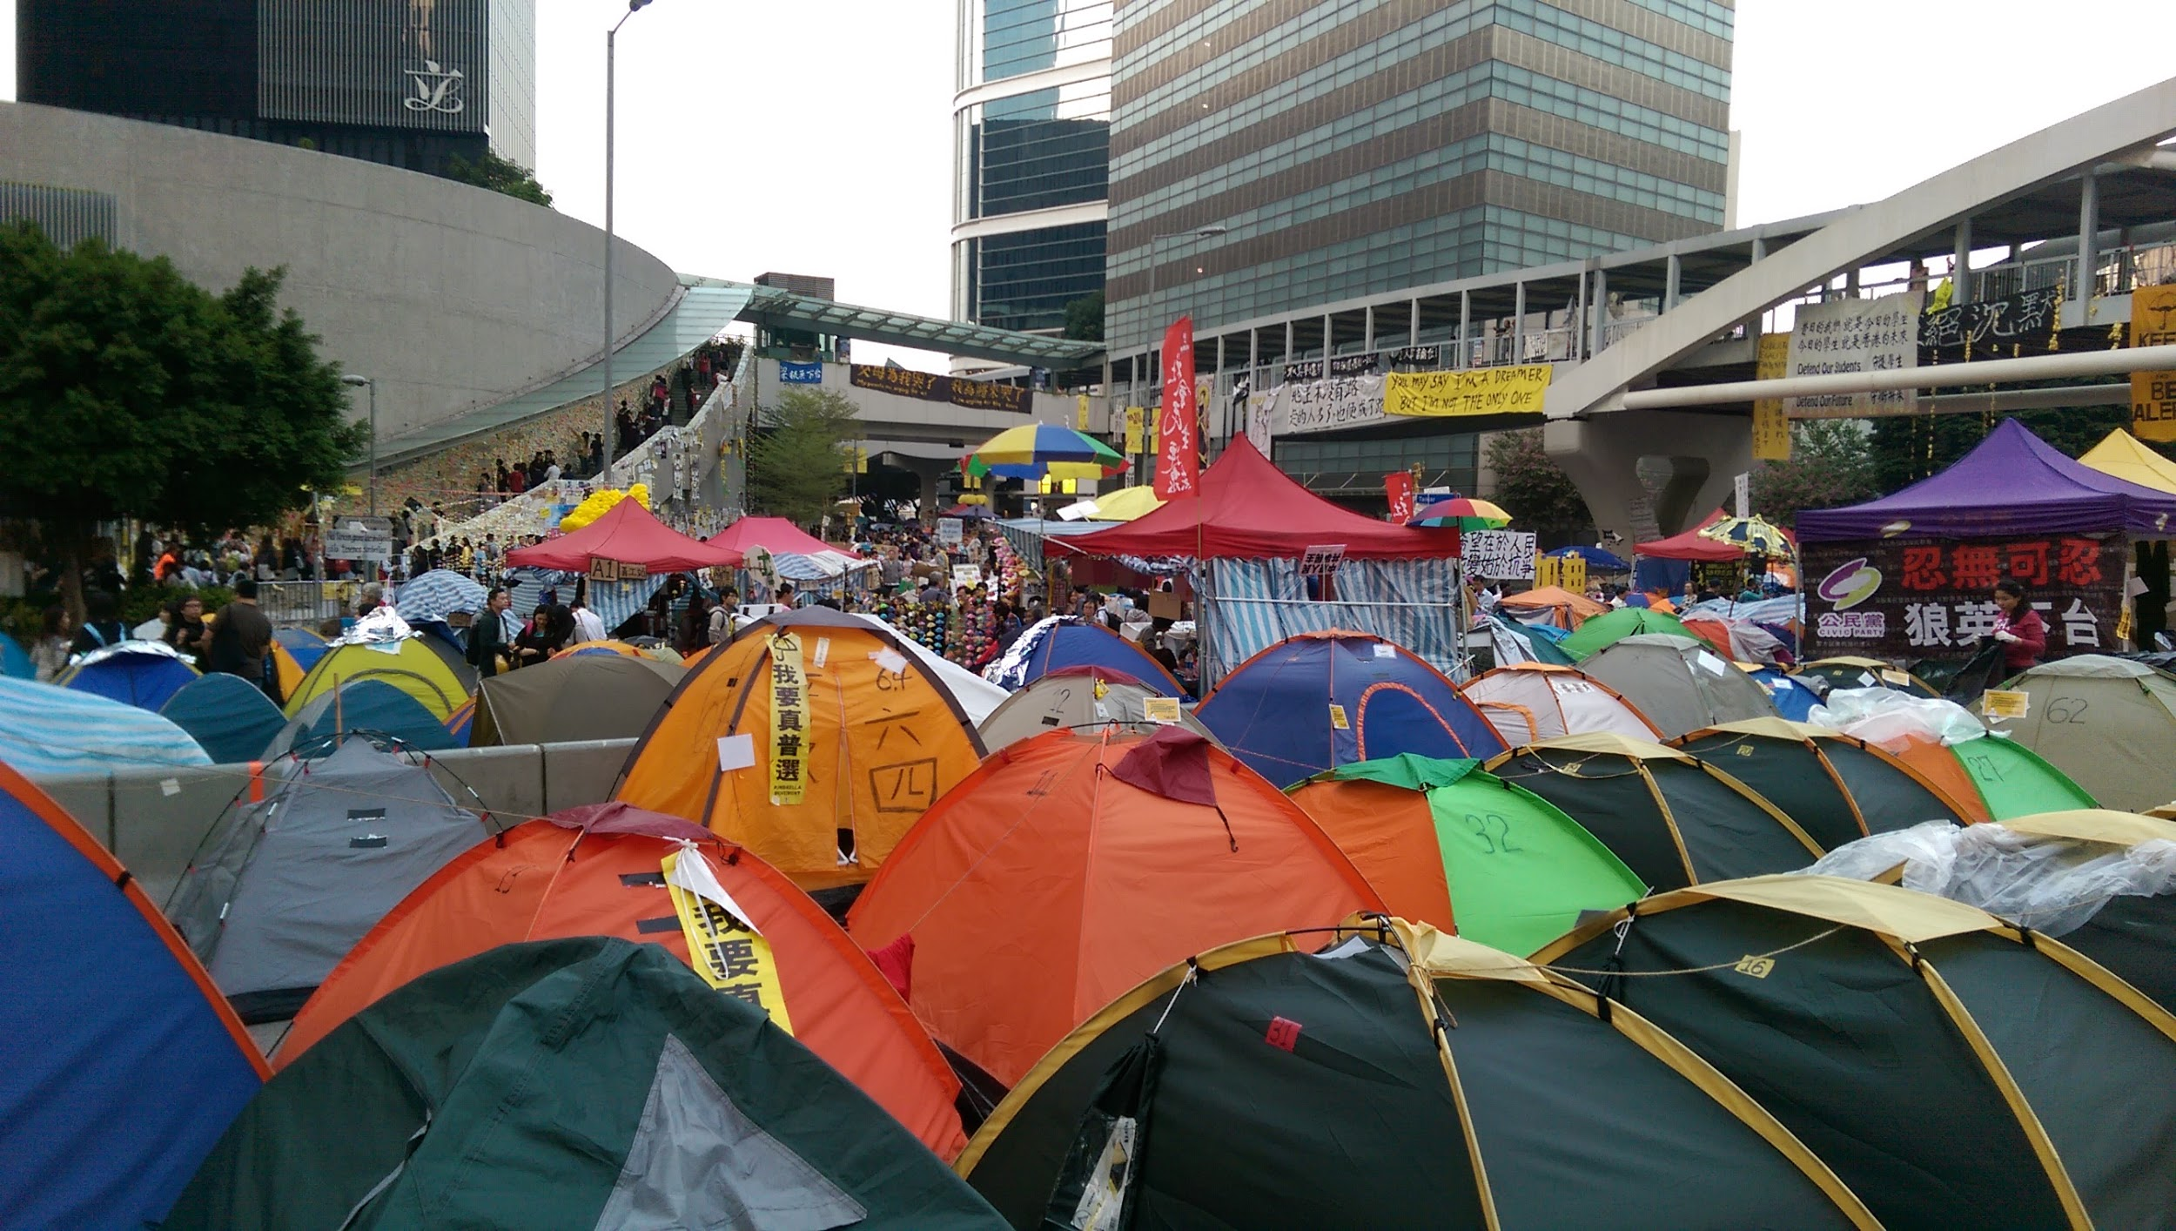
Wang, Keren. "Admiralty protest site" Admiralty, Hong Kong Nov. 15, 2014. Digital photography.

Slide 4
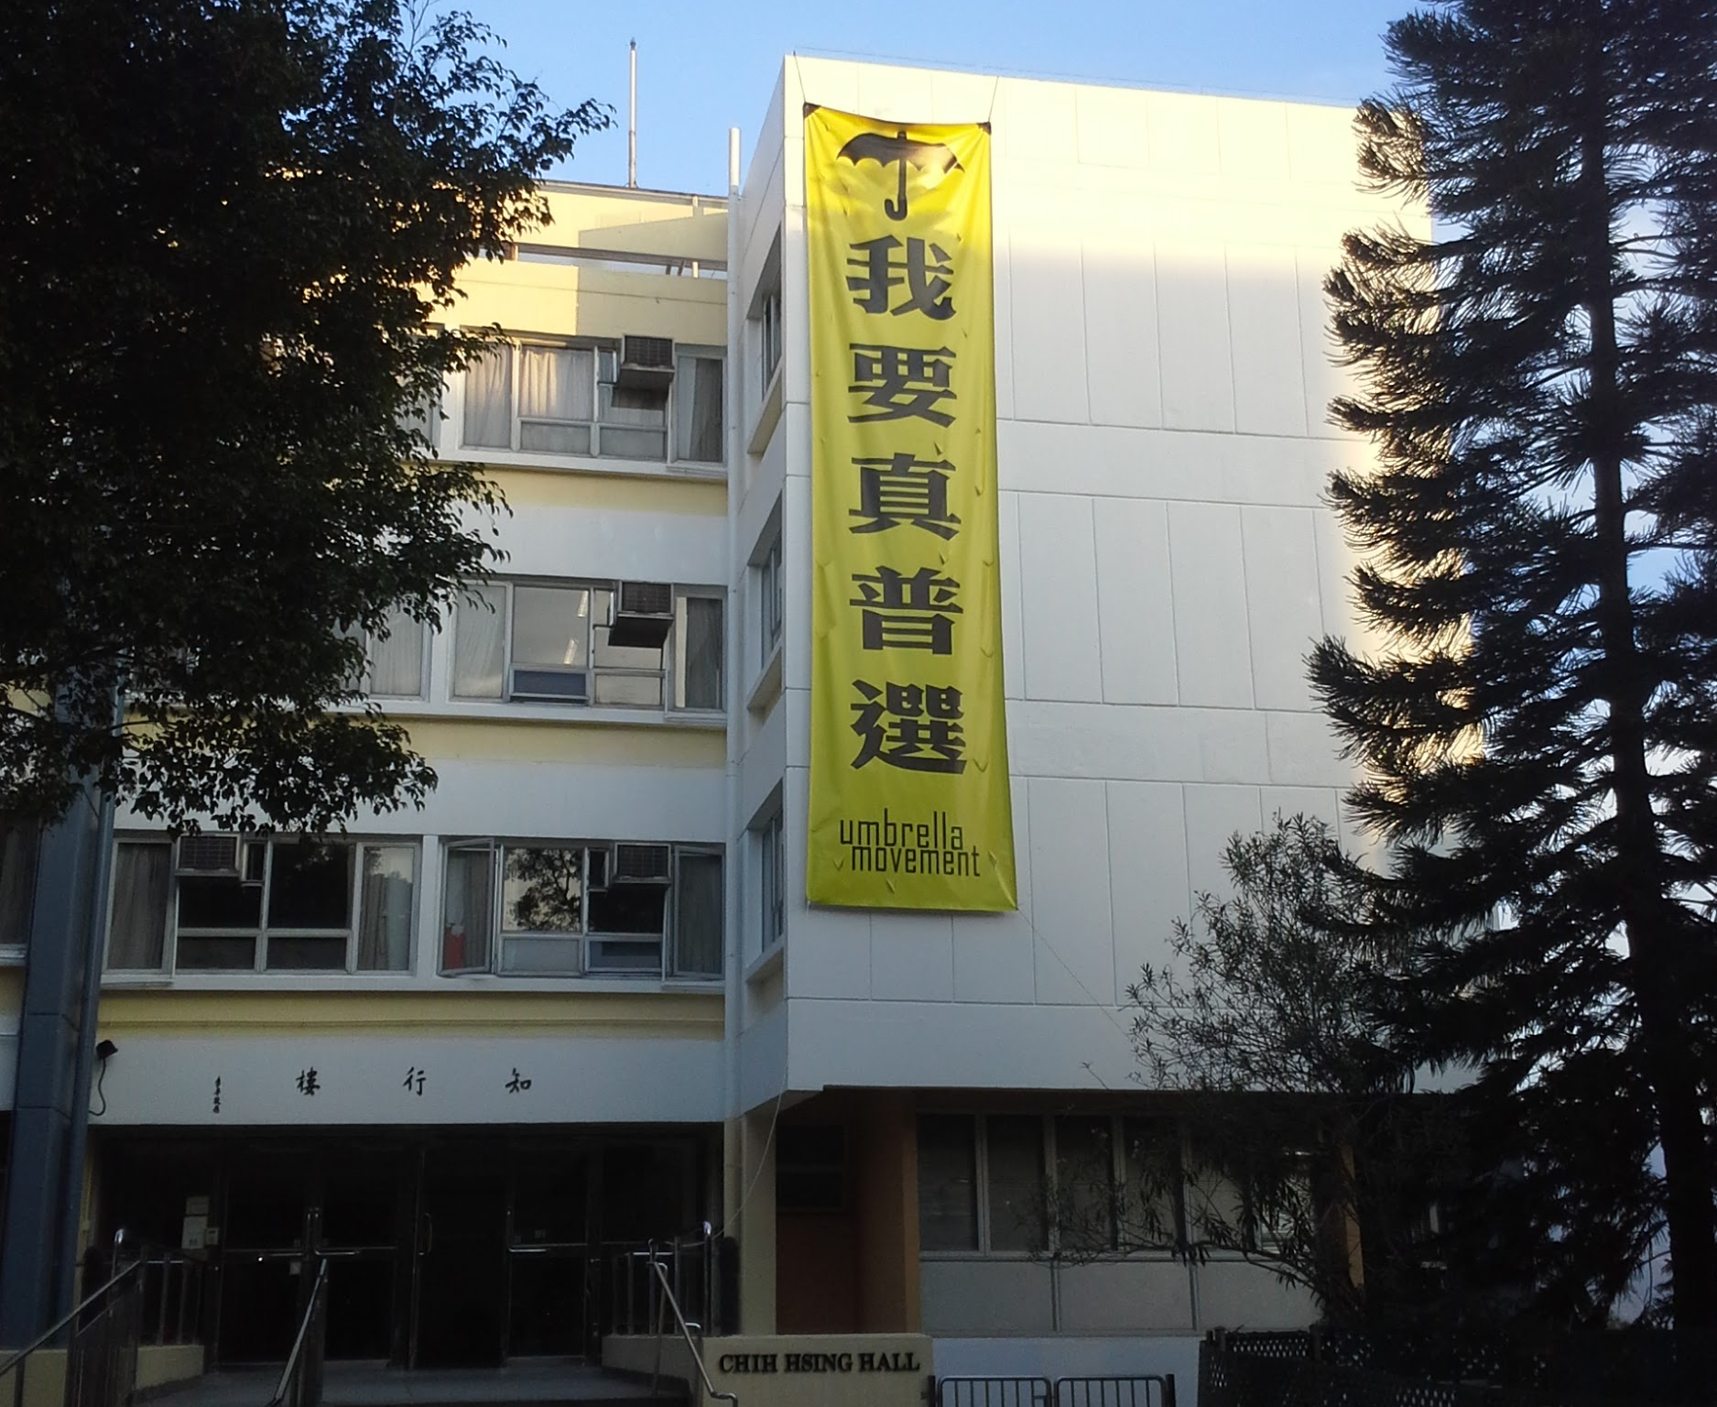
Manthey, Dominic. "We Want Real Universal Suffrage" CUHK Campus, Hong Kong, Dec. 22, 2014. Digital photography.

Slide 5
Introduction
A movement’s identity is shaped as much by counter-movement forces as by their own rhetoric.
It is much easier for the countermovement forces to frame the activists as “radicals” or “outliers” than for the activists themselves to frame their movement as an unified “moderate” front.

Slide 6
What makes the [Umbrella] Movement extraordinary is that it is unprecedented in Hong Kong’s history for its duration, scope, and public support… the last time we got students organized was back in the 1960s, but that was even smaller in scale and more violent.
– Dr. Hualing Fu

Slide 7
Context
The uniqueness of Umbrella Movement in HK’s context
Mobilized college students
Response to the NPCSC’s decision on HK electoral reforms
Demands: “real universal suffrage”, ending Functional Constituency

Slide 8
I myself use the term “Umbrella Revolution” because it’s a big change in the people’s mentality. Before people believe just in those peaceful protests, but now they believe in direct action.
– Spokesperson for the Keyboard Frontline
Most of the university students prefer the term “movement”, only the radicals use the term “revolution” – because we are only concerned with HK’s political problem, we’re not fundamentally against the central government.
– CUHK Student Council

Slide 9
“Movement” and “Revolution”
Revolution - 革命 (geming)
Movement - 運動 (yundong)

Slide 10
And the principle of “Helifeifei” [rational-peaceful nonviolent civil resistance], for me I think it is ridiculous! Just because I use language considered vile, it doesn’t mean I’m irrational! This is a self-undermining thing we’re doing to ourselves.
– CUHK Student Movement Organizer

Slide 11
Analysis
Strategic framing and counter-framing
Pivotal moments:
Sept. 28th “night of tear gas”
occupying Admiralty
Nov.18th late night / Nov. 19th early morning smashing the glass panel entrance of Legislative Council Complex

Slide 12
Conclusion
A movement’s identity is shaped as much by counter-movement forces as by their own rhetoric.
It is much easier for the countermovement forces to frame the activists as “radicals” or “outliers” than for the activists themselves to frame their movement as an unified “moderate” front.

