Slide 2
The Democratic Constitution of Illiberal States—An Empirical Approach to Theorizing Popular Participation, Representation and Constitutional Reform in Cuba
Larry Catá Backer, Pennsylvania State University
Flora Sapio, Università degli Studi di Napoli “L’Orientale”
James Korman, Pennsylvania State University
Presentation at Conference: Marxist Leninism 2.0; Pennsylvania State University
12 Feb,. 2019

Slide 3
The Foundations of the Project
Rise of theories of Socialist Democracy
Distinguish these from core principles of liberal democracies
Chinese Model emerges after 19th Chinese Communist Party Congress
Cuban (Caribbean) Model emerges after 7th PCC Congress

Slide 4
Questions:
Core premises of a theory of Cuban (Caribbean) Socialist Democracy?
Who are the “masses”
Relationship between the masses (populace) the state and the vanguard party
What is the nature of representation of the masses (1) by the Vanguard party and(2) in mass organizations?
Modalities of democratic participation
Voting
Engagement/consultation
The practice of Caribbean Socialist Democracy in the 2019 Constitutional Reform project
Engagement
Voting
Dissent
What can this tell us about the character of democratic systems not organized on the basis of core principles of Western liberal democracies?
Can this be applied elsewhere

Slide 5
The Long Arc of Development in Cuba
6th PCC Congress
Lineamientos
Development of a Cuban “Reform and Opening Up” Line
7th PCC Congress
Conceptualization of the political and economic model
Revision of the Lineamientos
Development of a revised approach to central planning (Year 2030 Plan)
The Project of Constitutional Reform 2017-2019
Reflect the changes in the PCC basic line
Reflect new focus on model citizen and model worker
Focus on efficient reconstitution of state organs

Slide 6
Popular Participation—First Wave 1960-62
First Havana Declaration 2 September 1960
Popular affirmation of action by revolutionary government
Mass physical gathering of the people in a space
Affirm actions taken; but no initiation of action
Revolutionary Government determines when or if to convene
Second Havana Declaration 11 Feb 1962
Who are the people who can assert sovereign authority?
Class based; class struggle basis for inclusion
But not nationality based: icludes other Latin Americans

Slide 7
Template—1975 1st PCC Congress and 1976 Constitution
Party leadership develops core documents to institutionalize government and party structures
Develop core ideological documents
Develop draft of a new constitution hat reflects ideological changes
Popular commentary
Review comments and modify
Constitution subject to popular affirmation and vote.

Slide 8
The Next Wave 2011
Reform and Opening Up
Objective to develop Guidelines (Lineamientos) for reform
No real engagement with theoretical model of the state
Interactive process; use local organizations Committees for the Defense of the Revolution etc.
PCC Initial draft
Popular consultation
Revised Draft
PCC Approval at 6th PCC Congress

Slide 9
The Reconceptualization of the political and Economic Model 2016
Follow the template of the 1st PCC Congress and the Linemientos
Much more tightly controlled process of engagement
Selected mass organizations
No general mass involvement

Slide 10
The 2017-2017 Process of Constitutional Reform
Transposing Conceptualización into the state constitution
PPC Committee
Asamblea Nacional
Popular Commentary
Revision by Asamblea
Plebiscite

Slide 11
Problem for Investigation
What was the nature of participation?
Who participated?
How did they participate?
What were the connections between structured and unstructured popular participation?
What was the role of social media?

Slide 12
Methodology The Democratic Constitution of Illiberal States—An Empirical Approach to Theorizing Popular Participation, Representation and Constitutional Reform in Cuba
Flora Sapio
Marxism Leninism 2.0: Theories and Practices of Socialist Democracy in China and Cuba
February 12, 2019 - Pennsylvania State University

Slide 13
Background
The Project of Constitution of the Republic of Cuba (Proyecto de Constitución de la República de Cuba) was made available online and put on sale between August 30 and 31, 2018.
Popular consultation on the Project Constitution took place between August 15 and November 15.
133,681 popular meetings were held, involving 8,945,521 persons (77,89% of the Cuban population).

Slide 14
Data Generated During the Popular Consultation
The following data was generated during the popular consultation:
783.174 proposals to amend, add, or delete articles in the Project Constitution
2,125 proposals sent by Cuban citizens living abroad to the Ministry of Foreign Affairs
All data generated during the popular consultation is owned by the government of Cuba and its citizens. It is accessible only to data scientists of the Cuban goverment.

Slide 15
Overcoming limitations in access to official data
Harvesting comments on the Project Constitution posted on digital platforms

Slide 16
Limitations of Social Media Data
4 limitations inherent in social media data
No lower and upper limits of datapoints a dataset should have to fit the definition of «Big Data»
Not all of those who will participate in popular decision-making process express their opinion on the internet. Citizens do not have an equal opportunity to be included in samples
Correlation among the rationale behind participation in debate, real opinions held by individuals, online behavior, and individual voting behavior is beyond proof
Content moderation by the Cuban government and by global social media platforms restricts the scope of available opinions

Slide 17
The Internet in Cuba
11,500,000 persons
33,536 fixed broadband connections
1 Hour of Wi-Fi Hotspot access can cost 8% of an individual’s monthly salary

Slide 18
Who is more likely to participate in social media debate on Cuba?
Persons born in Cuba who reside outside of the Island
Persons who live in Cuba and can afford the cost of a broadband connection
Persons who can use an internet connection belonging to educational institutions, government organs, foreign-invested enterprises, state-owned enterprises, tourist establishments
Persons who were not born in Cuba, and who enjoy internet access

Slide 19
Building a robust data ecology on the popular consultation
Summary transcriptions of two parliamentary sessions on the Project Constitution

Slide 20
Building a robust data ecology on the popular consultation
Opinions expressed as immediate reactions to the Project Constitution

Slide 21
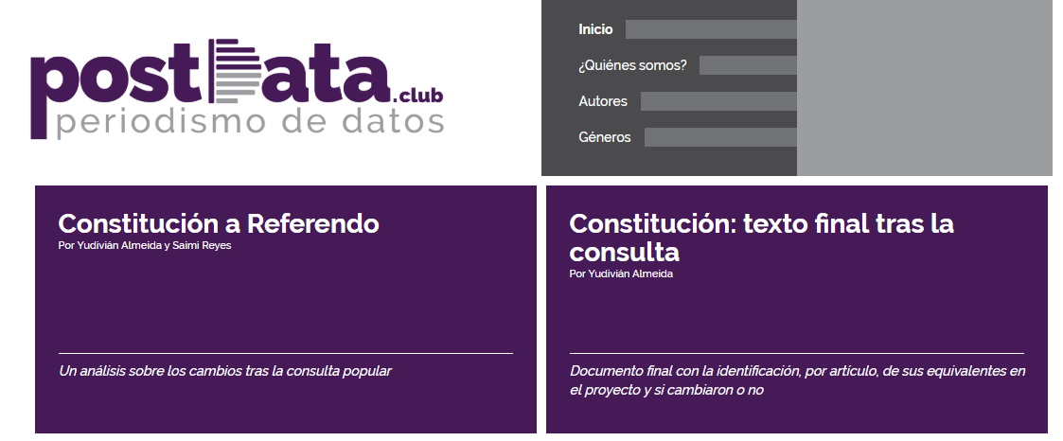
Building a robust data ecology on the popular consultation
Independent platform launched by Cuban academics based in Cuba

Slide 22
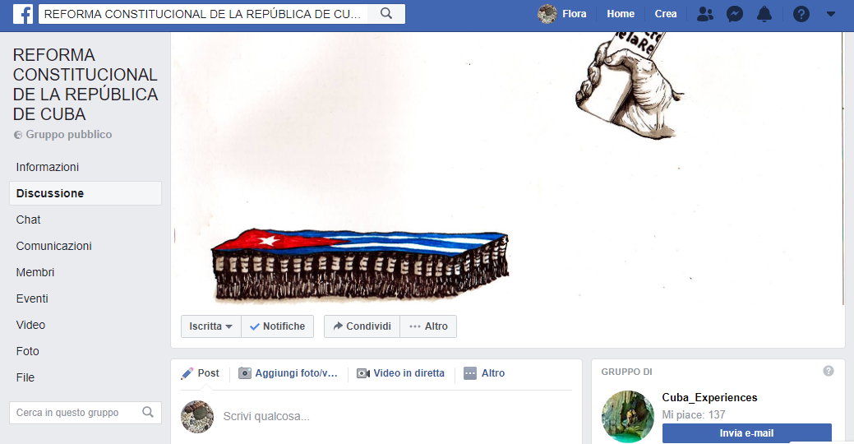
Building a robust data ecology on the popular consultation
Public discussion group hosted on a popular global social media platform

Slide 23
our data ecology
Human influencers
Cuban residents
Persons born in Cuba and who reside outside of the Island
Advocacy groups campaigning pro and contra the Project Constitution

Slide 24
James korman
Data and Results

Slide 25
Cubadebate

Slide 27
Minuto a minuto I & II

Slide 28
Postdata.club

Slide 29
Reforma constitucional facebook group

Slide 31
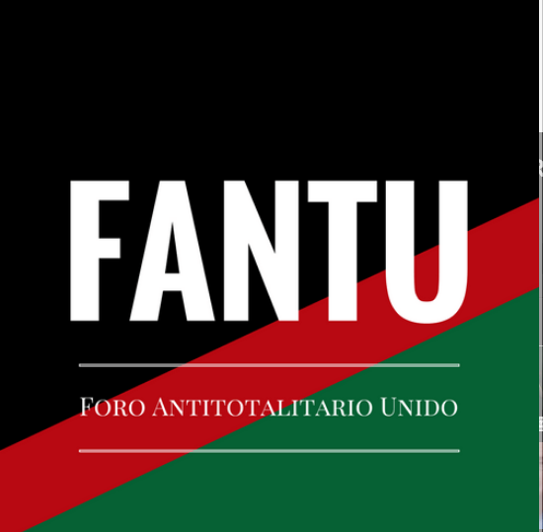
Our Initial Findings
Multi-track engagement
State directed
Engagement
Voting (plebiscite)
Informal Political Engagement
Web communities
Diaspora
Transposable lessons?
Cuba
Caribbean Region
Developing states

Slide 32
Implications
The Development of Socialist Consultative Democracy
The problem of representation; the role of the Vanguard; and the participation of the masses
The Modalities of Engagement and Dissent
The transposability of the Cuban Model to other developing States
The role of technology and the emergence of cyber communities
The emerging importance of social issues and of economic opportunity as the new frontier of ideology (the Cuban version of the new contradiction)

Slide 33
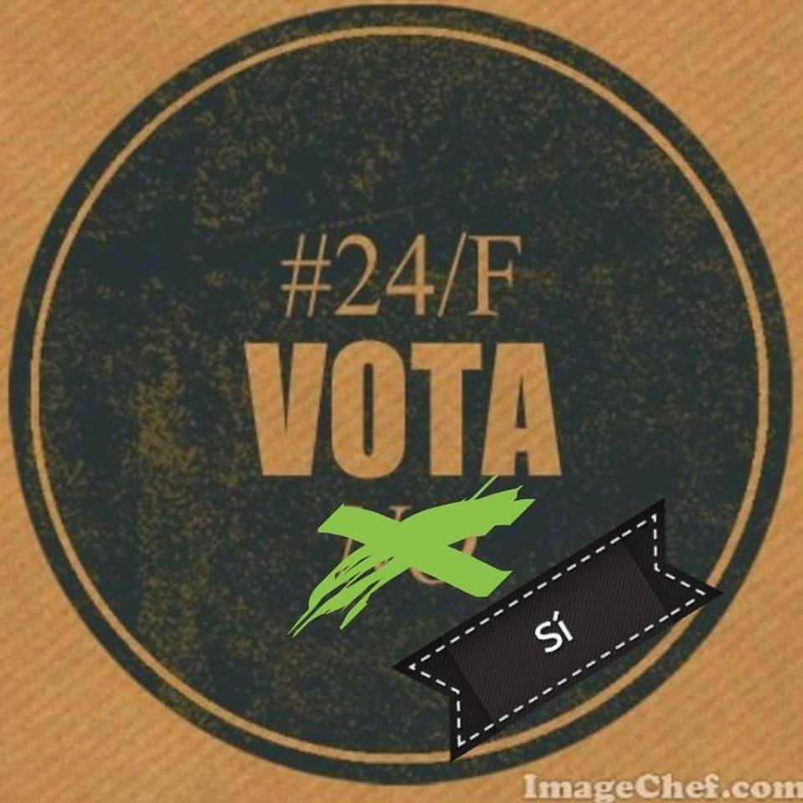
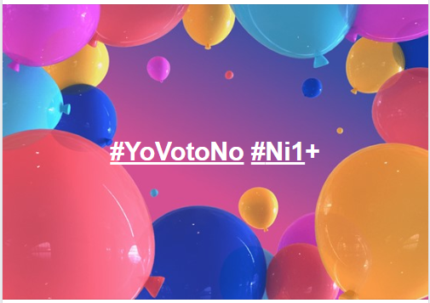
Existence and tolerance of Dissenting opinions

Slide 34
Willingness to Acknowledge Dissent

Slide 35
Polyfunctionality of the popular consultation
Unofficial channel of popular participation constituted by the Cuban government
Alternative, autonomous, self-organized channel of popular participation constituted by citizens, but modelled after existing mechanisms of Socialist democracy
Avenue for personal branding by the domestic and global intelligentsia
Marketing channel for domestic and foreign private businesses
«Safe space» to express emotionally intense, socially unacceptable responses

Slide 36
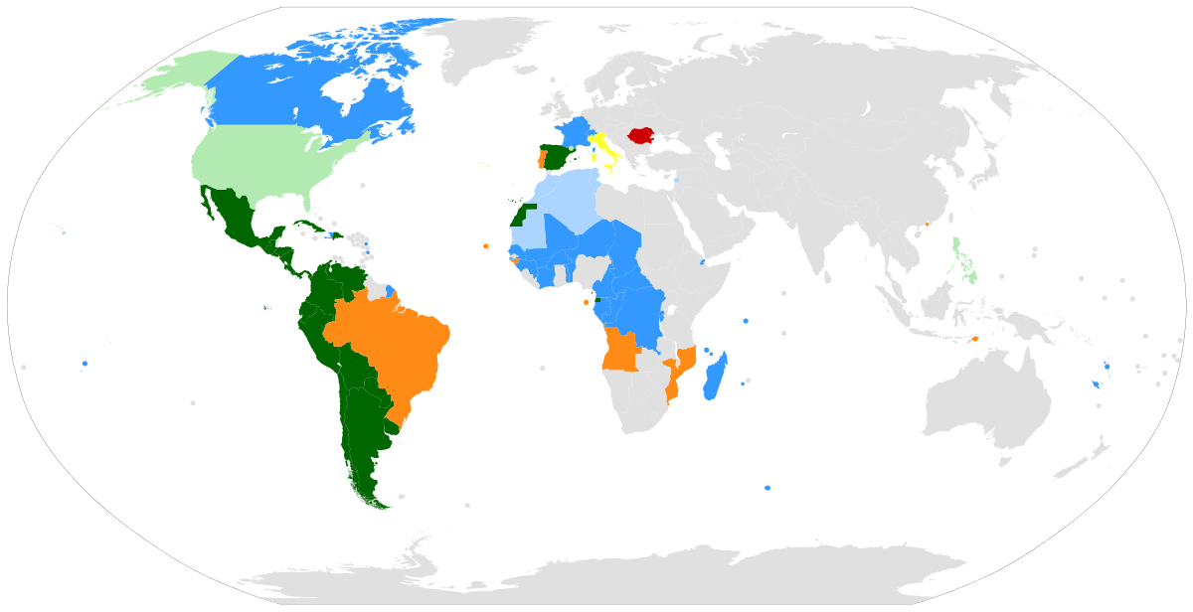
Removal of geographical borders and Globalization of domestic political processes

Slide 37
Thanks!

