Slide 1
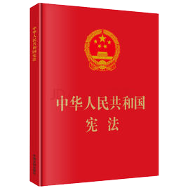


The Nature of CPPCC:
Normative or Political
Sun Ping

Slide 2
CPPCC in the Constitutional Law
In the long years of revolution, construction, and reform, there has been formed under the leadership of the Communist Party of China a broad patriotic united front composed of the democratic parties and people's organizations and embracing all socialist working people, all builders of socialism, all patriots who support socialism, all patriots who stand for the reunification of the motherland, and all patriots devoted to the rejuvenation of the Chinese nation. ……The Chinese People's Political Consultative Conference, a broadly based representative organization of the united front, …….The system of multi-party cooperation and political consultation led by the Communist Party of China will exist and develop for a long time.

Slide 3
Original Intention
The nature of PCC is different from state power organ——National Congress, and it is not an executive organ, too. Someone said only if the power of National Committee of PCC is equal or bigger than state organs, the PCC will be taken seriously. If so, then CCP has no power to make constitutional law, to make law, to make order, only can propose advices, is it not important? This is not right. If the CPP was turned into a state organ, then there will be two masters in one state. It can’t happen. The functions should be divided.
——Mao Zedong, On the Nature and Task of PCC, Dec. 12, 1954

Slide 4
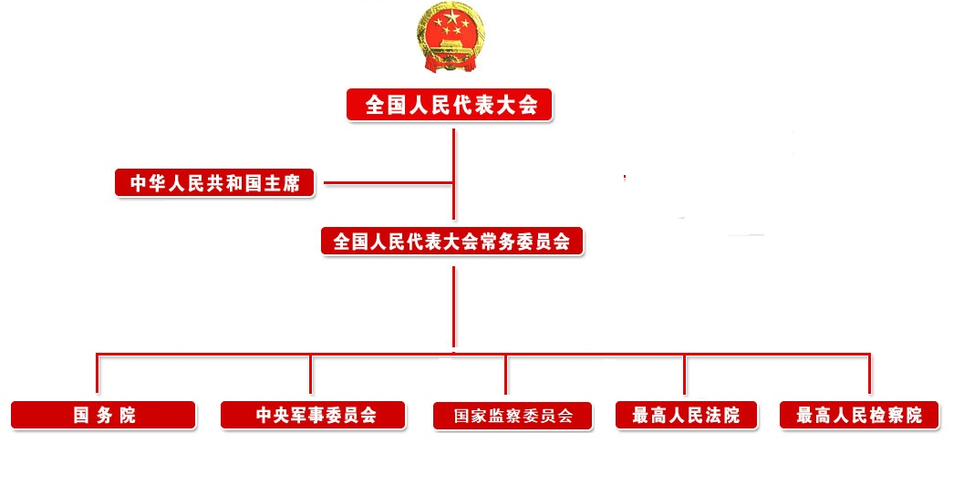

Slide 5
Normative vs. Political
Normative Constitutional Jurisprudence
  Fundamental Political System without Constitutionalization
  Bicameralization and Legalization
Political Constitutional Jurisprudence
  Popular Sovereignty
  Unwritten Constitutional Law

Slide 6
The Real Practice
Weakly Consultative
Highly Bureaucratic
Surprisingly Corporatization

Slide 7
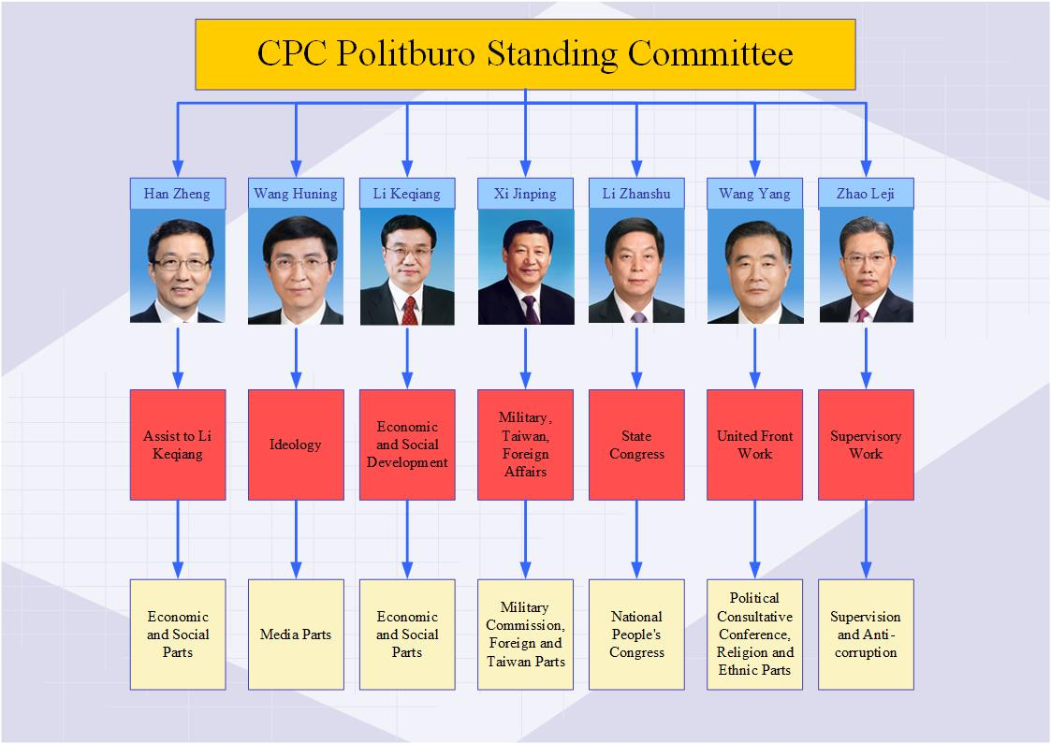

Slide 8
The Scandal of Ctrip Kindergarten
Ctrip.com International, Ltd.（携程）
People’s Organization（人民团体）
  Shanghai Federation of Trade Unions(上海总工会)
  Shanghai Women‘s Federation（上海妇联）

Slide 9
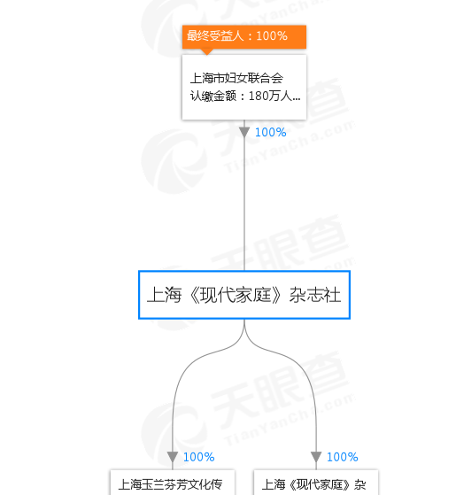
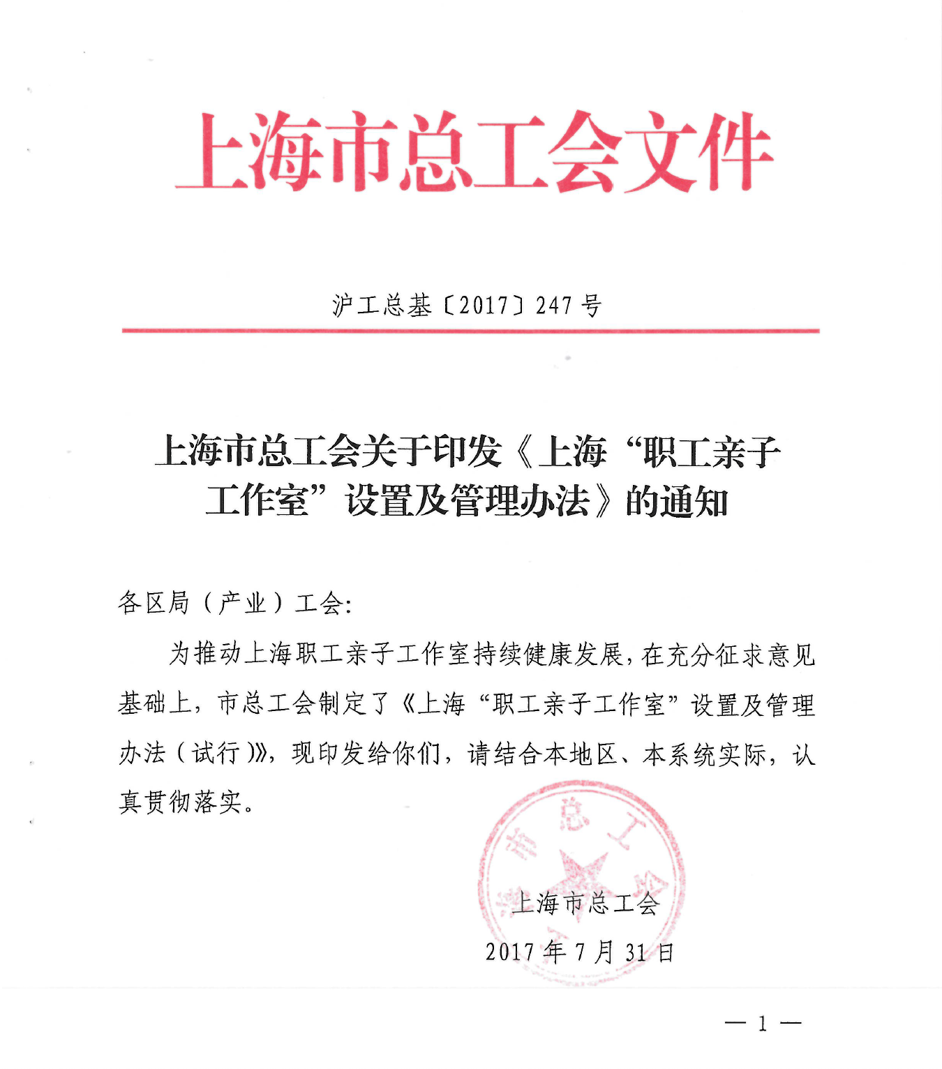

Slide 10
Conclusion
Normative: Not to avoid
Political: Not to paint
Back to Consultative Institution
  Jobs dividing with proper check and balance
  To divide consultation and regulation
  To divide people’s and organization

