Slide 1
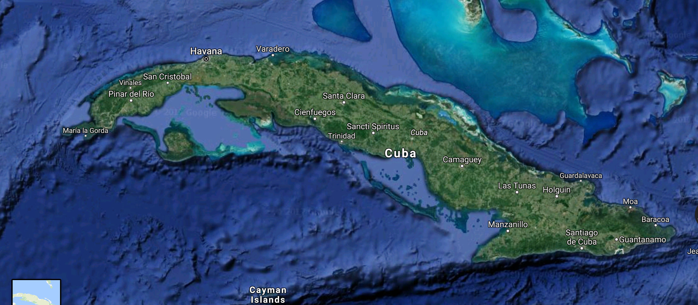
Cuba’s Caribbean Marxism:
Essays on Ideology, Government, Society, and Economy in the Post Fidel Castro Era
Larry Catá Backer
Book Launch
Lecture and Discussion
Penn State School of International Affairs
12 November 2018

Slide 2

Context
Genesis of book project:
Structuring governance
How ideology affects social, political, regional and legal structures

Slide 3

Introduction
The eco-system of Marxism
European
Asian
Latin American
Marxism versus Leninism
Normative principles
Principles of government
Caribbean Marxism
Ideology
Nationalism
Regionalism
Fortress Cuba
The incarnation of Cuba as the Party/state

Slide 4

Chapter 1
Pearl of the Caribbean and Mother of Marxism
Contemporary Cuba in the shadow of three great transformations
Historical foundations of ideology
Spanish conquest and colonization in the 15th century.
Hatuey
From Spanish colony to state.
Martí
1959 Revolution
Builds on a specific reading of the two prior transformations
How does one express independence?

Slide 5
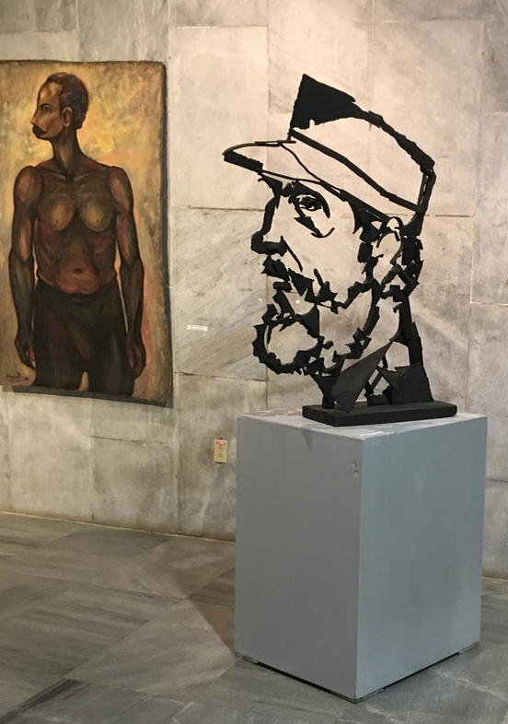
Chapter 2
The Centrality of Ideology to Caribbean Marxism
To “think like a Cuban”
framing premises within which Cuban officials at any rate, view and understand the world.
Socialism versus communism;
Cuba versus China Model
State versus Party; Law versus politics
Administrative decision-making and rules of discretion
defensive characteristics of an ideology built to protect its integrity against attack from the United States
markets are inherently corrupting
Either as an economic mechanism or as a regulatory approach
State capitalism and the construction of the ideal
The model worker
The model culture
Regional integration based on shared culture
Ethnic and migratory
Shared Anti-colonialism
Fortress Cuba

Slide 6
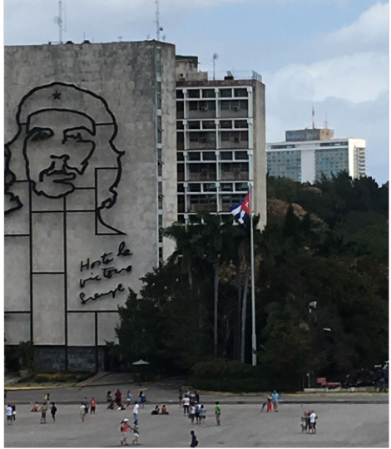
Chapter 3
Cuban Leninism as Praetorian Marxism
If ideology is the doorway through which one can more accurately understand Cuba, the key to opening that door lies in a better understanding of the context in which Leninism itself acquires “Cuban characteristics.”
Praetorian Marxism: Party as the army of politics
European Stalinism

Slide 7

Chapter 4
“Order, Discipline and Exigency:” From Ideology to Lineamientos and Reform With Cuban Characteristics
In the face or an organizing ideology, how does one effect reform as historical conditions change?
The chronicle of the Lineamientos (Guidelines) for “reform and Opening Up”
Party driven
A distinct sort of democratic practice
Ideology as the constraining element
The specific examples of education, Culture and Sport for the construction of a model society.

Slide 8
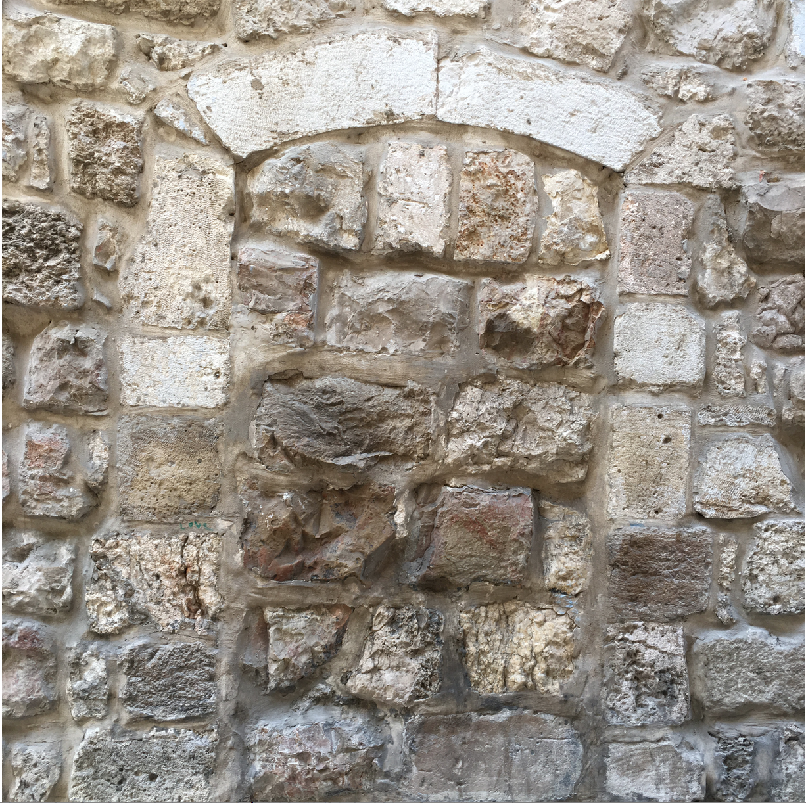
Chapter 5
The Current State of Political Ideology
The emergence of a revitalized revolutionary ideology that forms the contemporary framework of Caribbean Marxism.
The process of the Conceptualización del modelo económico y social Cubano de desarrollo socialista
suggests the framework through which it is possible to invest key terms with specific signification.

Slide 9
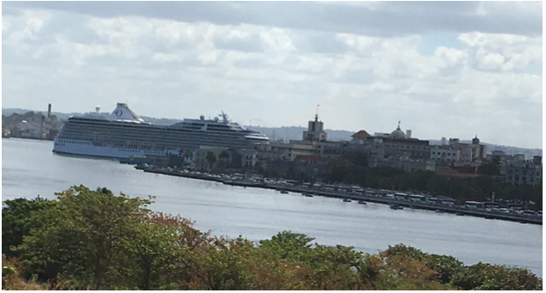
Chapter 6
The Ideology of Central Planning
Transplanting political ideology into an economic model.
Plan national de desarrollo económico y social hasta 2030: Propuesta de vision de la nación, ejes y sectores estratégicos or PNDES
From ideology to algorithm
Regulation as a means of managing exercise of administrative discretion
The model worker

Slide 10
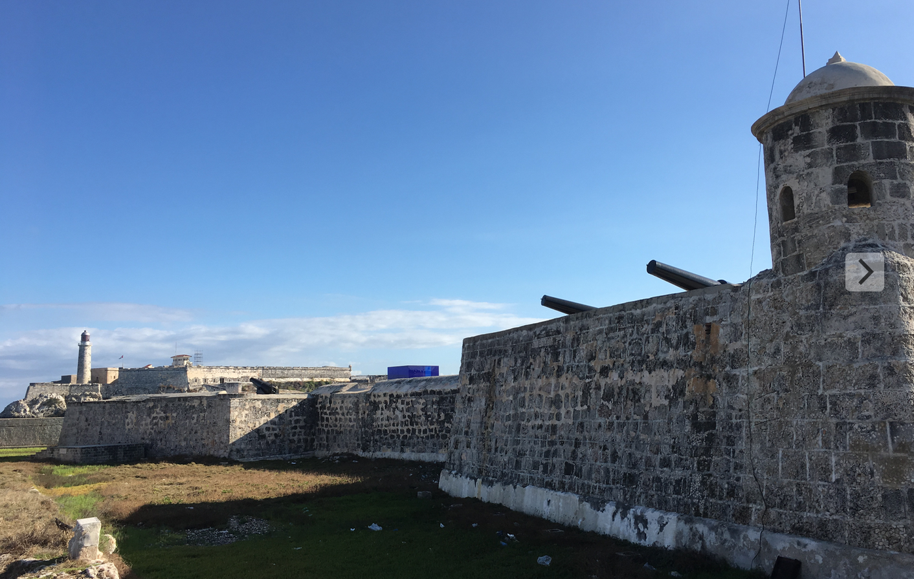
Chapter 7
Sovereign Finance, Odious Debt Doctrine, and Reform
Caribbean Marxist approach to sovereign finance.
Fortress Cuba applied to the global system of sovereign finance
Context is odious debt
Foundation is Marxist nationalism
Objective is to reject and transform system that is seen both as corrupt and as an extension of markets based capitalism
An indirect political indictment of post WWII globalization

Slide 11

Chapter 8
The Role of Labor Cooperatives in Cuban Reform
Examine the way that ideology has shaped the form and willingness of the state to open even a small space to the private sector
Focus on labor cooperatives
Spotlight project of Lineamientos
Case study of the way that ideology constrained and shaped reform

Slide 12
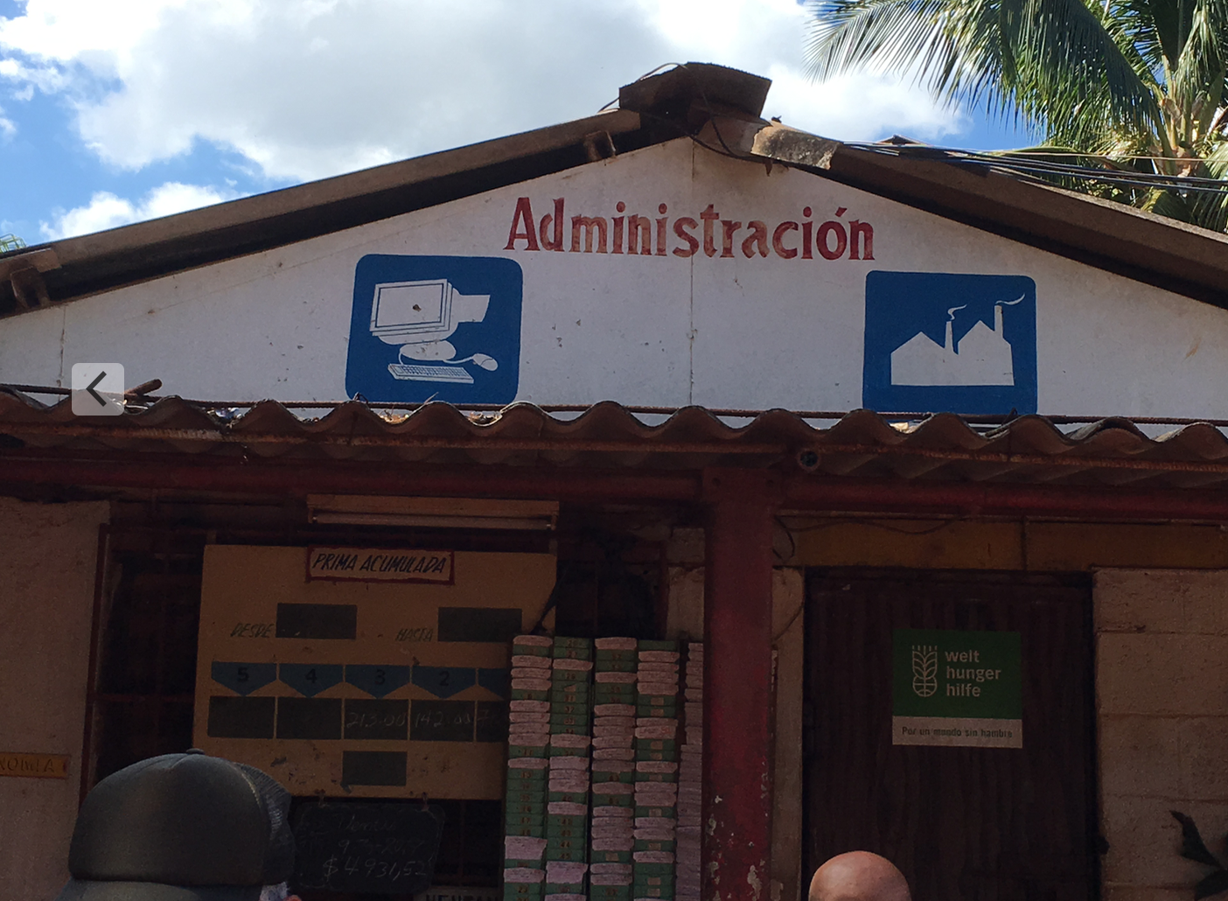
Chapter 9
The Challenges of Regulatory Reform
How reform was expressed in law
In an economic system in which the state was recognized as the principal owner (or controller) of productive capital, private activity organized in corporate form would have created an ideological contradiction.
Tightly controlled markets
Indirect central planning
Strong constraints against accumulating “excess” wealth
Private activity in the service of the state system

Slide 13

Chapter 10
Globalization and the Caribbean Marxist Multinational
Turn attention to issues of global trade and investment
considers the efforts to translate ideology to
forms of regional integration
to construction of multilateral trade regimes.
ALBA and a counter-ideology to global trade
Making good on the theoretical arguments developed in Chapter 7

Slide 14

Chapter 11
Reform and Global Corporate Social Responsibility
Another effect of the “Fortress Cuba” ideology.
Protection from emerging expectations in the conduct of transnational economic activity, and
Shielding Cuban external operations by sovereignty assertions.
Examines limits of Cuban efforts to protect the internal operation of its economy
Battleground—emerging global structures of business and human rights

Slide 15
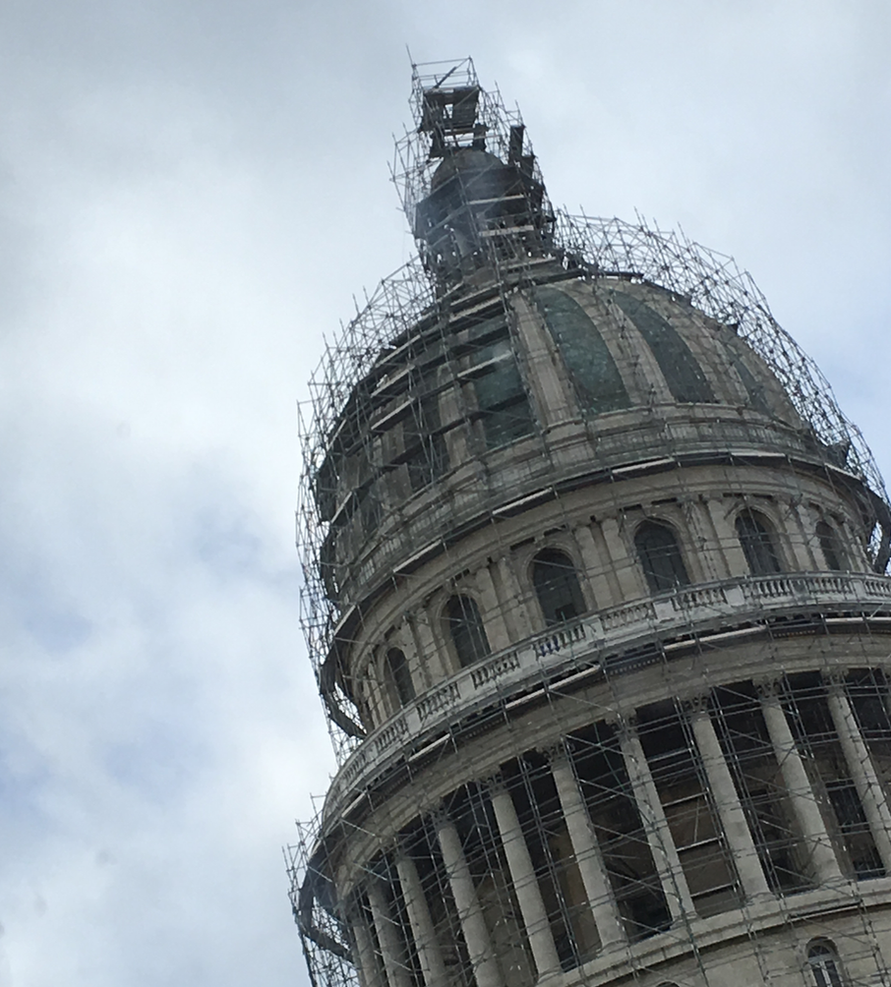
Chapter 12:
From Ideology to Cuban Constitutional Reform
returns to the initial problem of ideology.
This time the specific object of study is the construction of the administrative apparatus of government itself.
Look at the process and substance of the 2018 constitutional reform.
What is the meaning of constitutional reform in a Leninist system?
Can it be legitimate?
What are its constraints?
How does it express democratic engagement within its own ideological premises?

Slide 16
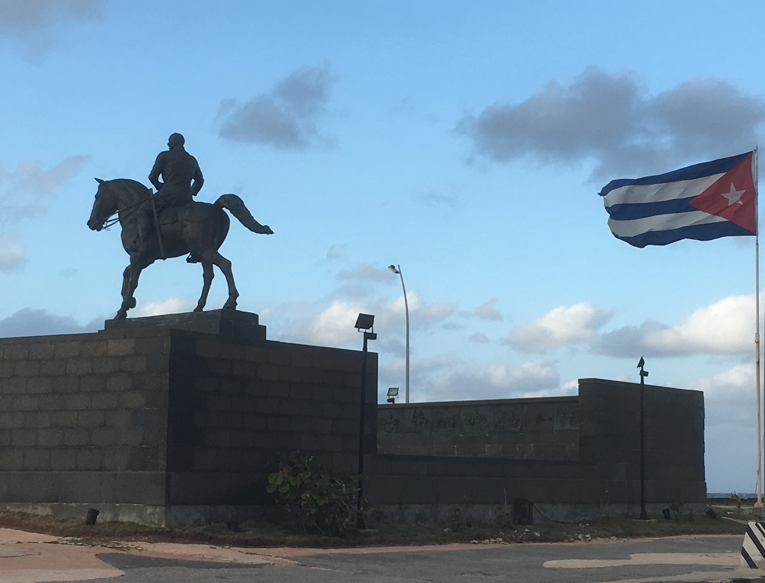
Moving Forward?
Caribbean Marxism provides a nicely self-contained system through which a faith could be premised, taboos developed, and meaning imposed in self-referencing ways
Caribbean Marxism provides a excellent example of the way that an ideology can operate on the construction of both the idea of the state and the expression of that idea in its institutions.
In understanding the way that Cuba sees and order themselves may be useful in helping us see ourselves more clearly.

Slide 17

Thanks! Consider Purchase!
ISBN: 978-1-949943-00-9 (pbk); ISBN: 978-1-949943-01-6 (ebk)

