Slide 1
The Key to Understand the New Era: The Reform of the Party-State Institutions
Sun Ping(孙平) Vice Researcher
Center for Rule of Law in China
East China University of Political Science and Law(ECUPL)

Slide 2
Two Maps of
Normative one: 90% of State Constitution
Political one: 90% of Party Constitution

Slide 3
A Broader Map
Public Power System=Party-State System
Supported by public finance
Built according to organization rules
Make or enforce rules
Has authority on certain public issues

Slide 4
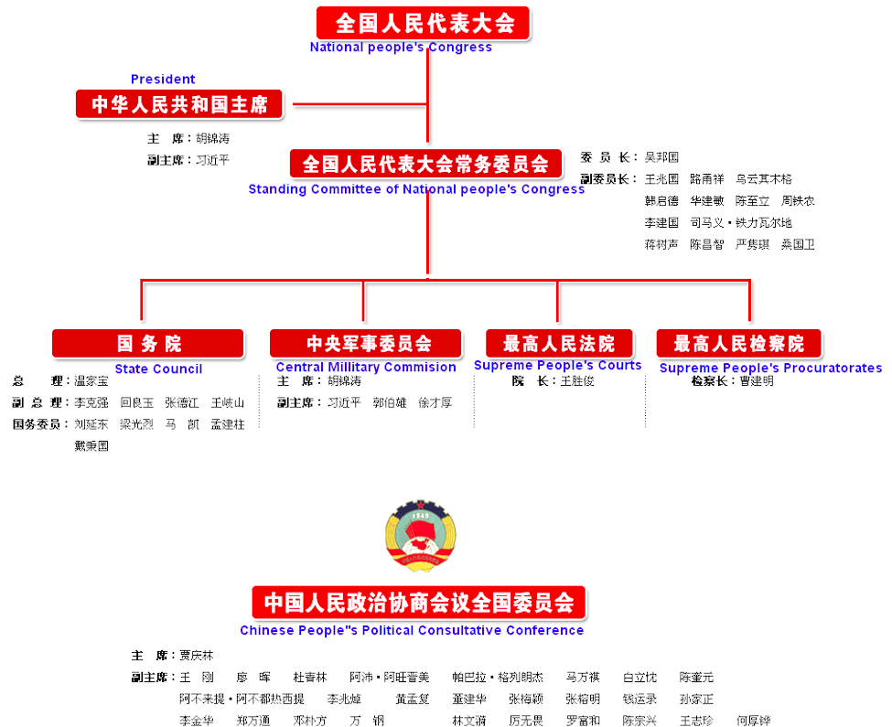

Slide 8
Horizontal Separation without Check and Balance
8 Parallel Lines
Ministries Reshuffled
Rule by Party vs. Rule by Law
Multiple Dysfunctions

Slide 9
Some Tests
NPC is a rubber stamp?
Why there is no western version of constitutional review?
Why a super Supervision Commission was needed?
Anti-monopoly Investigation on Telecom Companies

Slide 10
AML of 2007
Article 19: Undertakings that have any of the following situations can be assumed to be have a dominant market position:
(i) the relevant market share of one undertaking accounts for1/2 above;
(ii) the joint relevant market share of two undertakings accounts for 2/3above;
(iii) the joint relevant market share of three undertakings accounts for 3/4above.

Slide 11
Anti-monopoly Investigation
More then 90% of the broadband access market occupied by China Unicom & China Telecom
Apr. 2011, AM Bureau(NDRC) started a AM investigation according to someone’s report
A battle for market between Propaganda and Economy lines: rule by party vs. rule by law

Slide 12
The New Era
Party state system reform as a whole
Strengthen the rule of party
Check and balance by one line H+V
Organization according to law

Slide 13
Conclusion
Define the lead of party in legal term
More check and balance between different parallel lines

Slide 14
Thank You！ sunping.ecupl@gmail.com

