Slide 1
The Role of Groups of the Communist Party of China in MNCs’ Social Responsibility
Regulation with Socialist Characteristics in the New Era
Flora Sapio
Paper prepared for the Conference «Rule of Law and Governance in China at Home and Abroad»,
Pennsylvania State University
March 15, 2018

Slide 2
CSR With Socialist Charactericts in the New Era
Regulation
Actors
Goals
Mechanisms
Party
State
Voluntary
Transnational
Party Groups
Inspection Tours
SASAC
Consultative Bodies
Local and Global Societal Actors
Party Leadership and Oversight
Party Remedial Mechanisms
Big Data
Ranking and evaluation algorithms
Inclusiveness, transparency, sustainability
Clean Governance
Labor, safety, quality
International Competitiveness

Slide 3
CSR in Chinese Party-State Constitutionalism
CPC Regulatory System
Political task Binding on:
- Party members, and institutions
- All enterprises with a Party group
State legal system
Declaratory, non-binding provisions
(5, Company Law; 7, Partnership Enterprises Law)

Slide 4
CSR and the Party Constitution
11, Preamble: principal contradiction between the People’s evergrowing needs for a
better life and unbalanced and inadequate development. People-centered, innovative, coordinated, green, and open development that is for everyone.
20, Preamble: socialist ecological progress
Xi Jinping Thought on Socialism With Chinese Characteristics for a New Era
Includes, and builds upon the concept of a comprehensive, sustainable, coordinated growth that respects man and the natural environment (Scientific outlook on development)

Slide 5
Social Responsibility and Party Organizations
25% - Party members in State-owned MNCs

Slide 6
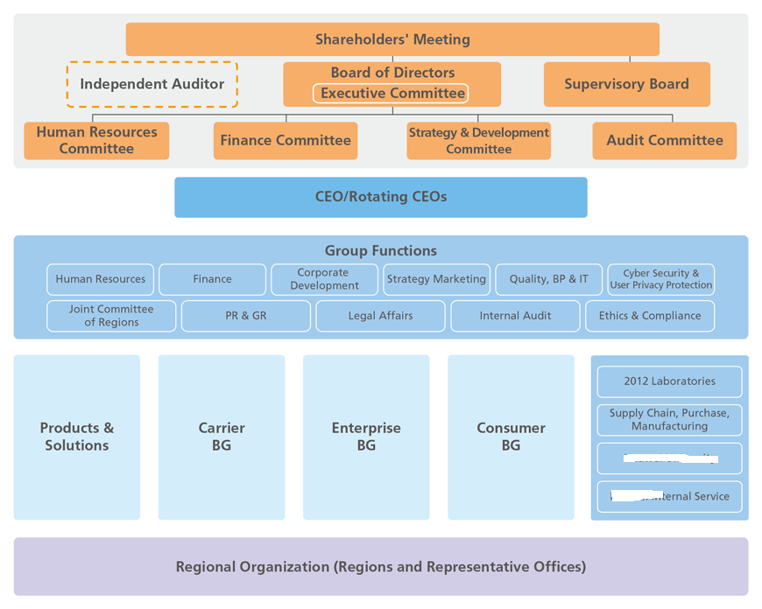
Social Responsibility and Party Organizations
Inspection Tour Groups of the Communist Party
Group of the Communist Party of China

Slide 7
Social Responsibility and Party Organizations
Groups of the Communist Party of China
in State-Owned MNCs
Overlap with corporate governance organs
Implement Party regulations on social responsibility, and clean governance
Monitor the conduct of all Party members
Monitor subsidiaries of State-Owned MNCs
Maintain coherence and consistency between the Party line and corporate conduct
Vicarious liability

Slide 8
Social Responsibility and Party Organizations
Inspection Tour Groups
Party organizations external to State-owned MNCs
Composed by Party investigative and anti-corruption organs, and by Party organization departments
External, comprehensive audits lasting from 30 days to 3-4 months
Organized by the Central Committee of the CPC and/or by SASAC

Slide 9
Goals of Party Organizations
Political Goals
External audits:
- Compliance with Party regulation
- Compliance with state regulation
- Compliance with enterprise self-regulation
Compliance with domestic and international standards on safety, labor, environmental emissions, etc.
Providing remedial mechanisms
Guidance, practical information and assistance with CSR compliance
Referral to judicial organs

Slide 10
Mechanisms of CSR in the «New Era»
Publicity
SASAC Report to the National People’s Congress
MNCs Report to Party Groups
MNCs Report to Inspection Tour Groups
MNCs Disclosure of Audits by Inspection Tour Groups
National Enterprise Credit Information Publicity System
«Conventional» CSR Reports

Slide 11
Mechanisms of CSR in the «New Era»
Ranking and Evaluation
Social Responsibility is an important component of the evaluation of «political quality»
Evaluation and ranking mechanisms internal to the Party
Use of domestic and transnational non-binding guidelines on social responsibility
Use of domestic standards on CSR, safety, social credit, etc.
Evaluation and ranking mechanisms targeted to State-owned MNCs
Computation of ‘social credit scores’
Blacklisting of non compliant enterprises

Slide 12
Opportunities and Challenges of Social Responsibility in the «New Era»
Opportunities
# 1. Consistent with global approaches to social responsibility. Party membership creates binding obligations but the decision to join the CPC is entirely voluntary.
# 2. Premised on multi-stakeholder approaches that value actors’ diversity and inclusion
# 3. Use of non-state based, state based, societal, judicial and non-judicial mechanisms
#4. Leverage not only by apex enterprises but by Party institutions as well

Slide 13
Opportunities and Challenges of Social Responsibility in the «New Era»
Challenges
# 1. Difficulty in conducting audits beyond third-tier subsidiaries
# 2. All monitoring, assessment, audit and compliance systems are limited to the territory of the PRC
# 3. Corporate social responsibility mechanisms based on non-state institutions are misunderstood and misrepresented
#4. Partial coverage of Party-based CSR mechanisms

