Slide 1
Apologetics of 2018 Constitutional Revision
Keren Wang
Department of Communication Arts
kuw148@gmail.com

Slide 2
Apologia and Apologetics
Formalized defense of doxa for the confirmation of doxa – or affirmation of certain “Good judgement”

Slide 3
Apologia
Plato’s Apologia – stasis (raising issue) - facts - logos (rules) - plea – conclusion (praise/blame)

Slide 4
Apologetics
A deliberative style in theology
The “Good” that apologetics argue an abstract, transcendent Other that is not subjected to the positive confirmation or negation via empirical reality.
This transcendent “Good” that apologetics seek to affirm is not a concrete thing or idea that we attribute as “being-good”, but presumed as “Good-itself”, or the source of all goods.

Slide 5
Apologetics – Cataphatics
Cataphatics seeks to positively defending doxa by ways of positive conformational reasoning, usually via connecting the doxa with other totemic “good” signifiers
沈春耀：”王晨同志作宪法修正案草案的说明，法律的说明通常不会有什么波澜，比较平稳。但是，在讲到这个问题的时候，现场响起了两次掌声，除了一开场和一结束以外唯一的一处两次掌声。大家可以想一想，有没有广泛的、坚实的政治基础、法理基础和社会基础？我觉得是没有问题的。”
“宪法的修改是国家政治生活的一件大事，是利国利民的一件大喜事，是新时代中国特色社会主义这样一个大的背景下，我国法治建设取得的重大成果...可喜可贺。”
王晨: “符合国情、符合实际、符合时代发展”

Slide 6
Apologetics – apophatics
Apophatics, conversely, seeks to defending doxa via way of negation, typically via naming the inevitable and insurmountable ills that would stem from the rejection of doxa. Apophatics involves the identification of heretical claims and taboo acts, and then counter them via negation.
“Explicit silence” – the identification of heretical claims in-itself amounts to a taboo act

Slide 7
Apologetics – hamartiology
hamartiology (ἁμαρτία, hamartia, "error") – which involves narratives on the alleged transgressions of totemic beliefs, and identification of the accursed.
Xinhua: “一是坚持党对宪法修改的领导。坚持党中央集中统一领导 ...增强政治意识、大局意识、核心意识、看齐意识”

Slide 8
Apologetics – Etiology
Etiology, or the “origin myths,” that serve as legitimation narratives for the court to declare a more perfect and complete interpretation of the law’s “original” meaning.
沈春耀: “这次宪法修正案的一个重要内容就是对现行宪法的第79条第三款的规定作出修改完善”
Xinhua: “我国现行宪法是根据党的十一届三中全会确定的路线方针政策、于1982年12月4日由五届全国人大五次会议通过并公布施行的。再往前追溯，1982年宪法是对1949年具有临时宪法作用的《中国人民政治协商会议共同纲领》、1954年《中华人民共和国宪法》的继承和发展。”

Slide 9
Apologetics – Soteriology
Soteriology (σωτηρία sōtēria "salvation") – which deals with narratives that justifies certain sacrifice on the condition that its bringer greater collective salvation.
People’s daily: “大力弘扬宪法精神，才能更好发挥宪法在新时代推进全面依法治国、推进国家治理体系和治理能力现代化中的国家根本法作用，让宪法为中华民族伟大复兴的中国梦保驾护航。”
Xi: “实现中华民族伟大复兴的中国梦”

Slide 10
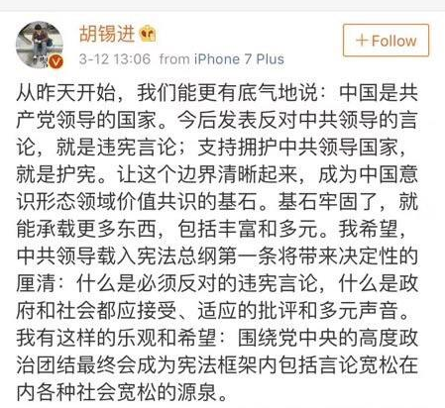
Apologetics – Eschatology
Eschatology (ἔσχᾰτος, ‎éskhatos, “end of a continuum”) – which concerns the finality of contestable meanings (e.g. SCOTUS as final interpreter of law), preclusion continued debate of a meaning
“宪法的根基在于人民发自内心的拥护，宪法的伟力在于人民群众真诚的信仰。宪法只有深入人心，宪法实施才能真正成为全体人民的自觉行动”

