Slide 1
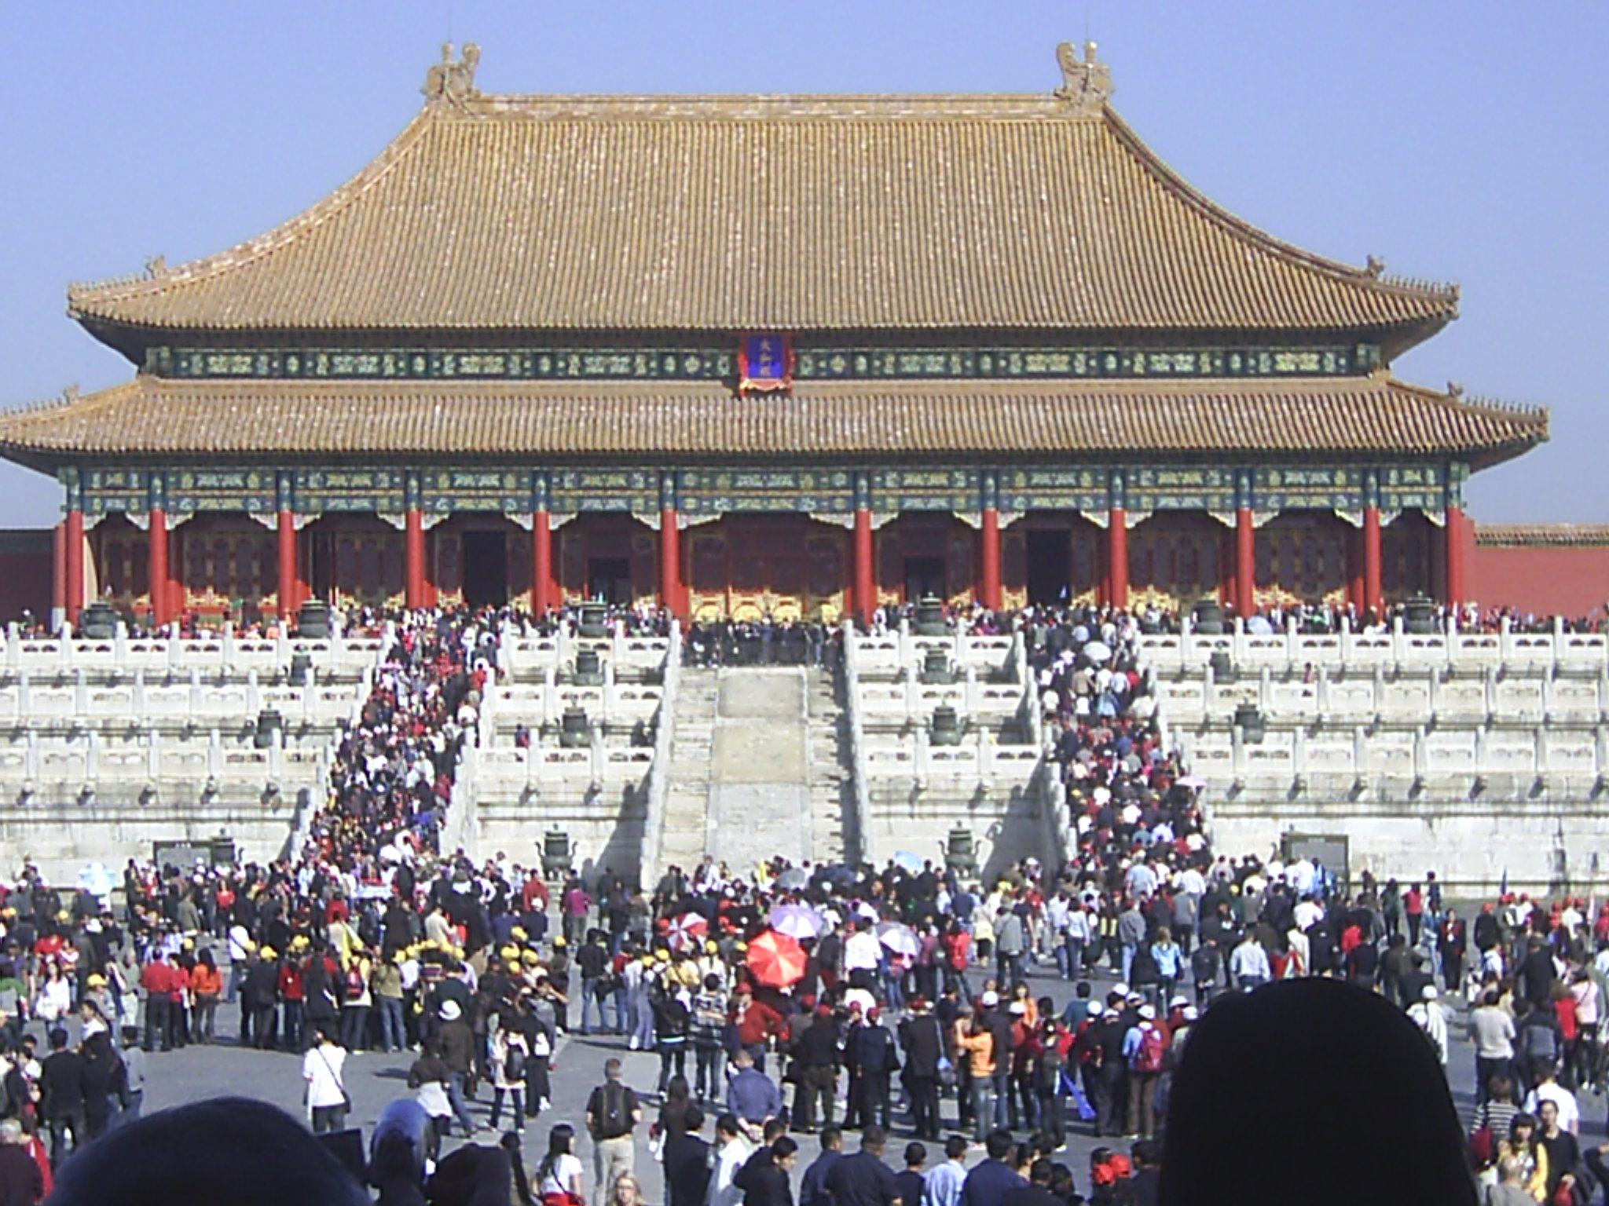
China’s One Belt One Road (OBOR) Initiative and the New Communist International.
Larry Catá Backer (白 轲)
W. Richard and Mary Eshelman Faculty Scholar Professor of Law and International Affairs
Pennsylvania State University | 239 Lewis Katz Building, University Park, PA 16802
Presentation for the Conference
Rule of Law and Governance in China at Home and Abroad
中国的法治与国家治理：国内与国外两个视角
Pennsylvania State University 15 March 2018

Slide 2
Context: Communist Internationalism
The Third, Communist, International (Comintern) lasted from 1919 when it was established by Lenin in Moscow, through 1943 when it was dissolved by Stalin as a gesture toward his allies against Axis powers.
It produced a powerful template for the internationalization of ideology and its discipline by a central authority.

Slide 3
Communist Internationalism With Chinese Characteristics in the New Era?
This paper considers the echoes of the Comintern in the structures and operations of the OBOR Initiative.
It explores the extent to which OBOR might be considered the start of a 4th International, one grounded not on politics and revolution, but on economics and markets based coordinated power.

Slide 4
Order of Discussion
European Communist Internationalism
from the1st through the 3rd International
Chinese International Engagement
The construction of New Era Internationalism
Divergence and Convergence
Proletarian Internationalism
Markets internationalism
Other Internationalisms: The Washington Consensus

Slide 5
The Working Class has no country
The First International, founded by Marx, existed from 1864 to 1872. The defeat of the heroic workers of Paris-of the celebrated Paris Commune-marked the end of this International. It is unforgettable, it will remain for ever in the history of the workers' struggle for their emancipation. It laid the foundation of that edifice of the world socialist republic which it is now our good fortune to be building.
Lenin’s Collected Works, 4th English Edition, Progress Publishers, Moscow, 1972 Volume 29, pages 240-241

Slide 6
The Working Class Develops an Institutional Form
The Second International existed from 1889 to 1914. . . This was the period of the most calm and peaceful development of capitalism. . . . During this period the working-class movement gained strength and matured in a number of countries. But the workers' leaders in most of the parties had become accustomed to peaceful conditions and had lost the ability to wage a revolutionary struggle. When, in 1914, there began the war, . . . these leaders deserted to the side of their respective governments. They betrayed the workers, they helped to prolong the slaughter, they became enemies of socialism, they went over to the side of the capitalists.
Lenin’s Collected Works, 4th English Edition, Progress Publishers, Moscow, 1972 Volume 29, pages 240-241

Slide 7
From Institution to the Institutionalization of Global Political Proletarian Revolution
3rd International
“Today, the workers who have remained loyal to the cause of throwing off the yoke of capital call themselves Communists. All over the world the association of Communists is growing. In a number of countries Soviet power has already triumphed. Soon we shall see the victory of communism throughout the world; we shall see the foundation of the World Federative Republic of Soviets.”
Lenin’s Collected Works, 4th English Edition, Progress Publishers, Moscow, 1972 Volume 29, pages 240-241

Slide 8
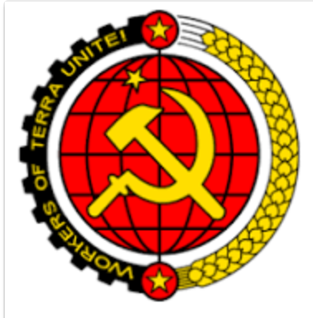
The Comintern 1919-43
Focus on class struggle
Proletarian political world revolution
  Failures: Spartacists Germany
  Hungarian Soviet
  Italian loss to fascist revolution
By 1924 refocused on the defense of Soviet Union
Internationalism through state development
Control of Communist Parties around the world
From Comintern to Cominform 1943
  Control of Soviet satellite countries

Slide 9
Toward Chinese Internationalism
Objective
Make a place for Chinese approach to economic, social and political models
Provide leadership in the elaboration of alternative basis for national organization and global engagement
Methods
OBOR
Engagement in international organizations
Participation in international financial structures

Slide 10
Core RMB Internationalization in Fits and Starts
  People’s Bank of China Governor Zhou Xiaochuan called for reform of the international reserve system. Zhou (March 2009)
  Pilot program for cross-border trade settlement in the RMB launched in 2009; 2011 RMB trade settlement extended to cover all cross-border trade.
  Offshore markets for RMB denominated bonds
  bilateral local currency swap agreements (use RMB to finance imports from China) with 33 foreign central banks (e.g., European Central Bank) by 2015.
  Renminbi Qualified Foreign Institutional Scheme (RQFII), which permits licensed foreign investors to invest in equities and bonds in China using offshore RMB
  RMB clearing banks that offer clearing services for RMB transactions (20 countries by the end of 2015)
  The Cross-border Interbank Payment System (2015), which facilitates the settlement of trading and and investments denominated in RMB.
  RMB now in global currency basket
  European Central Bank RMB holdings
Capital Controls remain restrictive
Fluctuating markets for RMBs
Fears of instability and economic cooling
No consistent systemicity to efforts
  “The shrinking offshore currency pool, as well as the stronger rate outside the mainland, has prompted suggestions among traders that Beijing is happy to allow the offshore market to stagnate for now as it switches its focus from the long-term goal of internationalisation to the more pressing issue of stabilising the renminbi.” (Renminbi internationalisation remains elusive)

Slide 11
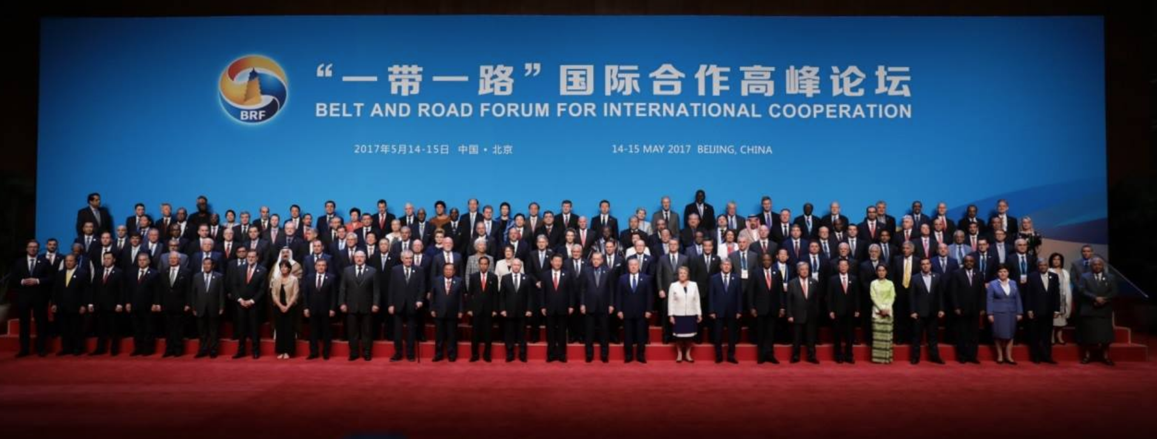
The OBOR Initiative

Slide 12
OBOR Chronology
OBOR was first put forward by President Xi in national visit to Middle East and SE Asia in September 2013.
  At the time he said all the countries along Silk Road will be better off if they could revive a modern version of the old silk road (see President Xi Jinping Delivers Important Speech and Proposes to Build a Silk Road Economic Belt with Central Asian Countries).
  Even local hosts paid little attention, thinking it was more rhetoric than substantive.
Third Plenary Session of the 18th Central Committee of the Communist Party of China there was a formal call for the called for accelerating infrastructure links among neighboring countries and facilitating the Belt and Road initiative.
In March 2014, Premier Li Keqiang, in a report to the National People's Congress called for accelerating Belt and Road construction Development of significance laid down in those reports.
October 2014 -- Twenty-one Asian countries willing to join the AIIB as founding members signed the Memorandum of Understanding on Establishing AIIB.
March 5, 2015 -- Premier Li, in his government work report, again highlighted the initiative, saying China will move more quickly to strengthen infrastructure with its neighbors, simplify customs clearance procedures and build international logistics gateways.
2015 to present: announcement of several infrastructure projects (ports, roads, etc.) to build physical structures of OBOR
Sino-CEEF, which was inaugurated by Premier Li Keqiang and his Latvian counterpart Maris Kucinskis in the Latvian capital Riga in November 2016, was set up as a platform for economic cooperation between China and Central and Eastern Europe

Slide 13
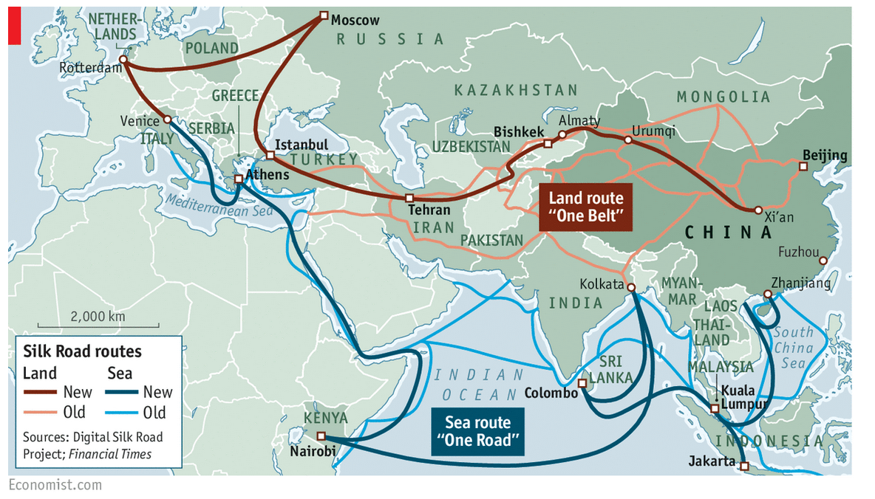
OBOR Routes
OBOR Routes
  (1) silk road economic belt (land based belt to West);
  (2) 21st century maritime economic belt. The land route will cover 65 countries in addition to the 2 maritime routes. These are then supported by a large number of interlinked commercial centers along the road.
  Space?
    'Belt and Road’ Space Information Corridor.” (Source)
Source: Our Bulldozers, Our Rules, The Economist

Slide 14
OBOR Out of BITs and Pieces
No OBOR “treaty” or unified instrument
  OBOR is formally constituted through (a) a set of coordinated BITs; and (2) collateral related policies (infrastructure; culture, and education ties)
Two ways of looking at the issue.
First, Transforming Conventional Structures through piecemeal and soft multilateralism.
  As piecemeal multilateralism: partnership arrangement between countries (an aggregation of BITs), yet also bearing some elements of regional economic integration. These can be fine tuned in one to one negotiations. That, in effect, is what China has appeared to be doing
  As soft multilateralism: b2b and p2p cooperation, education exchanges etc.
  As collateral multilateralism: trade dependent on collateral agreements touching on infrastructure, financing and investment (lubricated through RMB internationalization in fact, e.g. all yuan transactions )
  Challenges COORDINATION AND COHERENCE: Need to assemble a number of distinct legal instruments to produce a legalized OBOR framework.
Second, OBOR may be treated as sui generis.
  Two points were emphasized in this respect. First, it could take advantage of traditional diplomatic partnerships, producing a new model of alliance or association among states grounded in principle and soft power arrangements. Dean Shen Wei pointed to the partnership arrangement with Sweden as a new model; or it could point to a Chinese version of the Marshall Plan) (for commentary along those lines see here). Second, the focus on "Partnership and Cooperation Agreements (PCSs) (e.g. here generally pp. 389-93) could reshape the trade only focus of OBOR into a more comprehensive social and political and cultural vehicle to produce a new version of global governance, a Chinese version of globalization that also advances Chinese national interests.

Slide 15

Asia Infrastructure and Investment Bank
multilateral development bank with a mission to improve social and economic outcomes in Asia and beyond.
HQ Beijing
Commencement January 2016
84 approved members from around the world.
“By investing in sustainable infrastructure and other productive sectors today, we will better connect people, services and markets that over time will impact the lives of billions and build a better future.”
“AIIB does not have country strategies for its members. AIIB will review any project that is aligned with the Bank’s thematic priorities and will bring clear benefits to Asia.”

Slide 16
Key Areas of OBOR Policy
G2G Policy Coordination
Infrastructure connectivity
P2P connectivity
B2B connectivity
OBOR Policy Objetives
Cultural Cooperation and educational exchanges
Financial Cooperation
Regional Trade
Meant to represent a coordinated framework of hard and soft power implemented through both public and private channels.
  Soft power is bound up in the people to people exchanges.
  Most amplified through media coverage are the infrastructure projects and financial cooperation.

Slide 17
Putting Policies Together
BITs
Infrastructure
SOEs; SWFs 走出去战略
Investment
FTAs
Finance RMB Internationalization
中国
Cultural Cooperation
Social Credit
Why are OBOR and RMB internationalization linked
  Stability
  Development
  Control
RMB internationalization makes no sense outside this complex web of interrelated economic and political objectives
A world of cross-dependencies: Success of any are tied to all.

Slide 18
Overall Objective: New Era Thinking
(1) transition to new normal for trade and finance;
(2) change of focus from the old "go out" (走出去战略) policy to a new "go global" policy
(3) policy to seek yuan internationalization
(4) effort to re-balance drivers of trade and trade structures.

Slide 19
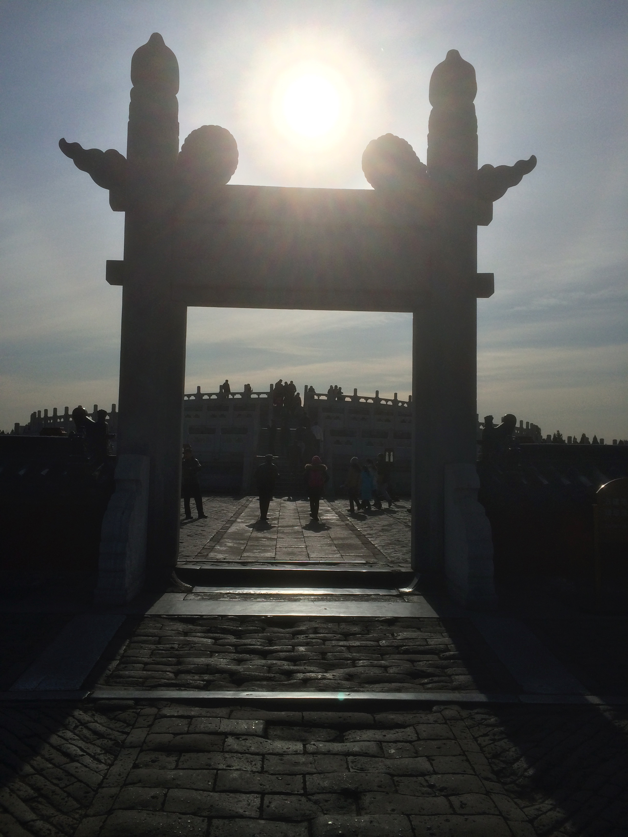
Summary Points
Why are OBOR and RMB internationalization linked?
  Stability; Development; Control
In order to protect Chinese interests it is necessary to protect an international economic system in mortal danger caused by its own fatal flaws, as well as the missteps and inattention (and growing lack if capacity) of the Americans (again from a Chinese point of view).
That requires greater power to control the reality of global trade and investment as well as to manage the perception of control.
To that end, China cannot merely step into the shoes of the United States; it must instead construct its own "shoes" for leading global trade and finance in ways that both serve Chinese interests, and consequently those of the global trade and finance regimes those interests must also serve.
Four Prongs:
  TRADE: OBOR;
  INFRASTRUCTURE: AIIB and other development facilities;
  FINANCE: RMB Internationalization;
  CULTURE/EDUCATION: Social Credit-

Slide 20
A 4th Communist International?
3rd International
Grounded in politics
Revolution as technique of choice
Basis in class struggle and the triumph of the proletarian order
Values based changes reflected in social, economic and political organization
Soviet Union as the vanguard and centering element
Result: Borderless world in which the proletarian revolution realized through the leadership of the (Russian) communist party
4th International?
Grounded in economics
Markets based integration as technique of choice
Basis is development of productive forces
Values based changes reflected in economic, political and social organization
China as the vanguard and centering element
Result: Borderless world in which integrated national productive forces can be developed under the leadership of the (Chinese) communist Party

Slide 21
Compared to Western Internationalism?
Western
Washington consensus
Multilateralism based on investor protection and national neutrality
Markets focused
Key role for IFIs in socializing national behavior to international consensus conduct
Focus on good governance
Ideology of democratic governance
Chinese
OBOR
Mutually advantageous cooperation based on aggregating bilateralism
Markets Marxism as a basis
Key role of AIIB in socializing participating states to OBOR framed consensus conduct
Focus on corruption
Ideology of non-interference

Slide 22
Thanks!
Contact author at lcb911@gmail.com

