Slide 1
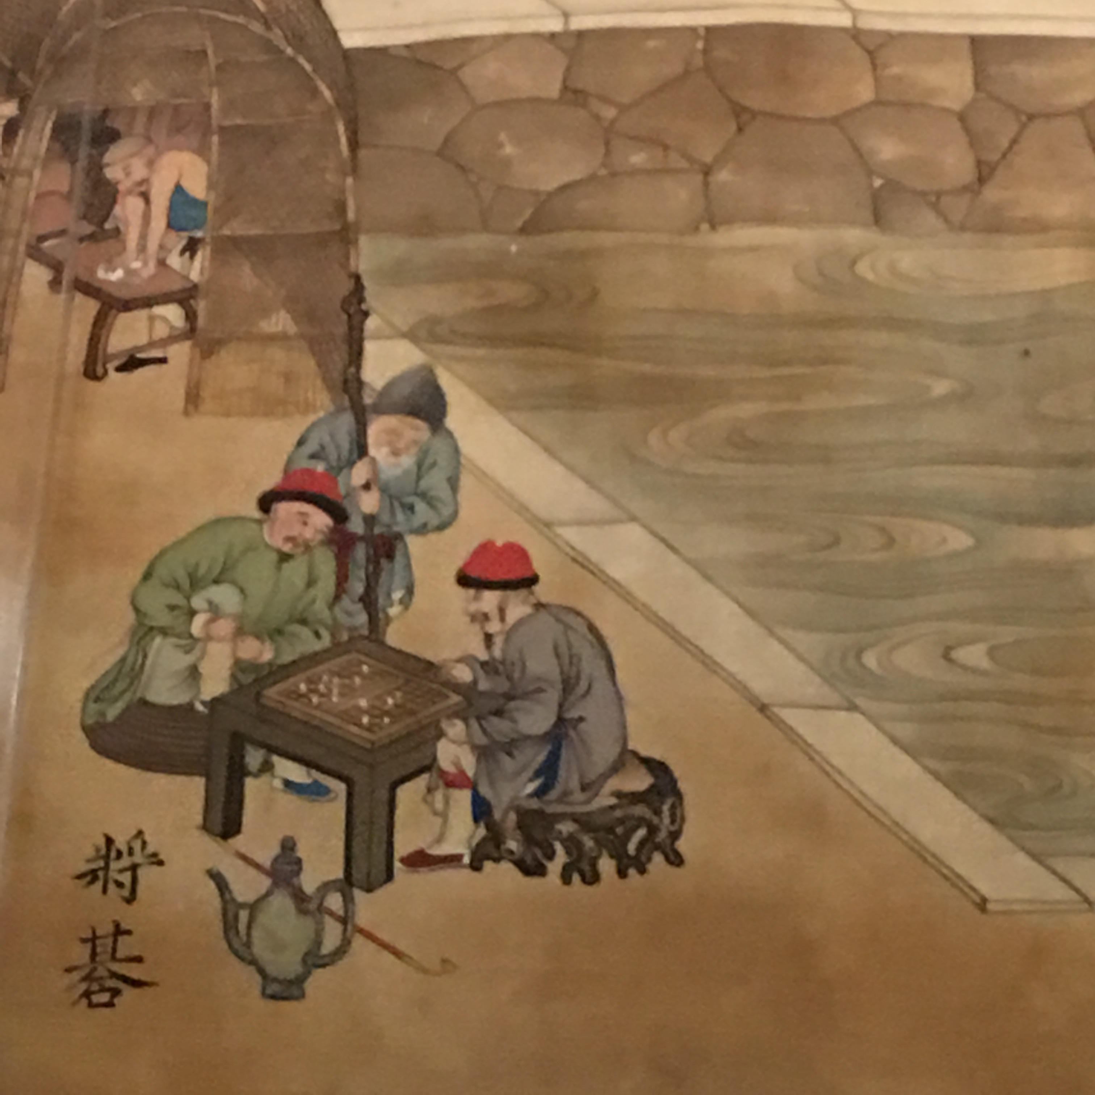
Snapshot: Tools for Grievance Mechanisms in China; Flora Sapio and Larry Catá Backer
(1) How the global language of the Third Pillar can be transposed to Marxist-Leninist contexts, and their transnational supply chains.
Case studies: SOEs and human rights due diligence in Chinese enterprises operating in Africa
(2) How Big Data technologies and initiatives can be used as a grievance mechanism.
Considering the use of social credit systems to create enterprise CSR credit systems
(3) How grievance and monitoring mechanisms originating from within Marxist-Leninist systems can be embedded in supply chains.
Scenarios: (1) Working through the local Communist Party organs of enterprises; (2) empowering local labor council’s to serve as the focal point for mediating grievances and remedies.
(4) How state organs can contribute to the creation of transnational grievance mechanisms through the regulation of specific sectors
Chinese state approaches to CSR guidelines

