Slide 1
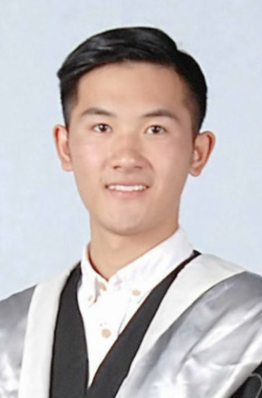
Roundtable Discussion on The 19th National Congress of CPC
Moderator’s Bio
Miaoqiang is a Master of International Affairs ’19 candidate and serves as the president of the Research and Career Development Network for Law and International Affairs. He works as an research assistant to professor Backer and a research intern at the Foundation for Law and International Affairs. Being honored with the College Graduate Excellence Award of Shanghai, he graduated and gained his Bachelor of Laws and Bachelor of Economics from Shanghai University of International Business and Economics in June 2017. He also studied political science at Université Paris Ouest Nanterre La Defénse in Paris, France as an exchange student in 2015.
Miaoqiang Dai
Hosted by: Penn State Law; Penn State School of International Affairs; Coalition for Peace and Ethics; and the Research Career Development Network of Law and International Affairs

Slide 2
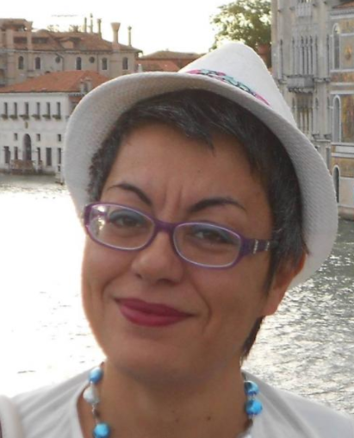
Speaker’s Bio
Roundtable Discussion on The 19th National Congress of CPC
Dr. Flora Sapio (Habilitated Associate Professor) is a Board Member of FLIA. She is internationally reknown for her sophisticated analyses of themes in China studies ranging from legal theory to politics, from economy and society to political communication, from criminal law to social organisations. Her mixed intellectual background, and life experiences in China, the United States, Europe, and Australia have shaped her perspective on the most diverse topics. She is the author or editor of China: The Justice Experience (Cambridge University Press, 2017), Legal Reforms and Deprivation of Liberty in China (Routledge, 2016), The Politics of Law and Stability in China (Edward Elgar, 2014), Sovereign Power and the Law in China (Brill, 2010), besides several articles and commentaries on contemporary issues.
Flora Sapio
Hosted by: Penn State Law; Penn State School of International Affairs; Coalition for Peace and Ethics; and the Research Career Development Network of Law and International Affairs

Slide 3
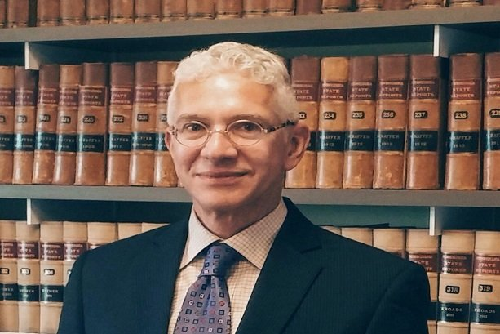
Speaker’s Bio
Roundtable Discussion on The 19th National Congress of CPC
Larry Backer is the W. Richard and Mary Eshelman Faculty Scholar and Professor of Law & International Affairs at the Pennsylvania State University (B.A. Brandeis University; M.P.P. Harvard University Kennedy School of Government; J.D. Columbia University). His research focuses on governance related issues of globalization and the constitutional theories of public and private governance, with a focus on institutional frameworks where public and private law systems converge. He is particularly interested in transnational problem solving through law, broadly defined, including issues of corporate social responsibility, the relationship between state-based regulation and transnational systems of “soft” regulation, state participation in private markets and the emerging problems of polycentricity where multiple systems might be simultaneously applied to a single issue or event, and problems of translation between Western and Marxist Leninist (especially Chinese) constitutional systems. He teaches courses in corporate law, transnational law, and International Organizations.
Larry Cata Backer
Hosted by: Penn State Law; Penn State School of International Affairs; Coalition for Peace and Ethics; and the Research Career Development Network of Law and International Affairs

Slide 4
Speaker’s Bio
Roundtable Discussion on The 19th National Congress of CPC
Professor Patricia Thornton currently serves as the Chair of the Sub-Faculty of Politics and International Relations, Chair of the PPE Committee, which oversees and manages the PPE degree programme at the University of Oxford.
Professor Patricia Thornton’s research focuses on mapping the interactions—including institutions, practices and networks—between state and social forces in China over time. She was awarded a 2011-12 British Academy Mid-Career Fellowship to begin work on a monograph on the enduring impact of the Chinese Cultural Revolution, the political transformation of the Chinese Communist Party, and the rise of the New Left. She has also published articles on grassroots Party-building in the non-publicly owned sector of the economy and among NGOs, contemporary urban geographies of power and consumption in Beijing, and the shifting practices of "making public opinion" (造舆论) under reform
Patricia Thornton
Hosted by: Penn State Law; Penn State School of International Affairs; Coalition for Peace and Ethics; and the Research Career Development Network of Law and International Affairs

Slide 5
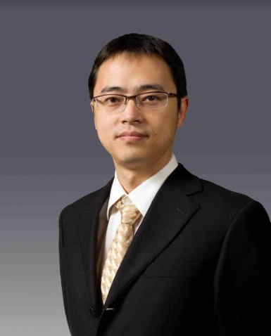
Speaker’s Bio
Roundtable Discussion on The 19th National Congress of CPC
Dr. Sun Ping is a Vice Researcher at the Center for Rule of Law in China, East China University of Political Science and Law. Dr. Sun’s research focuses on the constitutional law, fundamental rights, right to privacy, data protection, and freedom of expression. His current research focuses on social credits and data protection, defamation law and free speech. Though without any aboard education or research experience yet, he has been trying to bridge China and the world with the language and theory that both sides can understand.
Ping Sun
Hosted by: Penn State Law; Penn State School of International Affairs; Coalition for Peace and Ethics; and the Research Career Development Network of Law and International Affairs

Slide 6
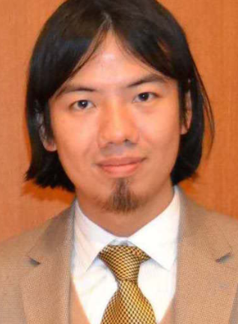
Roundtable Discussion on The 19th National Congress of CPC
Speaker’s Bio
Keren Wang is a Ph.D. Candidate in Rhetoric with Social Thought Minor (A.B.D., expected December 2017) Pennsylvania State University, University Park, PA. Department of Communication Arts & Sciences. He works as a graduate instructor at Penn State University’s Department of Communication Arts & Sciences, and as the Assistant Director for the Coalition for Peace & Ethics. Keren holds a master’s degree in International Affairs from Penn State University, and a B.A. in International Area Studies from Drexel University and Sophia University in Tokyo, Japan. As a researcher, Keren’s interdisciplinary background has enabled him to employ pluralistic methods to the study of global problems, where he has engaged in a wide range of research projects involving political rhetoric, constitutionalism, transnational law, socio-economic rights and social movements. Prior to joining the CPE, Keren worked at University of Pennsylvania’s Wharton School of Business as the manager of the student support office, and as a research intern at the Global Security Institute, Philadelphia.
Keren Wang
Hosted by: Penn State Law; Penn State School of International Affairs; Coalition for Peace and Ethics; and the Research Career Development Network of Law and International Affairs

Slide 7
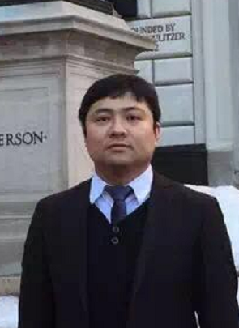
Speaker’s Bio
Roundtable Discussion on The 19th National Congress of CPC
Yuhua Sun
PH.D, East China University of Political Science and Law, 2013.
Post doctor, Fudan University, 2013-2015
Appointment: ​Assistant professor，
EAST CHINA UNIVERSITY OF POLITICAL AND SCIENCE
Yuhua Sun
Hosted by: Penn State Law; Penn State School of International Affairs; Coalition for Peace and Ethics; and the Research Career Development Network of Law and International Affairs

Slide 8
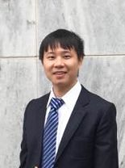
Speaker’s Bio
Roundtable Discussion on The 19th National Congress of CPC
Shan Gao is a researcher and program associate for the immigration Pro Bono project Know your Rights, An Information Guide to the Basics of New York State Legal System at The Coalition for Peace & Ethics. He received his academic training from Penn State Law. As a licensed attorney in both China and New York State, Dr. Gao's interests focus on corporate governance, China's trade and foreign exchange regulations and Chinese constitution theory. He is also the translator for the book Lawyers Making Meaning, The Semiotics of Law in Legal Education II.
Shan Gao
Hosted by: Penn State Law; Penn State School of International Affairs; Coalition for Peace and Ethics; and the Research Career Development Network of Law and International Affairs

